Slide 1

CPD 4: How are our Associate Teacher’s Progressing?
5 and 7 March 2024
Introduction and updates
One stop: Primary Partnership Website
What does progress look like? Using the BCU ITE Assessment Tracker
Feedback/Actions/next steps
Notes:
A very warm welcome. This is the Agenda for today's CPD. We will be recoding this

Slide 2

Please add your name and school email in the chat bar.
Notes:
A very warm welcome to you all. If you are new to working with us this term, we are delighted that you are hosting our Associate Teachers and thank you for supporting them on their journey.

Slide 3

Primary Partnership Website
Holds all key BCU Primary partnership information
Placement documents and briefings (BA Year 1 , 2 and PGCE hyperlinks)
ITE Curriculum and Subject Specific Prompts
Lesson observation feedback template and exemplar
Phonics Lesson observation feedback template and exemplar
Mentor CPD and support

Slide 4
Key Mentor documents: A reminder
School Based Training Mentor Guidance Handbook – contains key information
BCU ITE Curriculum –
BCU ITE Assessment Tracker – in the Associate’ Teachers Progress Journal
Subject specific prompts – to support to give subject specific feedback
Lesson observation template – core/foundation
Lesson observation template –phonics
Lesson observation exemplars – examples of completed feedback
BCU Lesson planning proforma – all lessons to be planned until Review Meeting 2
Placement documents and briefings

Slide 5

Update on school-based training
Spring 2 Week 1
Spring 2 Week 2
Placement documents and briefings
Notes:
Click on the links to access the Sway.

Slide 6
The main purpose of this session…
To be able to make accurate judgements of the Associate Teachers’ attainment and progress based upon the impact the Associate Teachers’ performance has on pupil progress
To ensure evidence used to make accurate judgements is robust
To ensure all levels of pupil progress judgements, targets, report comments, and final grades are aligned with evidence
To be able to make accurate judgements using all the available evidence to complete the mid-point and final progress meetings.
For inspection: to satisfy Ofsted who will judge the accuracy of the ITT partnership’s assessment of Associate Teachers’ teaching
Notes:
Making accurate judgements is key and how do we know that those judgements are accurate and those Associate Teachers are on track to make good progress and gain their QTS at the end of the course.
Ensure we are using all of the available evident that judgements are robust
Ensure all levels of pupil progress, judgements, targets, report comments and final grades are aligned with appropriate evidence
Making accurate judgements using all the available evidence and we’ll consider what that looks like a little later on.
Ofsted will also look at the accuracy of our partnership assessment of our Associate Teachers teaching.

Slide 7
The quality of Associate Teachers’ teaching should be judged by the impact on pupil progress and learning over time
The context and content of their teaching, through sequences of lessons; individual lessons should not be judged in isolation but the full range of evidence available should be assessed... including marking
All assessment documentation and feedback should reference the 6 BCU Key Themes:
      to track progress against these
      to identify strengths
      to determine areas for additional development
Notes:
The quality of the Associate Teachers’ teaching should be judged by the impact on pupil progress and learning over time.
We do want to see those Associate Teachers planning and delivering a sequence of lessons so they’re building on knowledge and recognising where children need to get to in order to meet those age related expectations. So they are not judged in isolation there is a full range of evidence to use to support our judgements.
All assessment documentation and feedback should reference the 6 BCU Key Themes so we can track progress, identify AT’s strengths and determine areas of development

Slide 8
What does Associate Teacher performance look like?

Slide 9

What does …
A working towards…
A working at…
A working beyond…
Associate Teacher look like?
Notes:
On the Assessment Tracker we’ve got on 3 columns and its progressive starting with Working Towards, Working At and Working Beyond.

Slide 10
Teaching
Impact on
Pupil progress
Theme A
Associate Teachers use critical enquiry and research informed practice to develop their understanding of effective teaching and learning.
Theme B
Associate Teachers’ classroom practice establishes effective behaviour management through the use of high expectations and awareness of pupil wellbeing.
Theme C
Associate Teachers know more, remembers more and applies subject knowledge specific pedagogy to impact on pupils’ progress.
Theme D
Associate Teachers use knowledge about how pupils learn to plan and assess learning to ensure that all pupils make progress.
Theme E
Associate Teachers implement effective adaptive teaching approaches to support all learners, including SEND (Special Educational Needs and Disability) and EAL (English as an Additional Language) learners.
Theme F
Associate Teacher’s demonstrate professional behaviours and contributes effectively to the wider life of the school.
Notes:
If we just look at the BCU Themes these are what we are making our judgement against. These are underpinned by the Teachers’ Standards and the Core Content Framework but we do not judge against the Teachers’ Standards until summative Ly at the end of the course for QTS.
Theme A – critical enquiry and research informed practice. Marrying up are they learning in their Modules (which is effectively our BCU Curriculum) and using their learning to inform their practice on the school based training, Engaging with and developing their subject knowledge – through subject knowledge audits is key here as well. This also links to the Associate Teachers’ critical incident which they complete as part of both the Review and Progress meeting process. Identifying and making those essential links between research and practice.
Theme B – effective behaviour through high expectations and pupil wellbeing
Theme C – Using their Subject knowledge to support pupil progress and this links to their Subject Specific Development Journal which they should have already shared with you.
Theme D – Again looking at planning and delivery of a sequence of lessons and not concentrating on a ‘one off’ lesson but understanding how this sits within the teaching process.
Theme E – looking at adaptive processes and the range of children in the class including SEND and EAL
Theme F – Professional behaviours how the AT contributes effectively to the wider life of the school.

Slide 11
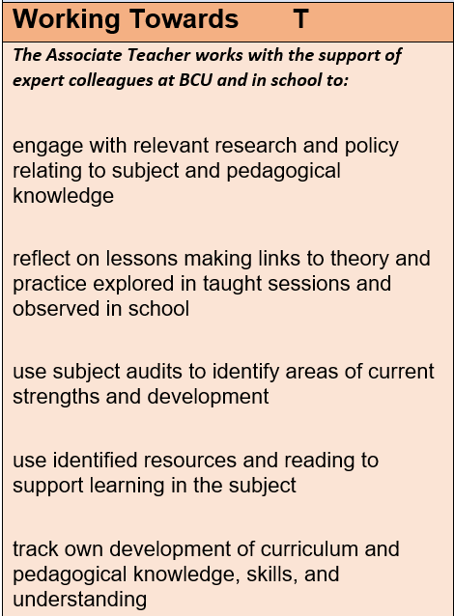
Expectations: Working towards
The Associate Teacher works with the support of expert colleagues at BCU and in school to:
pupil learning and progress: not always evident overtime
Associate Teachers must demonstrate working towards practice in most of the key themes
Part 2 consistently high quality practice in personal and professional conduct
Acts on advice and feedback most of the time
Notes:
Working Towards – first column showing an awareness of and developing a knowledge of rather than specifically teaching at this point. If you’ve had BA Year 1s you’ll know that the first part of their school based training has been looking at tasks which support their understanding of what it is like to be a teacher and the role. Immersing themselves into the classroom and building relationships and support you in the learning that is taking place. Observing practice and having discussion with expert colleagues in school. All Associate Teachers by the end of their training will have completed all elements in all of the key themes at Working Towards. Acting on advice on feedback and engaged.

Slide 12
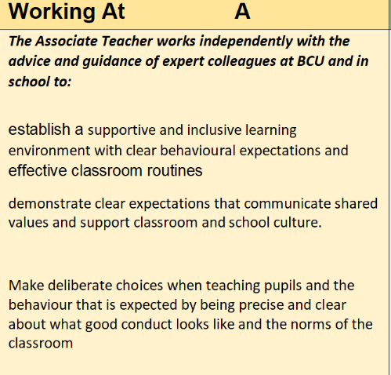
Expectations: Working At
The Associate Teacher works independently with the advice and guidance of expert colleagues at BCU and in school to:
pupil learning and progress: evident overtime
Competence in all elements at Working AT
Any working towards judgements to be scrutinised
Part 2 consistently high quality practice in personal and professional conduct
Consistently acts on advice and feedback
On track to be awarded QTS
Notes:
Working at – expectation to plan and teach. We will be looking at evidencing this overtime.
At least 75% statements are working at overall etc

Slide 13
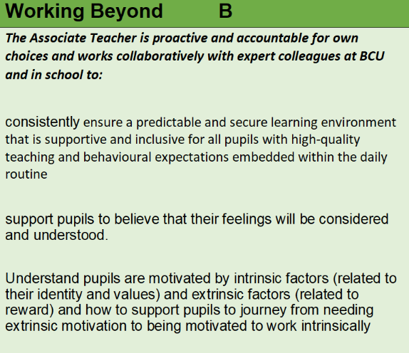
Expectations: Working beyond
The Associate Teacher is proactive and accountable for own choices and works collaboratively with expert colleagues at BCU and in school to:
pupil learning and progress: good or better overtime
At least 50% of statements are Working Beyond overall
AT must demonstrate Working Beyond practice in most of the BCU Key Themes
No Working Towards judgements outstanding
Part 2 consistently high quality practice in personal and professional conduct
Has continued to act on advice and feedback consistently
Notes:
Working Beyond at Review and Progress Meeting 3 – when we want to complete their training to gain QTS – at least 50%. Must demonstrate working beyond practice 6 Key Themes. No working towards judgements. Need to be scrutinised.
Part 2 on consideringly high etc

Slide 14



The tracker will provide an accurate picture of where the Associate Teacher is at the assessment point
Assessment Tracker 2023-24
The tracker will also provide a clear
picture for future targets to be set.

Slide 15
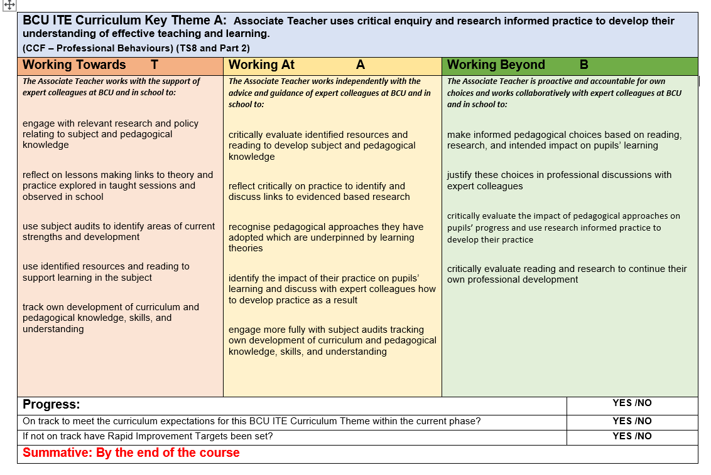
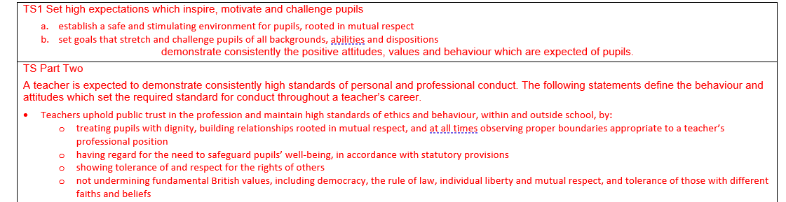
Key Theme A: Using research
We do not use the Teachers’ Standards to formatively assess. These are only referred to at the point of QTS recommendation.
Notes:
This is what the Assessment Tracker looks like – snapshot. In the Progress Journal is what you’ll see. If you cannot see this, please do not worry as I’ll send the link following the meeting but this PowerPoint is also already on our Primary Partnership Website.
Looking at Theme A – linked to research using their reading and research to inform what they’re dong in the classroom and having those conversation with you and go to their Subject Specific Development Journals and what has the recommended for this particular aspect of their practice. So the Working Towards is that work with expert colleagues looking at relevant research and policy, reflecting on lessons and making those links to that theory and that practice. Looking at subject audits – they do have these in English and Maths with action plans and a comprehensive Science Audit but have those conversations with the ATs. Is there an area of subject knowledge that they need to develop and how can we help with that at the same time. Looking at resources and reading – can you recommend relevant reading and research in school or Trusts. We don’t want to see there is two completely separate things. These are well linked – making those links clear. A reminder that we do not use the Teachers’ Standards to formatively assess.

Slide 16
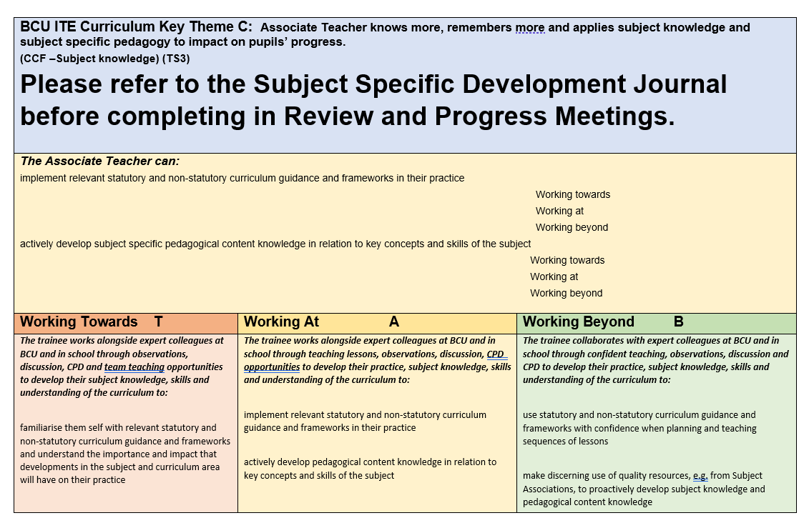
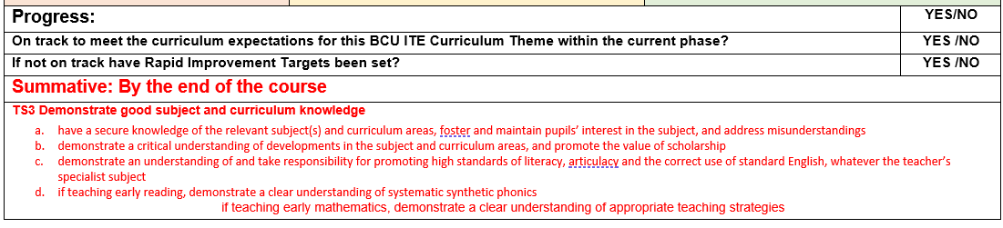
Key Theme C:
Associate Teachers will share their Subject Specific Development Journal to support Theme C. This is kept in their One Drive folder.
We do not use the Teachers’ Standards to formatively assess. These are only referred to at the point of QTS recommendation.
Notes:
Theme C – Highlight please refer to the Subject Specific Development Journal. In here there is a detailed curriculum for each subject – led by our learn that and learn how to statements – what we teach them in University through our Modules – learn how – what does this look like in practice in school. It should be shared with you by your Associate Teacher. If not, ask the AT to share via their One Drive.

Slide 17
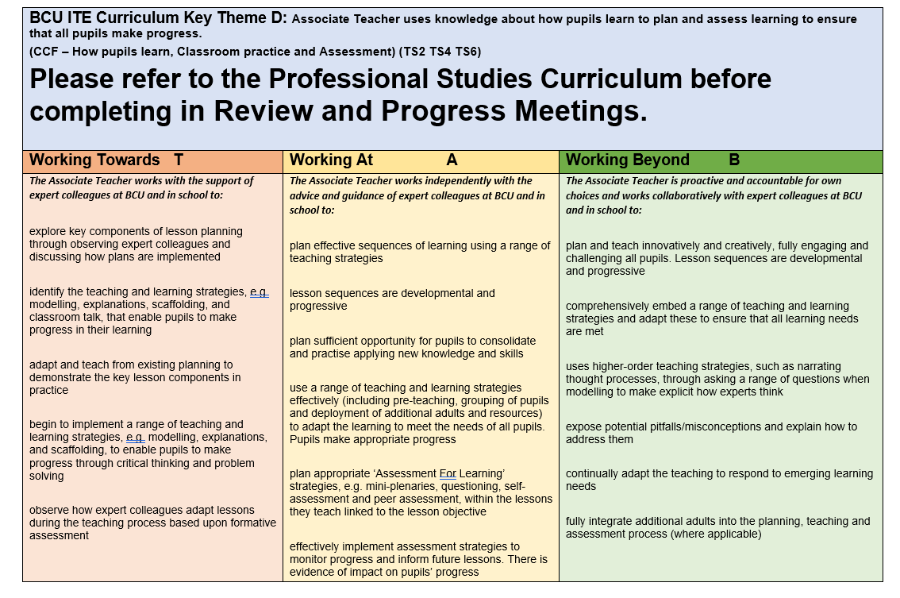
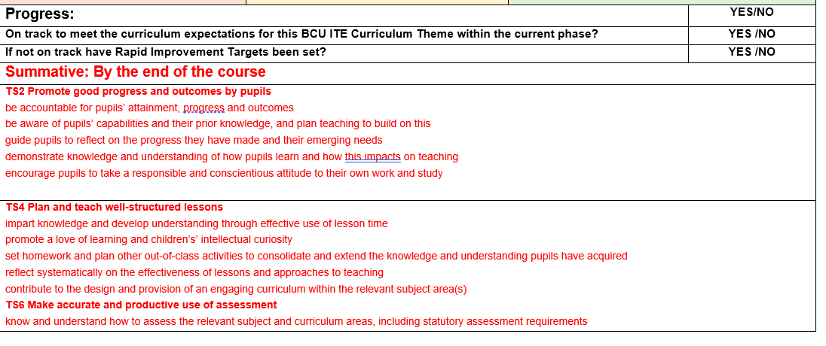
Key Theme D:
BA Year 1 and 2 Associate Teachers will share their Professional Studies Development Journal to support Theme D. For PGCE Associate Teaches this is included in their Subject Specific Development Journal.
We do not use the Teachers’ Standards to formatively assess. These are only referred to at the point of QTS recommendation.
Notes:
Theme D – looks at planning and assessing. We do expect all our BCU ATs to use their planning proforma to plan all the lessons they are teaching but this will be reviewed at Review Meeting 2. If everyone agrees, that planning is well on track. It is detailed, identifying prior learning, possible misconceptions, strong subject knowledge for teaching, understanding effective pedagogical strategies and adaptive teaching etc place and the AT understands the processes, they can revert to school planning but for any joint BCU observation with you as mentors, they need to be using the BCU proforma. Planning should provide a real structure for rehearsing and whilst of course we are aware of workload, we don’t want our ATs to think they can just use your planning without being able to adapt to meet the needs of the children. The quality of the planning and the provision of the children has to take precedence.
Advice for our BA Year 2s in terms of planning at Review Meeting 2 –
During your review meeting ATs will discuss the planning requirements with UT and mentor. If they are able to demonstrate proficiency in planning using the BCU format then you can discuss whether they are able to use the school format for the remainder of your placement.
ATs must plan each lesson that they teach, in whatever format they are using, and be able to demonstrate how they have adapted the school’s medium term planning to meet the needs of the children in the class and ‘make the lesson their own’. Careful planning helps them to be successful when teaching as they will have carefully thought through what they and the children will be doing, identified potential misconceptions and how to address these and identified the teaching strategies and questions that they will be using.
For any formal observation they must use the BCU lesson plan format and make sure that there is a copy available for the staff who are observing you.

Slide 18
How do we challenge progress?
Challenging the Associate Teacher to give specific examples of practice to support each Key Theme
How are ATs engaging in research to support their practice? Give an example.
How has the Subject Specific Development Journal enhanced ATs understanding of delivering a subject in school (choose Core and Foundation and give examples.)
How have ATs adapted their practice to support pupil progress?
What are the ingredients of planning and delivering a sequence of lessons?
How have ATs demonstrated professional behaviours?

Slide 19
Assessment Points

Slide 20
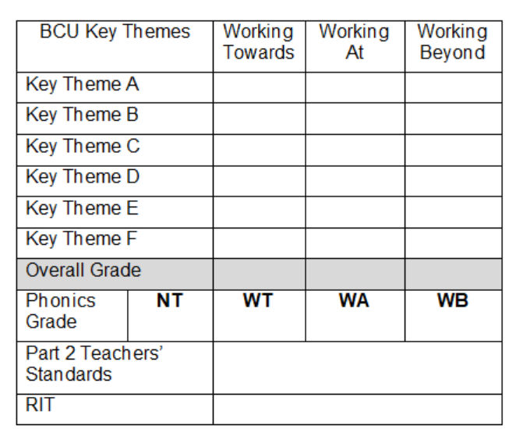
Review meeting 1
(Part 1)
Review Meeting 1 will take place between the Associate Teacher, Mentor and University Tutor.
BA Year1 (SBT1)
w/b 29 April
When making a judgement for the Review Meeting 1 consider the Associate Teachers’ overall performance to date and make a ‘best fit ‘judgement based upon performance against all of the BCU Curriculum Key Themes as recorded in the BCU Formative Assessment Tracker.
Review the Associate Teachers’ progress and attainment against Part 2 of the Teachers’ Standards.
Review Meeting 1 – Associate Teachers who are on track to be awarded QTS will be demonstrating their competence in some of the BCU Curriculum Key Themes at the Working Towards level.
Associate Teacher requiring improvement is not able to demonstrate their competence in some elements of the BCU Curriculum Themes at Working Towards level and/or not fully engaged or responding to advice and feedback. The Associate Teacher will be subject to the Rapid Improvement process and targets and strategies for improvement will be identified and a Rapid Improvement Targets (RIT) form will be completed.
If the Associate Teacher still requires further experience of teaching phonics/ guided reading, include as a target for their next placement.

Slide 21
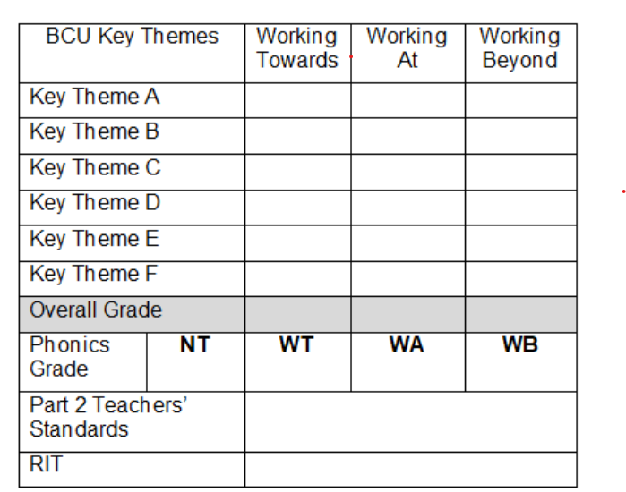
Progress meeting 1
(Part 2)
Progress Meeting 1 will take place between the Associate Teacher, class teacher (or school mentor) and university tutor.
BA Year 1 (SBT1)
w/b 20th May
Progress Meeting 1 (SBT1) – Associate teachers who are on track to be awarded QTS at the end of the course will be demonstrating their competence in 75% of each BCU Curriculum Theme at the Working Towards level.
Associate Teachers requiring improvement are demonstrating their competence in less than 75% of each of the BCU Curriculum Themes at Working Towards level and/or not fully engaged or responding to advice and feedback. The Associate Teacher will be subject to the Rapid Improvement process and targets and strategies for improvement will be identified and a Rapid Improvement Targets (RIT) form will be completed to be shared with the next placement school.
Associate Teachers not demonstrating their competence in at least 50% of elements in each of the BCU Curriculum Themes at Working Towards level and/or not fully engaged or responding to advice and feedback will have failed SBT1.

Slide 22
Review Meeting 2
(Mid-point)
BA Year 2 (SBT2)
w/b 26 Feb
PGCE (SBT2)
w/b 4 March
Review Meeting 2 will take place between the Associate Teacher, Mentor and University Tutor.
When making a judgement for the Review Meeting consider the Associate Teacher’s overall performance to date and make a ‘best fit ‘judgement based upon performance against all of the BCU Curriculum Key Themes as recorded in the BCU Assessment Tracker.
Review the Associate Teacher’s progress and attainment against Part 2 of the Teachers’ Standards.
Review Meeting 2 (SBT2) Associate teachers who are on track to be awarded QTS at the end of the course will be demonstrating their competence in 75% of each BCU Curriculum Theme at the Working Towards level.
Associate Teachers requiring improvement are demonstrating their competence in less than 75% of each of the BCU Curriculum Themes at Working Towards level and/or not fully engaged or responding to advice and feedback. The Associate Teacher will be subject to the Rapid Improvement process and targets and strategies for improvement
will be identified and a Rapid Improvement Targets (RIT) form will be completed. Phonics yes/no?
Notes:
Moving onto Review Meeting 2 which will be taking place next week for our BA Year 2s and PGCEs.
This is the mid-point. Using the Assessment tracker and overall performance to date and making a best fit judgement against those key themes. So at your weekly meetings or discussions with ATs you will have highlighted the relevant statements with robust evidence to support that judgement. What we want to see at this point who are on track should be demonstrating their competence of each of the key themes at 75% at the Working Towards. Some may have highlights statements at working at as well. Anyone requiring improvement will be demonstrating less than 75 % - not fully engaged or responding to advice and feedback. At this point we would put in a Rapid Improvement Target in place. Identifying where the gaps are and what they need to do and focus practice. This will of course be done in consultation with the AT, yourself and the UT.

Slide 23
Progress meeting 2
(Final)
BA Year 2 (SBT2)
w/c 18 March
PGCE (SBT2)
w/c 18 March
Progress Meeting 2 will take place between the Associate Teacher, Mentor and University Tutor.
Progress Meeting 2 (SBT2) – Associate Teachers who are on track to be awarded QTS at the end of the course will be demonstrating their competence in all elements all of the BCU Curriculum Themes at the Working Towards level and elements in the Working At Level.
Associate Teachers requiring improvement are demonstrating their competence in all elements of all of the BCU Curriculum Themes at Working Towards level and/or not fully engaged or responding to advice and feedback. The Associate Teacher will be subject to the Rapid Improvement process and targets and strategies for improvement will be identified and a Rapid Improvement Targets (RIT) form will be completed to be shared with the next placement school.
Associate Teachers not demonstrating their competence in 75% of each BCU Curriculum Theme at the Working Towards level and/or not fully engaged or responding to advice and feedback will have failed SBT2.
Associate Teacher has taught phonics/guided reading
Notes:
Working towards to Progress Meeting 2 – now making the judgement of their overall performance based against those key themes. At this point they should have all elements in all of the key themes in the Working Towards. If they haven’t by then it will be a failed SBT2.
This means that if they were not on track at Review Meeting 2 and come to this Progress Meeting still not meeting that 75% coverage at Working Towards even with Rapid Improvement Targets in place, this would be a failed SBT2.

Slide 24
Review meeting 3
(mid-point)
PGCE (SBT3)
Review Meeting 3 will take place between the trainee, class teacher (or school mentor) and university tutor.
When making a judgement for the Review Meeting 3 consider the Associate Teachers’ overall performance to date and make a ‘best fit ‘judgement based upon performance against all of the BCU Curriculum Key Themes as recorded in the BCU Assessment Tracker. Review the Associate Teacher’s progress and attainment against Part 2 of the Teachers’ Standards.
Review Meeting 3 – Associate Teachers who are on track to be awarded QTS will be demonstrating their competence in 75% of the BCU Curriculum Key Themes at the Working At level.
If Associate Teachers do not demonstrate competence in all standards at the Working Towards level and 50%+ in the Working At their progress is judged as requiring improvement. Please identify targets and strategies for improvement with the Associate Teacher and complete the RAPID IMPROVEMENT TARGETS form with your University Tutor.
Notes:
Moving on Review Meeting 3 – for PGCE associate Teachers. Demonstrating competency in all of the key themes in all of the Key Themes in Working At. If there are any Working Towards or less than 75% in the Working At they will have a Rapid Improvement Target set. Again this is about preparing our ATs to make sure they are meeting the minimum requirements in order to be awarded QTS.

Slide 25
Progress meeting 3
(Final)
PGCE (SBT3)
Progress Meeting 2 will take place between the trainee, class teacher (or school mentor) and university tutor.
When making a judgement for the Progress Meeting 3 consider the Associate Teachers’ overall performance to date and make a ‘best fit ‘judgement based upon performance against all of the BCU Key Themes as recorded in the Assessment Criteria.
If the Associate Teacher has any RAPID IMPROVEMENT TARGETS outstanding from during the placement, please review these during Progress Meeting 3.
Progress Meeting 3 – Associate Teachers who are on track to be awarded QTS will be demonstrating their competence in all of the BCU Curriculum Key Themes at the Working At level. Associate Teachers in the Working Beyond levels can be deemed to have made very good progress in readiness for their ECT year.
If Associate Teachers have any standard in the Working Towards level the placement is deemed as a FAIL.

Slide 26
Expectations
A failing Associate Teacher
Associate Teachers fail to meet the minimum level of practice expected of Associate Teachers as defined by the BCU Key Themes by the end of their placement.
The quality of Associate Teachers’ teaching over time is weak; it contributes to pupils/learners or groups of learners making limited or inadequate progress.
Notes:
Read as is. There are several options, offered a resit with support in place. As a University, a Panel would make those next decision for the individual AT.

Slide 27
Making accurate judgements
What evidence is available? (in no particular order or hierarchy of importance)
Observations
Observation tasks
Progress Journal
Planning a sequence of learning
Evaluations
Lesson observations and feedback
Weekly Reflections
Pupil records
Formative assessment tracker
At review/progress meetings
Consider the range of evidence to inform judgements
Notes:
How can we make sure our judgements are accurate.
Use the evidence that is available. Range from lesson observations – observation tasks that we give them. We do want to see a sequence of maths, of science and some of the foundation subjects. – They may not have the opportunity to teach a particular aspect of the curriculum Geography rather than history. Where there is an opportunity to plan and deliver a sequence of learning we want to see evidence of this. Are ATs evaluating their lessons – looking at the impact on pupil progress? Make that a focus for discussion. Whether observed or informal feedback .Quality of your written feedback – tailored to what the associate teacher needs at this point. We ask them to identify their weekly targets. Are they taking that advice forward is this being revisited? What is their subject knowledge like? Is it secure? Do comment on this. – Subject Specific Prompts on the Primary Partnership Website are there to support. What do they need to demonstrate in their planning and teaching? This will help support good links to their Subject Specific Development Journal. Are weekly reflections taking place – looking at and reviewing targets and setting targets. Using the assessment tracker – what do you want them to work on? Important – whatever we are feeding back including us – are we being really specific – are those targets achievable. Do they go away knowing what they need to focus on for the following week. Pupil records – do they input into records that you use in school? Use the weekly meetings – help to put together focus targets using the BCU ITE Assessment tracker.

Slide 28
Making accurate judgements: consider
impact on progress of groups of learners over time
which aspects of teaching, linked to BCU Key Themes, are securing this impact?
which aspects of teaching, linked to the BCU Key Theme, need strengthening to enhance impact?
Always emphasising it is the impact of the strengths across the BCU Key Themes overall which secure pupil progress

Slide 29
Impact on progress of pupils over time
Quality of Associate Teacher’s teaching:
Strengths
Which aspects of teaching, linked to the BCU Key Themes, are securing impact?
Which BCU Themes?
Which statement(s) best describe this in the Formative Assessment Tracker?
Development
Which aspects of teaching, linked to the BCU Key Theme, need strengthening to enhance impact?
Use the language of the BCU Key Themes to make points explicit to the Associate Teacher.

Slide 30

Q&A and Feedback
Please add comments in the chat bar.
Notes:
We welcome your feedback. Please add comments in the chat bar. Thank you again for joining us.

