Slide 1

CPD 2
21 and 23 November 2023
Welcome and introductions
Using the BCU ITE Curriculum to set appropriate SMART targets to support Associate Teacher development and progress
Critical incident update and quality of evidence
Assessing Associate Teachers accurately against the BCU ITE Assessment Tracker

Slide 2
1. Welcome and introductions
Welcome and introductions
Currently in school: PGCE and BA Year 3 Associate Teachers
BA Year 1 Associate Teachers
CPD training 1 and 2 – giving effective feedback

Slide 3

1. Welcome and introductions
Primary Partnership Website
Notes:
This is our Primary Partnership Website, the source of key information. I'm going to click on the link and show you around.

Slide 4
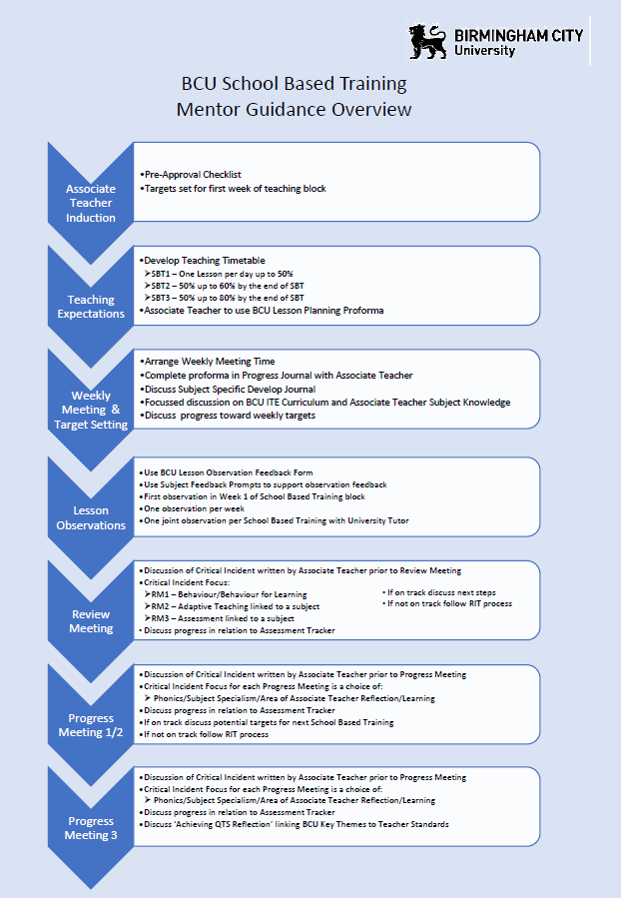
1. Welcome and introductions
Mentor CPD and support
Notes:
To support you to engage with our documentation you will receive (if you have not already done so) two handouts from your University Tutor that will allow you quick access to our Primary Partnership Website and documentation. All documents will be available once your block placement starts.

Slide 5
2. Using the BCU ITE Curriculum to set appropriate SMART targets

Slide 6
2. Recap from last session: giving effective feedback: verbal
Elicit – ask questions and then listen
Challenge – provide a different perspective, another point of view
Support – encourage and validate
Impart – share knowledge and experience

Slide 7
2. Recap from last session: targets
Focus on the targets
Knowing what the Associate Teacher needs to develop further
Setting precise targets to support Associate Teacher
Identify next steps
Using the Subject Specific Prompts to support written feedback (examples to follow)

Slide 8
2. BCU ITE Curriculum Key Themes: Assessment Tracker
BCU ITE Curriculum Key Themes
A. Associate Teachers use critical enquiry and research informed practice to develop their understanding of effective teaching and learning.
B. Associate Teacher’s classroom practice establishes effective behaviour management through the use of high expectations and awareness of pupil wellbeing.
C. Associate Teachers knows more, remembers more and applies subject knowledge and subject specific pedagogy to impact on pupils’ progress
D. Associate Teachers uses knowledge about how pupils learn to plan and asses learning to ensure that all pupils make progress.
E. Associate Teachers implement effective adaptive teaching approaches to support all learners, including SEND (Special Educational Needs and Disabilities) and EAL (English as Additional Language) learners.
F. Associate Teacher’s demonstrate professional behaviours and contributes effectively to the wider life of the school.
Notes:
As you will see from this slide the BCU ITE Curriculum has six principles which underpin the content of all our Initial Teacher Education courses. These principles are used by mentors and BCU University tutors in review and progress meetings to formatively assess a trainee’s strengths and areas for development. The six foci within this core curriculum are:
Associate Teacher uses critical enquiry and research informed practice to develop their understanding of effective teaching and learning
Associate Teacher’s classroom practice establishes effective behaviour management using high expectations and awareness of pupil wellbeing
Associate Teacher knows more, remembers more and applies subject knowledge and subject specific pedagogy to impact on pupils’ progress
Associate Teacher uses knowledge about how pupils learn to plan and assess learning to ensure that all pupils make progress
Associate Teacher implements effective adaptive teaching approaches to meet all learners’ needs, including SEND (Special Educational Needs and Disability) and EAL (English as an Additional Language learners).
Associate Teacher demonstrates professional behaviours and contributes effectively to the wider life of the school

Slide 9
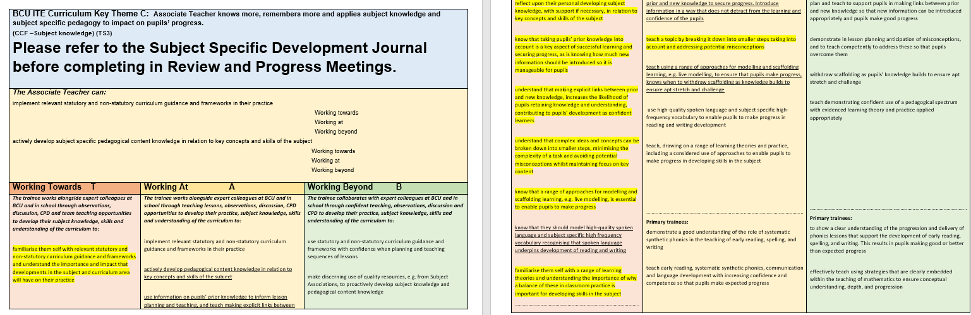
2. BCU ITE Curriculum and Assessment Tracker
Click on the link to access the BCU ITE Assessment Tracker
Flick through each of the Key Themes to familiarise yourself with the language. This will also support with target setting.
Notes:
This is a copy of Theme C. You will see that the colour coding as for our Phase 1, Phase 2 and Phase 3 of both our BAQTS and PGCE Curriculum coincides with our Primary Assessment Tracker. Theme C, focusing on subject knowledge through the Associate Teacher’s Subject Specific Development Journal which PGCE Associate Teachers will have shared with you. As an activity, click on the link on the PowerPoint to access the Primary BCU ITE Assessment Tracker. If you have a PGCE you will be primarily focusing on Phase 1 ‘Working towards’. If you are working with a BA Year 3 you should be looking at ‘Working at’ and ‘Working Beyond.’

Slide 10
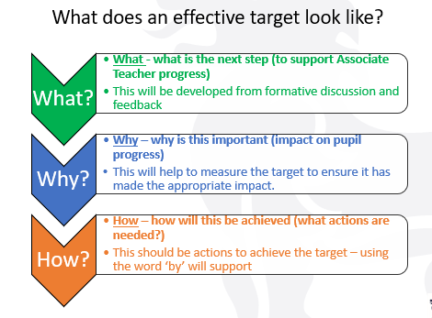
Notes:
What does an effective target look like? You will notice that to support you when thinking about each What Why How aspect, these have been developed to remind you when you are completing the Lesson Observation Feedback form.

Slide 11
Target Setting:
At least one subject specific target should be set following an observation. This should include what is the next step (to support Associate Teacher progress) why is this important (impact on pupil progress) and how will this be achieved (what actions are needed?)
Notes:
To support our Associate Teachers following their observation, one of these targets needs to be subject based. As this slide outlines, what the next step would be to support progress, why this is important and how will this be achieved.

Slide 12
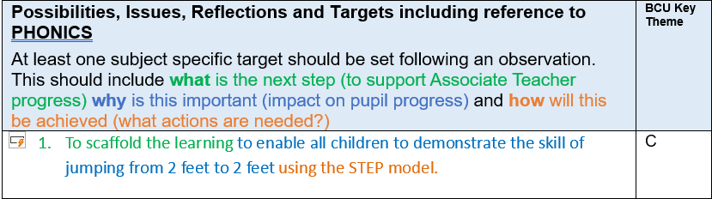
Using the new Lesson Observation Feedback Prompt sheet : PE Example of Target
Lesson Observation Feedback Form
Notes:
Here is an example in PE. This target is subject specific – links to the next step, scaffold learning, why this is important – to enable all children to demonstrate the skill jumping from 2 feet to 2 feet and how this will be achieved, using the STEP model (Space, Time, Task, Equipment. People). Remember to add in the Key Theme which this target represents.

Slide 13
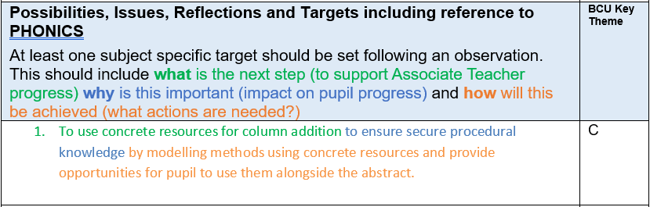
Using the new Lesson Observation Feedback Prompt sheet : Maths example
Lesson Observation Feedback Form
Notes:
Another example in mathematics. Remember you can also add in additional targets but these are specific.

Slide 14
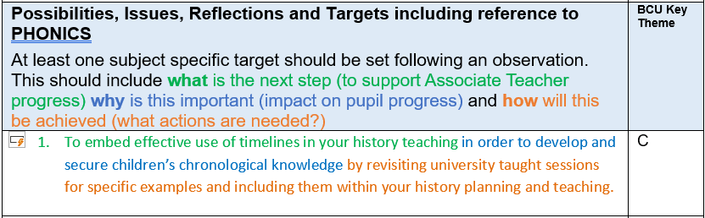
Using the new Lesson Observation Feedback Prompt sheet : History example
Lesson Observation Feedback Form

Slide 15
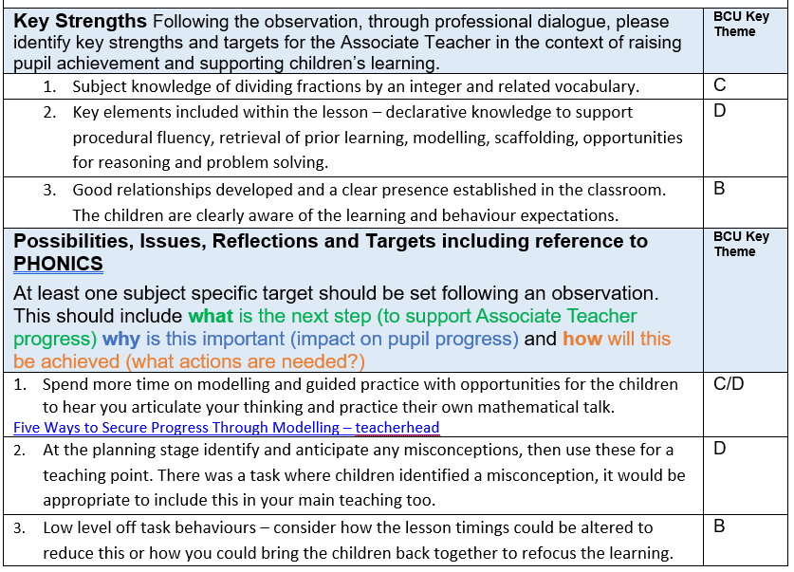
Maths focus: example
Targets
Subject Specific Feedback Prompts
Notes:
To demonstrate what these might look like, please look at the example shared. If you think the Associate Teacher would benefit from further reading or a short video, add in the links. Also the Subject Specific Prompts are designed to give you examples of how targets can be generated.

Slide 16
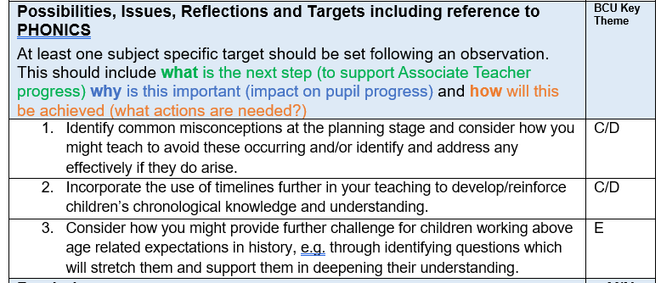
History focus: example
Targets
Subject Specific Feedback Prompts

Slide 17

Notes:
How are you developing your target setting?
How are you using the BCU ITE Assessment Tracker to support this?
Share ideas and observations.

Slide 18
3. Critical incident update
Quality of evidence
Does it demonstrate progress and understanding of learning?
Is it annotated?
More than one example

Slide 19
4. Assessing Associate Teachers against the BCU ITE Assessment Tracker

Slide 20
The main purpose of this section…
To be able to make accurate judgements of the Associate Teachers’ attainment and progress based upon the impact the Associate Teachers’ performance has on pupil progress
To ensure evidence used to make accurate judgements is robust
To ensure all levels of pupil progress judgements, targets, report comments, and final grades are aligned with evidence
To be able to make accurate judgements using all the available evidence to complete the mid-point and final progress meetings.
For future inspections: to satisfy Ofsted who will judge the accuracy of the ITT partnership’s assessment of Associate Teachers’ teaching
Notes:
Making accurate judgements is key and how do we know that those judgements are accurate and those Associate Teachers are on track to make good progress and gain their QTS at the end of the course.
Ensure we are using all of the available evident that judgements are robust
Ensure all levels of pupil progress, judgements, targets, report comments and final grades are aligned with appropriate evidence
Making accurate judgements using all the available evidence and we’ll consider what that looks like a little later on.
Ofsted will also look at the accuracy of our partnership assessment of our Associate Teachers teaching.

Slide 21

What does …
A working towards…
A working at…
A working beyond…
Associate Teacher look like?
Notes:
On the Assessment Tracker we’ve got on 3 columns and its progressive starting with Working Towards, Working At and Working Beyond and this is for Bas a 3 year process and PGCE ATs this is development process over the year that they are with us.

Slide 22
Teaching
Impact on
Pupil progress
Theme A
Associate Teachers use critical enquiry and research informed practice to develop their understanding of effective teaching and learning.
Theme B
Associate Teachers’ classroom practice establishes effective behaviour management through the use of high expectations and awareness of pupil wellbeing.
Theme C
Associate Teachers know more, remembers more and applies subject knowledge specific pedagogy to impact on pupils’ progress.
Theme D
Associate Teachers use knowledge about how pupils learn to plan and assess learning to ensure that all pupils make progress.
Theme E
Associate Teachers implement effective adaptive teaching approaches to support all learners, including SEND (Special Educational Needs and Disability) and EAL (English as an Additional Language) learners.
Theme F
Associate Teacher’s demonstrate professional behaviours and contributes effectively to the wider life of the school.
Notes:
If we just look at the BCU Themes these are what we are making our judgement against. These are underpinned by the Teachers’ Standards and the Core Content Framework but we do not judge against the Teachers’ Standards until summative Ly at the end of the course for QTS.
Theme A – critical enquiry and research informed practice. Marrying up are they learning in their Modules (which is effectively our BCU Curriculum) and using their learning to inform their practice on the school based training, Engaging with and developing their subject knowledge – through subject knowledge audits is key here as well. This also links to the Associate Teachers’ critical incident which they complete as part of both the Review and Progress meeting process. Identifying and making those essential links between research and practice.
Theme B – effective behaviour through high expectations and pupil wellbeing
Theme C – Using their Subject knowledge to support pupil progress and this links to their Subject Specific Development Journal which they should have already shared with you.
Theme D – Again looking at planning and delivery of a sequence of lessons and not concentrating on a ‘one off’ lesson but understanding how this sits within the teaching process.
Theme E – looking at adaptive processes and the range of children in the class including SEND and EAL
Theme F – Professional behaviours how the AT contributes effectively to the wider life of the school.

Slide 23
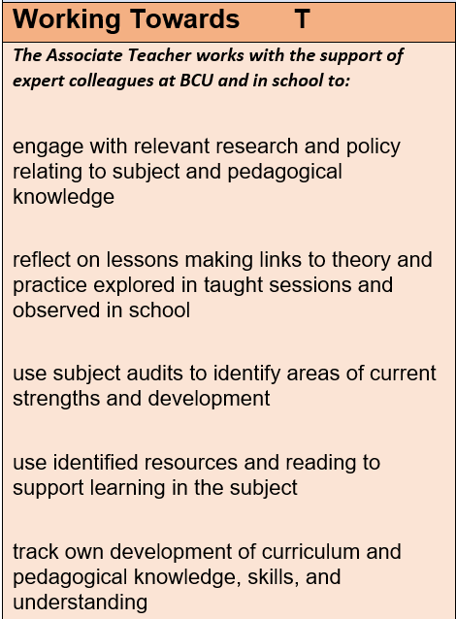
Expectations: Working towards
pupil learning and progress: not always evident overtime
Associate Teachers must demonstrate working towards practice in most of the key themes
Part 2 consistently highquality practice in personal and professional conduct
Acts on advice and feedback most of the time

Slide 24
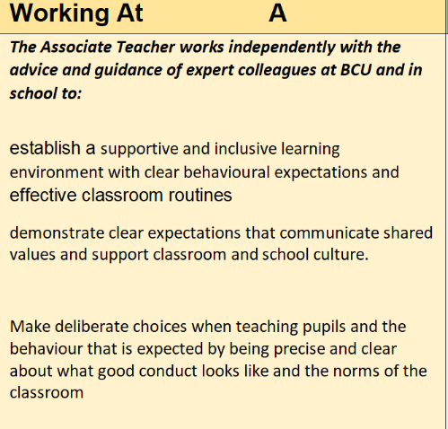
Expectations: Working At
pupil learning and progress: evident overtime
At least 75% of statements are working at overall
Associate Teacher must demonstrate establishing practice in most of the BCU Key Themes
Any working towards judgements to be scrutinised
Part 2 consistently high quality practice in personal and professional conduct
Consistently acts on advice and feedback

Slide 25
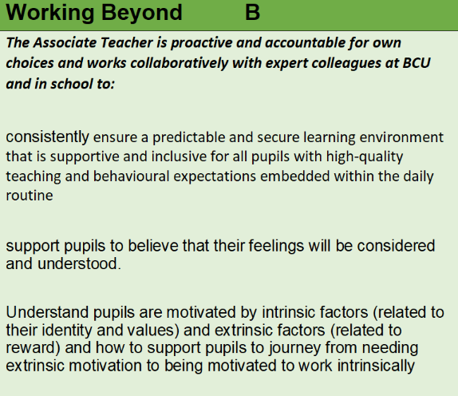
Expectations: Working beyond
pupil learning and progress: good or better overtime
At least 50% of statements are Working Beyond overall
AT must demonstrate Working Beyond practice in most of the BCU Key Themes
No Working Towards judgements outstanding
Part 2 consistently high quality practice in personal and professional conduct
Has continued to act on advice and feedback consistently

Slide 26
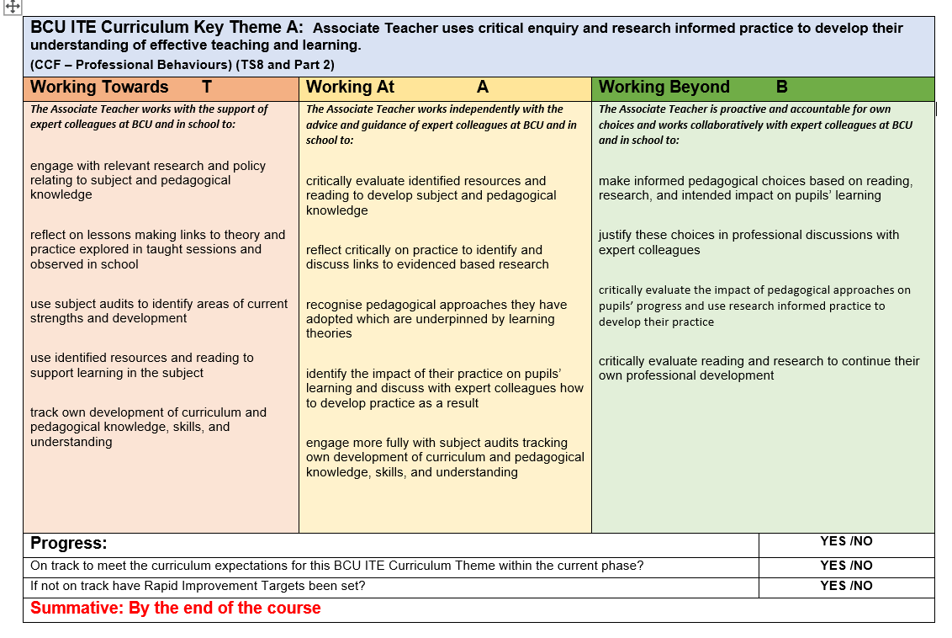
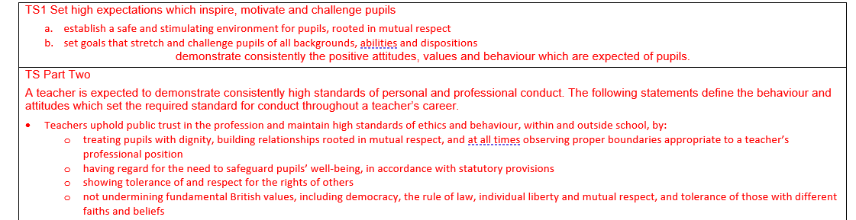
Key Theme A: Using research
We do not use the Teachers’ Standards to formatively assess. These are only referred to at the point of QTS recommendation.

Slide 27
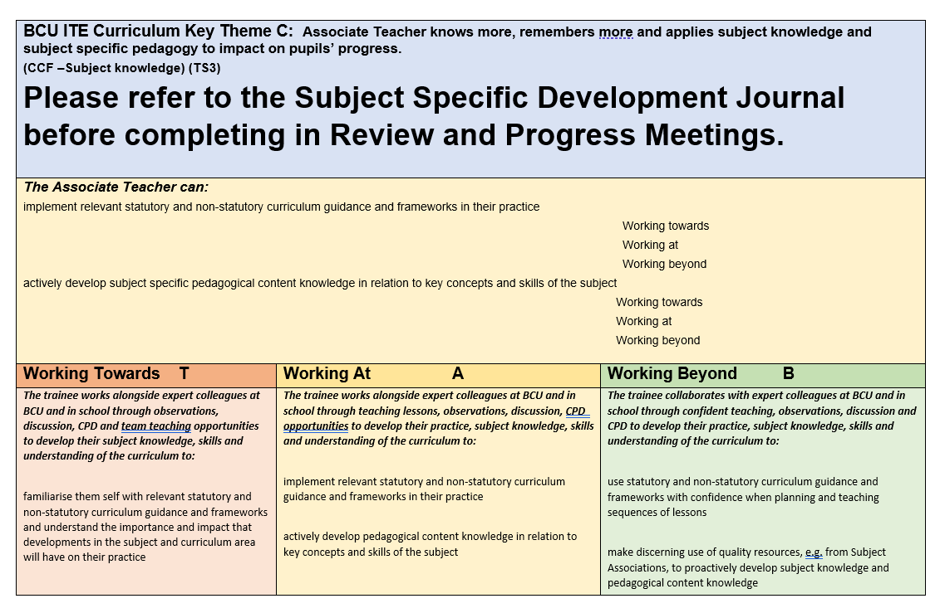
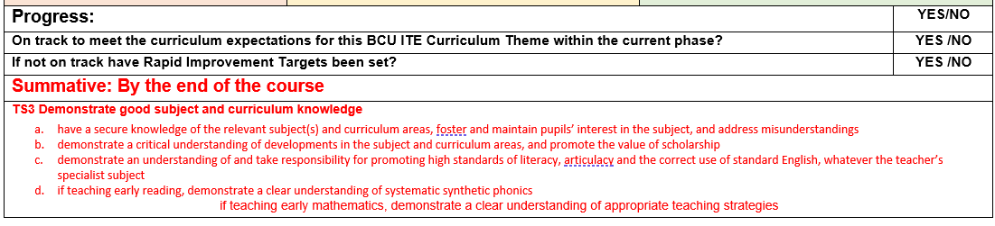
Key Theme C:
Associate Teachers will share their Subject Specific Development Journal to support Theme C. This is kept in their One Drive folder.
We do not use the Teachers’ Standards to formatively assess. These are only referred to at the point of QTS recommendation.
Notes:
Theme C – Highlight please refer to the Subject Specific Development Journal. In here there is a detailed curriculum for each subject – led by our learn that and learn how to statements – what we teach them in University through our Modules – learn how – what does this look like in practice in school. It should be shared with you by your Associate Teacher. If not, ask the AT to share via their One Drive. BA Year 1s and Year 2s also have a Professional Studies Journal to support their professional development. For PGCE this is included at the end of their Subject Specific Development Journal to support their workload.

Slide 28
4. Assessment Points
SBT1 and SBT3

Slide 29
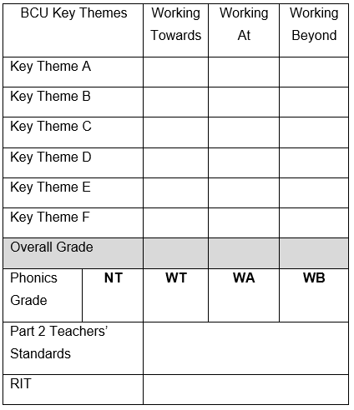
Review meeting 1 : (Mid point) SBT1
Review Meeting 1 will take place between the Associate Teacher, class teacher (or school mentor) and university tutor.
When making a judgement for the Review Meeting consider the Associate Teacher’s overall performance to date and make a ‘best fit ‘judgement based upon performance against all of the BCU Curriculum Key Themes as recorded in the BCU Assessment Tracker.
Review the Associate Teacher’s progress and attainment against Part 2 of the Teachers’ Standards.
Review Meeting 1 (SBT1) Associate Teachers who are on track to be awarded QTS at the end of the course will be demonstrating their competence in some of the BCU Curriculum Themes at Working Towards level.
Associate Teacher requiring improvement is not able to demonstrate their competence in some elements of the BCU Curriculum Themes at Working Towards level and/or not fully engaged or responding to advice and feedback. The Associate Teacher will be subject to the Rapid Improvement process and targets and strategies for improvement will be identified and a Rapid Improvement Targets (RIT) form will be completed.
If the Associate Teacher still requires further experience of teaching phonics/ guided reading, include as a target for their next placement.

Slide 30
Progress meeting 1 : (End-point SBT1)
Progress Meeting 1 will take place between the Associate Teacher, class teacher (or school mentor) and university tutor.
When making a judgement for the Progress Meeting consider the Associate Teacher’s overall performance to date and make a ‘best fit ‘judgement based upon performance against all of the BCU Key Themes as recorded in the Assessment Criteria.
If the Associate Teacher has any RAPID IMPROVEMENT TARGETS outstanding from during the placement, please review these during the Progress Meeting.
Review the Associate Teacher’s progress and attainment against Part 2 of the Teachers’ Standards.
Progress Meeting 1 (SBT1) – Associate teachers who are on track to be awarded QTS at the end of the course will be demonstrating their competence in 75% of each BCU Curriculum Theme at the Working Towards level.

Slide 31
Progress meeting 1 : SBT1
Progress Meeting 1 will take place between the Associate Teacher, class teacher (or school mentor) and university tutor.
Associate Teachers requiring improvement are demonstrating their competence in less than 75% of each of the BCU Curriculum Themes at Working Towards level and/or not fully engaged or responding to advice and feedback. The Associate Teacher will be subject to the Rapid Improvement process and targets and strategies for improvement will be identified and a Rapid Improvement Targets (RIT) form will be completed to be shared with the next placement school.
Associate Teachers not demonstrating their competence in at least 50% of elements in each of the BCU Curriculum Themes at Working Towards level and/or not fully engaged or responding to advice and feedback will have failed SBT1.
If the Associate Teacher still requires further experience of teaching phonics/ guided reading, include as a target for their next placement

Slide 32
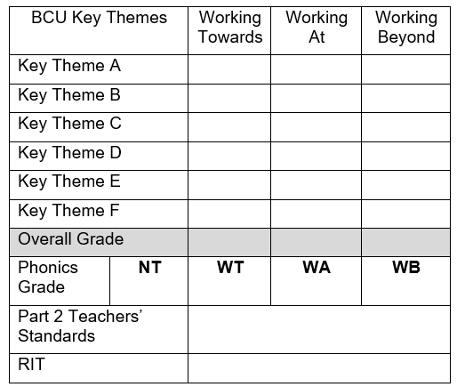
Review meeting 3 : SBT3
Review Meeting 3 will take place between the Associate Teacher, class teacher (or school mentor) and university tutor.
When making a judgement for the Review Meeting consider the Associate Teacher’s overall performance to date and make a ‘best fit ‘judgement based upon performance against all of the BCU Curriculum Key Themes as recorded in the BCU Assessment Tracker.
Review the Associate Teacher’s progress and attainment against Part 2 of the Teachers’ Standards.
Review Meeting 3 (SBT 3) Associate Teachers who are on track to be awarded QTS at the end of the course will be demonstrating their competence in 75% of each of the BCU Curriculum Themes at the Working At Level.
If the Associate Teacher is not able demonstrate competence in in all of the BCU Curriculum Themes at the Working Towards Level and 50% in the Working At Level their progress is judged as requiring improvement. The Associate Teacher will become subject to the Rapid Improvement process and targets and strategies for improvement will be identified and a Rapid Improvement Targets (RIT) form will be completed.
If the Associate Teacher still requires further experience of teaching phonics/ guided reading, include as a target for their next placement.

Slide 33
Progress meeting 3 : SBT3
Progress Meeting 3 will take place between the Associate Teacher, class teacher (or school mentor) and university tutor.
Associate Teachers requiring improvement are demonstrating their competence in less than 75% of each of the BCU Curriculum Themes at Working Towards level and/or not fully engaged or responding to advice and feedback. The Associate Teacher will be subject to the Rapid Improvement process and targets and strategies for improvement will be identified and a Rapid Improvement Targets (RIT) form will be completed to be shared with the next placement school.
Associate Teachers not demonstrating their competence in at least 50% of elements in each of the BCU Curriculum Themes at Working Towards level and/or not fully engaged or responding to advice and feedback will have failed SBT3.
Associate Teacher has taught phonics/guided reading
If the Associate Teacher still requires further experience of teaching phonics/ guided reading, include as a target for their next placement

Slide 34
Expectations
A failing Associate Teacher
Associate Teachers fail to meet the minimum level of practice expected of Associate Teachers as defined by the BCU Key Themes by the end of their placement.
The quality of Associate Teachers’ teaching over time is weak; it contributes to pupils/learners or groups of learners making limited or inadequate progress.

Slide 35
Making accurate judgements
What evidence is available? (in no particular order or hierarchy of importance)
Observations
Observation tasks
Progress Journal
Planning a sequence of learning
Evaluations
Lesson observations and feedback
Weekly Reflections
Pupil records
Formative assessment tracker
At review/progress meetings
Consider the range of evidence to inform judgements

Slide 36
Making accurate judgements: consider
impact on progress of groups of learners over time
which aspects of teaching, linked to BCU Key Themes, are securing this impact?
which aspects of teaching, linked to the BCU Key Theme, need strengthening to enhance impact?
Always emphasising it is the impact of the strengths across the BCU Key Themes overall which secure pupil progress

Slide 37
Impact on progress of pupils over time
Quality of Associate Teacher’s teaching:
Strengths
Which aspects of teaching, linked to the BCU Key Themes, are securing impact?
Which BCU Themes?
Which statement(s) best describe this in the Formative Assessment Tracker?
Development
Which aspects of teaching, linked to the BCU Key Theme, need strengthening to enhance impact?
Use the language of the BCU Key Themes to make points explicit to the Associate Teacher.

Slide 38


