Slide 1
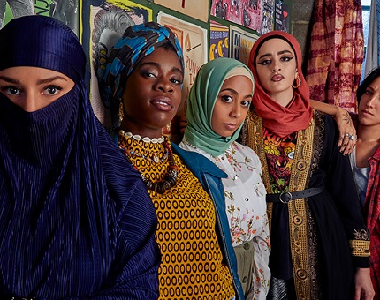
Progressive Islamic Feminism and the Limits of the Sacred
An analysis of We Are Lady Parts (2021)
Dr Muzna Rahman, Manchester Metropolitan University.
This Photo by Unknown Author is licensed under CC BY-SA-NC

Slide 2
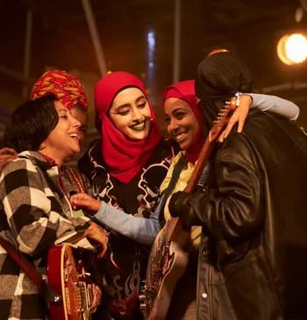
Multiplicity of Muslim Representation
This Channel 4 show is focused on female British Muslim representation – and presents a variety of identities and codes of practice of Islam exemplified through a diverse group of women.
“Despite the constant silliness, the show rails against the “us versus them” narrative that polarises us. As a diasporic kid, I know what it’s like to live within multiple identities. I’ve been told that they’re in conflict.” Show writer Nida Manzoor (https://inews.co.uk/culture/television/we-are-lady-parts-nida-manzoor-channel-4-991333).
This this show’s primary intent is to present a multiplicity of underrepresented Islam though comedic realism, seeks to subvert stereotypes of Muslims and attempts to undermine the binary between the ‘good Muslim’ who is ‘moderate,’ law-abiding and non-violent’ according to post-9/11 western discourses and ‘Other Muslims’ who deviate from this model. Apart from the obvious violent terrorist figure, the ‘Othered’ Muslims presented in this show often intersect comfortably with acceptable western modes of feminism and identity politics.
This Photo by Unknown Author is licensed under CC BY

Slide 3
Polysemic Meanings
This show also directly responds to another binary found within western Muslim audiences (post-911 and globally) of an ‘authentic Islam’ and those Islamic practices that deviate from this model and thus are ‘haram’ – or forbidden. Thus although the previously mentioned ‘Othered’ Muslim may co-exist within a western context of acceptable Islam, these ‘Othered’ figures may threaten an authentic Islam.
Authentic Islam draws its authority from the notion of ‘The Sacred.’ This model of Islam is essentialist, and is a discourse of unchanging preservation. It is the cornerstone of a variety of mainstream approaches to practicing Islam – i.e, - ‘The Koran is a unchanged text, therefore cannot be questioned.’
The feminist Islam presented in this show pushes against the limits of this ‘authentic Islam’, and this produces contradictions within the show; particularly for a Muslim viewing audience who may find the feminisms in the show offensive and unviable. However, the show remains careful to attempt to make space within conventional Islamic practices with their own brand of liberal Islam – without breaking off from it. This creates challenges for Muslim audiences, although the show may be received differently by a western and/or feminist audience.
However, by operating within these binaries and directly responding to its limits, the show still circulates and maintains its these polarization found withinn representations of Muslims on screen.

Slide 4
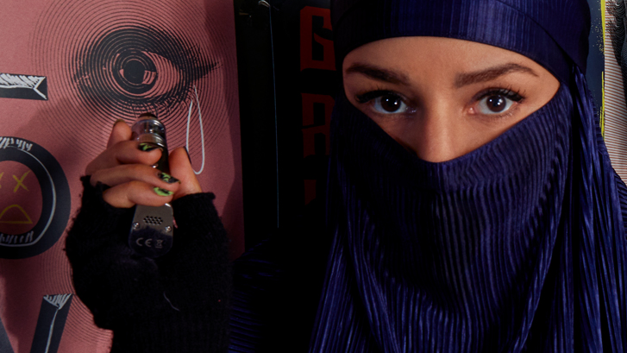
The Hejab and its Discontents
The Hejab and its display on the female Muslim body has been, and continues to be a point of contention in the western context, both pre- and post-9/11. It is a site of negotiation between what forms of Islam are permitted within the western matrix of multiculturalism, and what is rejected as too alien – antithetical to western liberalism.
Since Edward Said’s Orientalism examination of the west’s fascination with the oppressed ‘native’ woman, the veil has always been posited as a boundary between savagery and civilisation.“[The]“white man’s” fascination with the veil is layered with imperialist images of mysteries, depths, and folds of darkness. Veiled behind a new, patently absurd argument of national security is the old Orientalist impulse to penetrate the burqah.” (Ahmed, Leila. 1992. Women and Gender in Islam. New Haven, CT: Yale University Press.

Slide 5
The Hejab continued…
The hejab is doubly read: “one is the colonial gaze, which comes from a history of colonization and for which the face veil stands out as a barrier to obtaining knowledge about these women and thus conquering them. The other coded way of seeing is that of nationalism which translates Muslim women as symbols of anti-nationality and inability to assimilate into” the west (Jiwani 2006; Berland 2009).
This show presents a variety of veil wearing practices – from full burqah to head wraps. These hejabs represent the possibility of competing forms of Islam (particularly Islamic feminisms) existing unproblematically next to one another. My project will explore whether the use of the Hejab in this show is a productive and persuasive representation of third-wave Islamic feminism, or whether the show deploys hejab wearing practices problematically as they push against the acceptable Islamic sacred.

Slide 6
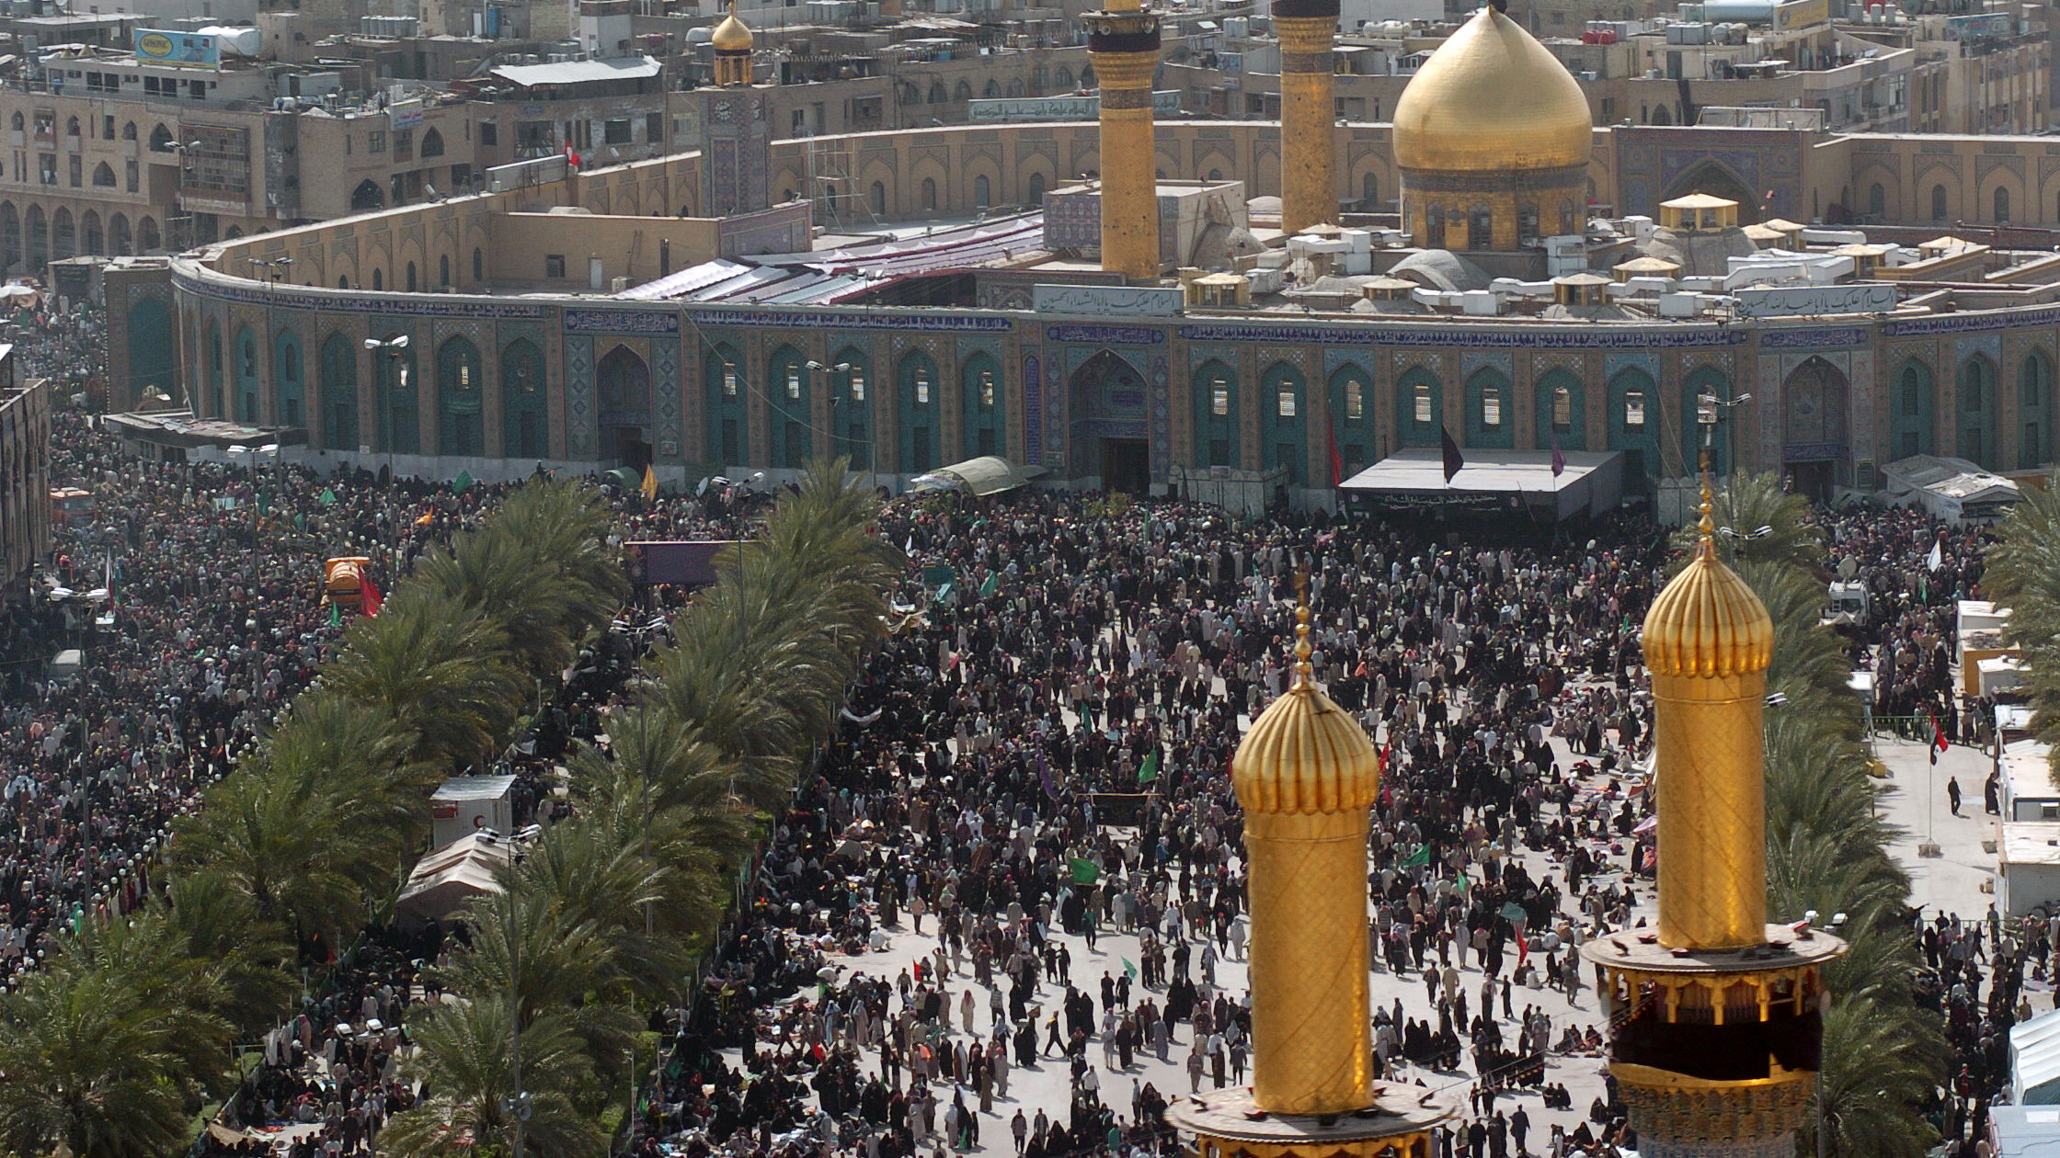
The Profane and the Sacred
The central thrust of this show is propelled by two competing storylines – which can roughly be analogized by binary of the sacred vs the profane – the main protagonist Amina’s oppressive university friendship circle representing traditionalism and anti-feminism, and Lady Parts, the punk band that is a progressive site of new ways of being a Muslim woman.
Thus, although the show seeks to overcome binaries and stereotypes, it nonetheless repeats the same dialectic of Islam vs progress, or Islam vs the west.
I will seek to deconstruct the binaries presented in this show, particularly that of the sacred vs the profane.
The generic format of the show combines the conventions of a the rom-com and that of the Künstlerroman – illustrated through Amina’s narrative.
This Photo by Unknown Author is licensed under CC BY-SA-NC

Slide 7
Project Methodology
My project will use a variety of theoretical approaches to produce a 15-20 minute ‘explanatory video’ as found on popular YouTube channels ‘Alt Shift-X’ and ‘The Take.’ These videos explore visual texts and analyse them for a general audience in highly effective and accessible ways.
The video – which I will write, create and narrate – will be critically informed by a number of theoretical approaches, such as Postcolonial studies, Islamic feminism, Comedy Studies and Diaspora theory.
The video will interlace visible on-screen text with my own narration in order to work in these theories. The short film will be critically engaged but aimed at a general audience. I will use images from the show We Are Lady Parts to illustrate my analysis.

Slide 8
Progress to Date
I have conducted a second close analysis of the entire first season of We Are Lady Parts, and am in the process of coalescing my observations into a central thesis that will frame my short film. I have collated a bibliography of texts to critically frame my analysis. I hope to complete this part of the project by 20th of March.
My next step will be to write a 2000-2500 word script, which will then be used as a basis for creating the short film. Target date: 28th of March.
I will be collaborating with a professional film maker to ensure the video’s quality. Target completion date: 8th of April.

Slide 9
Bibliography
Ahmed, L. (1992). Women and Gender in Islam. New Haven, CT: Yale University Press.
Berland, J. (2009). North of Empire. Durham: Duke University Press.
Jiwani, Y. (2006). Discourses of Denial: Mediations of Race, Gender, and Violence. Vancouver: UBC Press.

