Slide 2
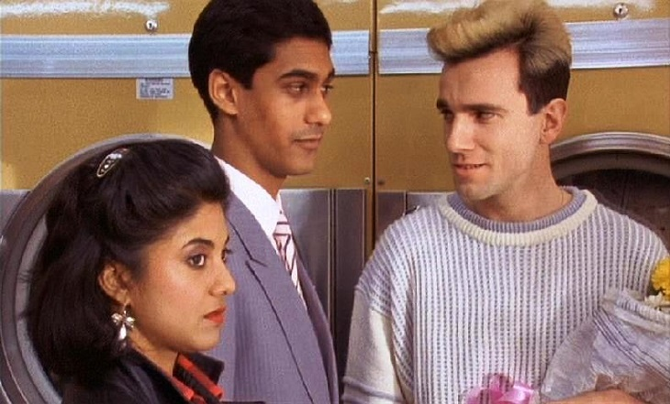
British Matrimonies + Queer Glocalities South Asian Diasporic Sexualities from Hanif Kureishi’s My Beautiful Launderette (1985) to Daniel O’Donnell’s East is East (1999) Dr Rahul K Gairola, The Krishna Somers Senior Lecturer in English & Postcolonial Literature Murdoch University, Greater Perth, Western Australia
My presentation examines how queerness disrupts one of the most oppressive family functions in British South Asian diasporic culture – the arranged marriage. It engages in a comparative retrospective of two classic filmic texts: My Beautiful Launderette (1985) written by Hanif Kureishi and directed by Stephen Frears; and East is East (1999) directed by Damien O’Donnell. Both British South Asian diasporic films offer powerful representational alternatives the nationalist heteropatriarchy that characterize Thatcherite England.
I read Kureishi’s and O’Donnell’s cinematic texts as treating heterosexual, arranged marriage as a “glocal” phenomenon that is at once a grand life milestone to publicly celebrate across one’s transnational network of family members, on the one hand, while remaining anchored to social formations in local communities and neighbourhoods, on the other.
Photo courtesy of Working Title Films and Channel Four Films

Slide 3
British Matrimonies + Queer Glocalities
I read Tania, Omar, and Johnny in Launderette and Nazir and his partner in East is East as queering agents who disrupt the neoliberal, heteronormative order of arranged marriage that is embedded within the strict Muslim heteropatriarchy of their families. For Omar, Tania, and Nazir, this is especially important as they are liminal diasporic subjects that exists between three worlds: the British, the Pakistani, and the heteronormative. As such, these characters effectively disrupt the discourse of arranged marriage of queer/ non-heteronormative members of the South Asian diaspora in the UK. This process is at once “glocal” as it occurs at the local level of community but also impacts their relatives.
However, I also note that the burden of being queer agents of change that challenge the heteropatriarchy of arranged marriage of the South Asian diaspora in the UK also has its pitfalls. I observe that the romantic union of Omar and Johnny occurs at the expense of Tania, who is literally erased at the end of the film as a convenient way of ensuring the reunion of the two gay men and the security of their capital and assets at the end of Launderette.
In East is East, Nazir too disappears from his family’s home at the very moment he can ensure that his two younger brothers avoid getting forced into arranged marriages. This erasure, along with his stereotypical, effeminate “gayness” undercuts the efficacy of the representations. Nonetheless, both My Beautiful Launderette and East is East offer optics of glocal resistance to enforced arranged marriages of queer diasporic South Asians in the UK.
Photo courtesy of FilmFour and Assassin Films

Slide 4
Rahul.Gairola@murdoch.edu.au
Diaspora Screen Media Network (DSMN), 2022
Institute of Media and English
Birmingham City University, UK

