Slide 1
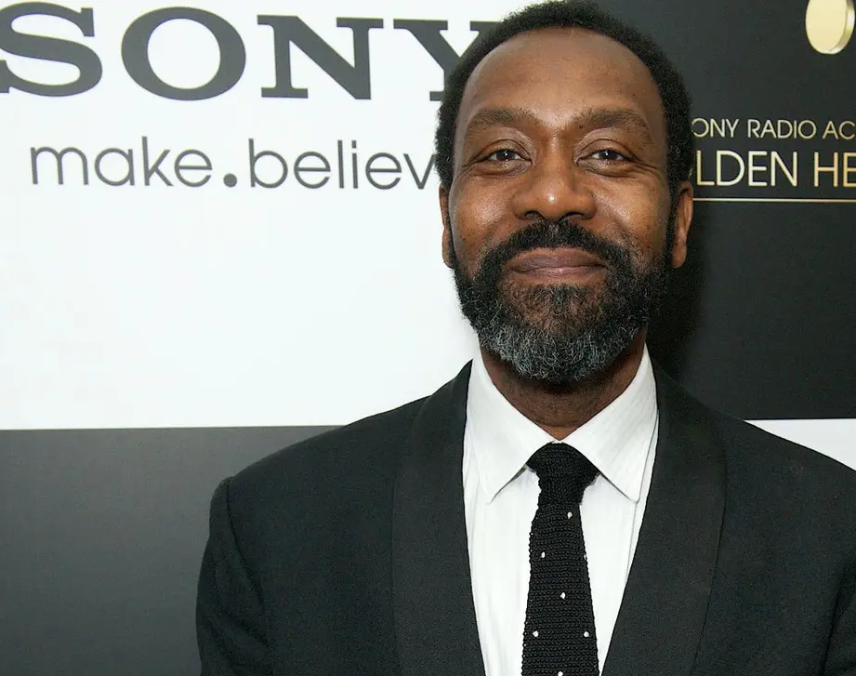
Race and Traditional British Media
2013, Lenny Henry’s widely reported comments “There weren’t any black people at the BAFTAs”
Henry has noted that while 14.5% of the UK population is BAME (rising to 40% in London, where most of the sector is based), currently only 5.4% of the creative industries' workforce is non-white – the lowest figure since the monitoring group Creative Skillset started counting.

Slide 2
Social Media and Microcelebrity
The potential of social media as an avenue for GEM performers?
Microcelebrity as a ‘stepping stone’ to entering traditional media for GEM performers?
The potential of microcelebrity as a practice to effectively critique socio-political discourses around race?

Slide 3
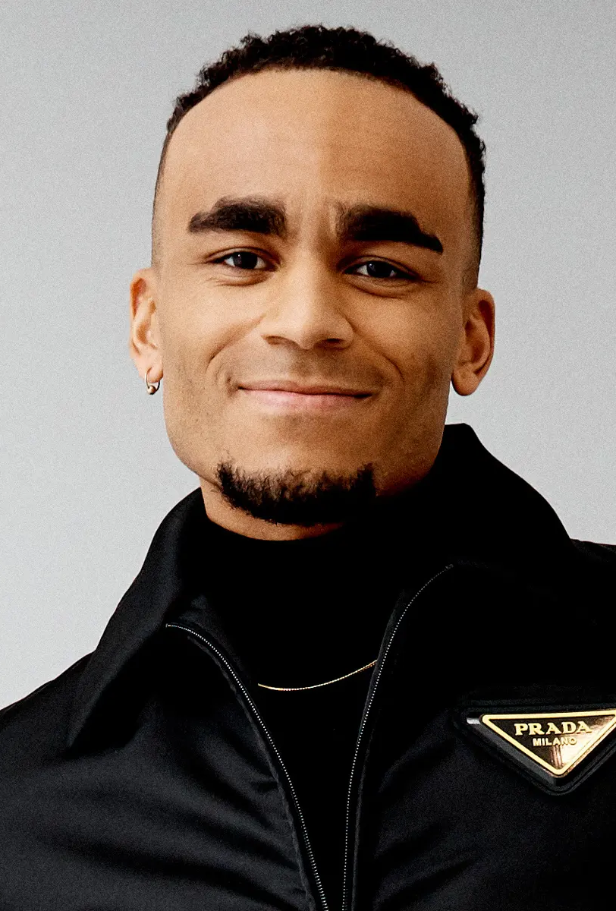
Microcelebrity
Social media scholar Alice E Marwick has suggested: “Microcelebrity is not an identity, nor is it simply celebrity scaled down. Instead, I stated clearly that microcelebrity is a practice, it is something one does, a way to present oneself online and relate to others” (162)
“Microcelebrities are able to attract hundreds of thousands, even millions, of fans and followers via their specific niche, and be entirely successful and self-sustaining” (Marshall et al 91)
''I make content because I need to express how I'm feeling about the world,‘’ (Chawawa qtd in Kwai)

Slide 4
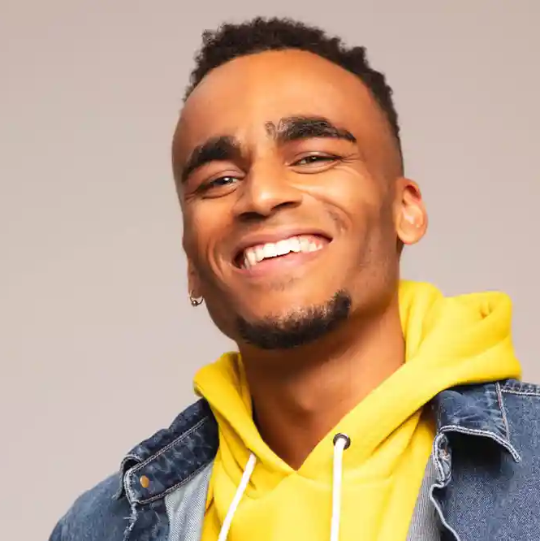
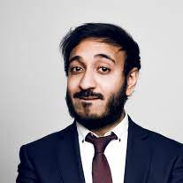
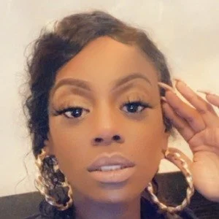
Munya Chawawa
Other relevant figures might include Bilal Zafar, Michael Dapaah, Vee Brown, Asim Chaudhry, Mo Gilligan and Guz Khan.

Slide 5
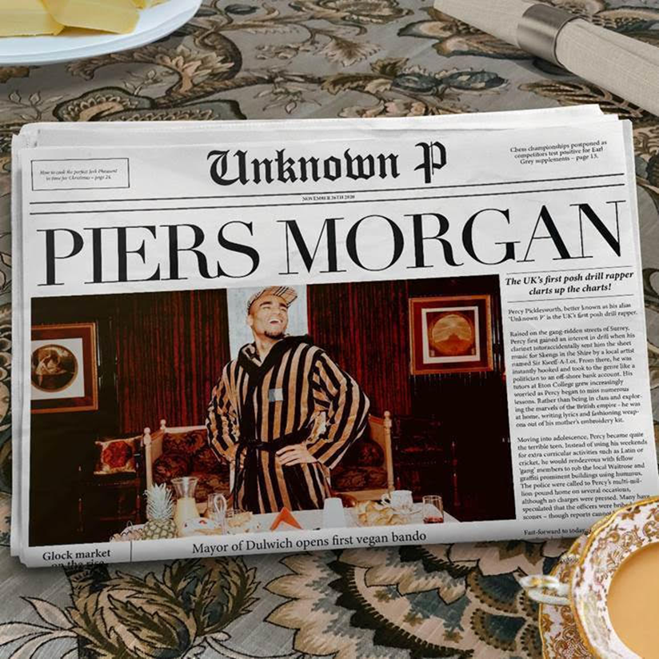
Munya Chawawa
Chawawa has made a career (including half a million Instagram followers) out of satirising contemporary instances of racial prejudice and inequality, with a particular recent focus on how such stories are reported in the traditional media.
Targets for Chawawa have included white outrage at Sainsbury’s Black History Month Initiatives, the complaints over Black Lives Matter Protests on ITV’s Britain’s Got Talent, and the racist abuse aimed at footballers Marcus Rashford, Jadon Sancho and Byako Saka after their penalty misses in Euro 2020.
Notes:
https://www.instagram.com/p/CRRl67jhXxU/?hl=en

Slide 6
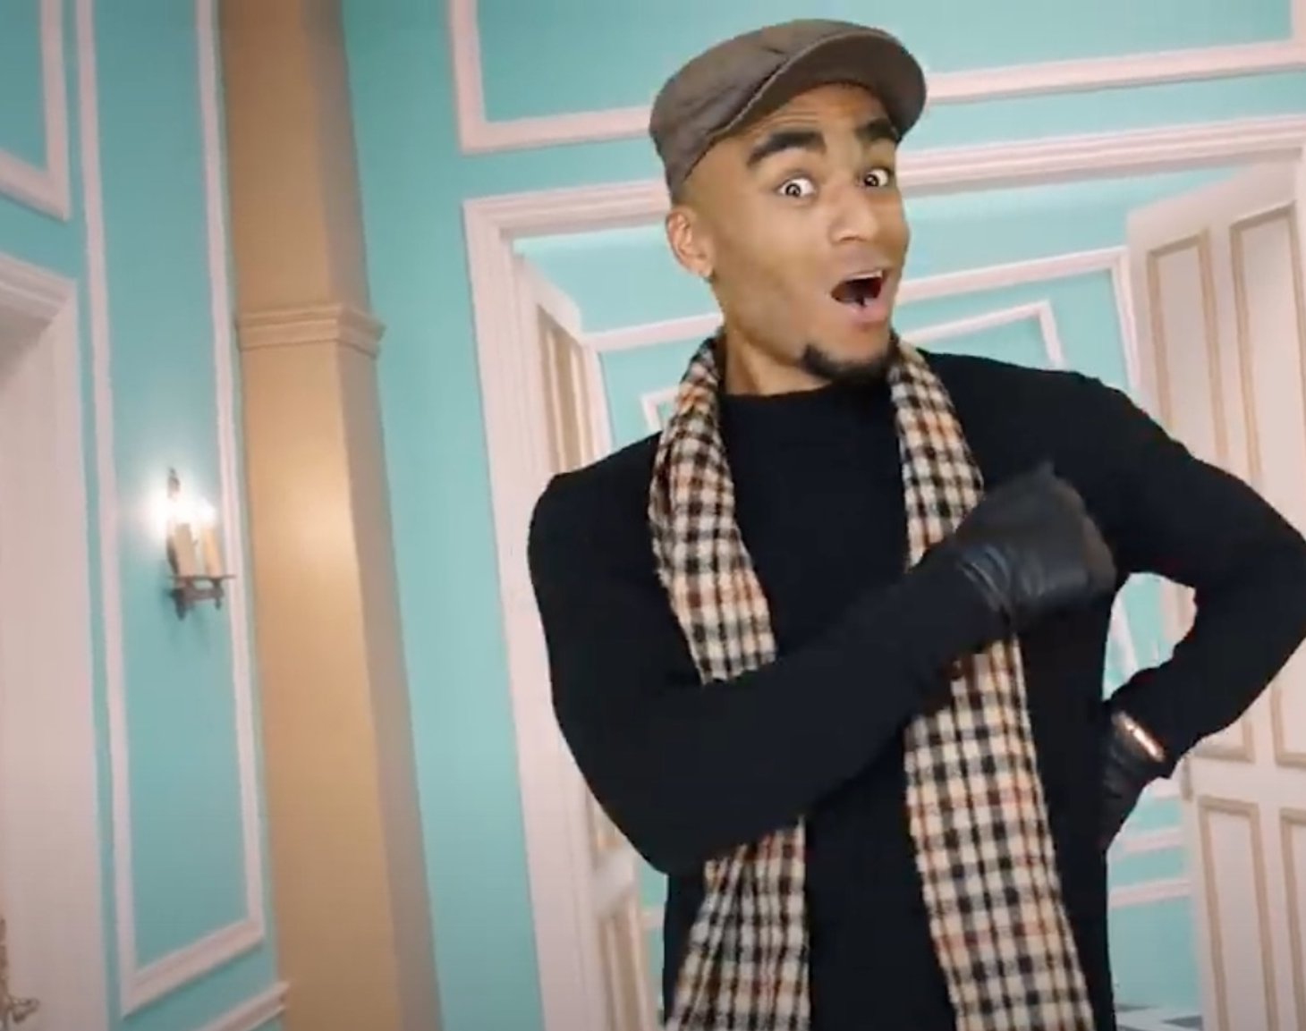
Unknown P.
Chawawa is perhaps best known for his creation Unknown P. A drill rapper who hails from the gang ridden streets of Surrey and sings about topics such as tax evasion and fox hunting.
“The character was born from a desire to expose the hypocrisy of classism and cultural appropriation amid a public debate over U.K. drill -- a subgenre of hip-hop music that British authorities have tried to censor, blaming it for a rise in knife crimes in London.” (qtd in Kwai)

Slide 7
Unknown P. “Piers Morgan”
“The irony that middle and upper class people at my uni chat about unknown p without realising it’s literally satire about them and their working class fetishization” (Allan Smith, YouTube Comment)
“Some upper class kids are obessesed [sic] with the hood culture and will imitate when they are far from that. You can enjoy it, but not imitate it, it's corny.” (Divinity Litty, YouTube Comment)

Slide 8
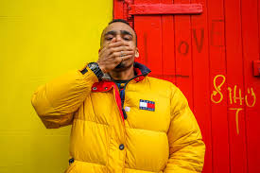
“{Chawawa’s] unwavering confidence and humour are being celebrated at a time when few Black people can speak about racism or critique the government without receiving swathes of abuse” (Joseph)
“Maybe we stop having to force our way into an organisation that’s made up its mind, and just make one that’s more aligned with our world, with a team that understand our type of humour – people who understand what I will be saying when I’m making jokes about jollof rice.”

Slide 9
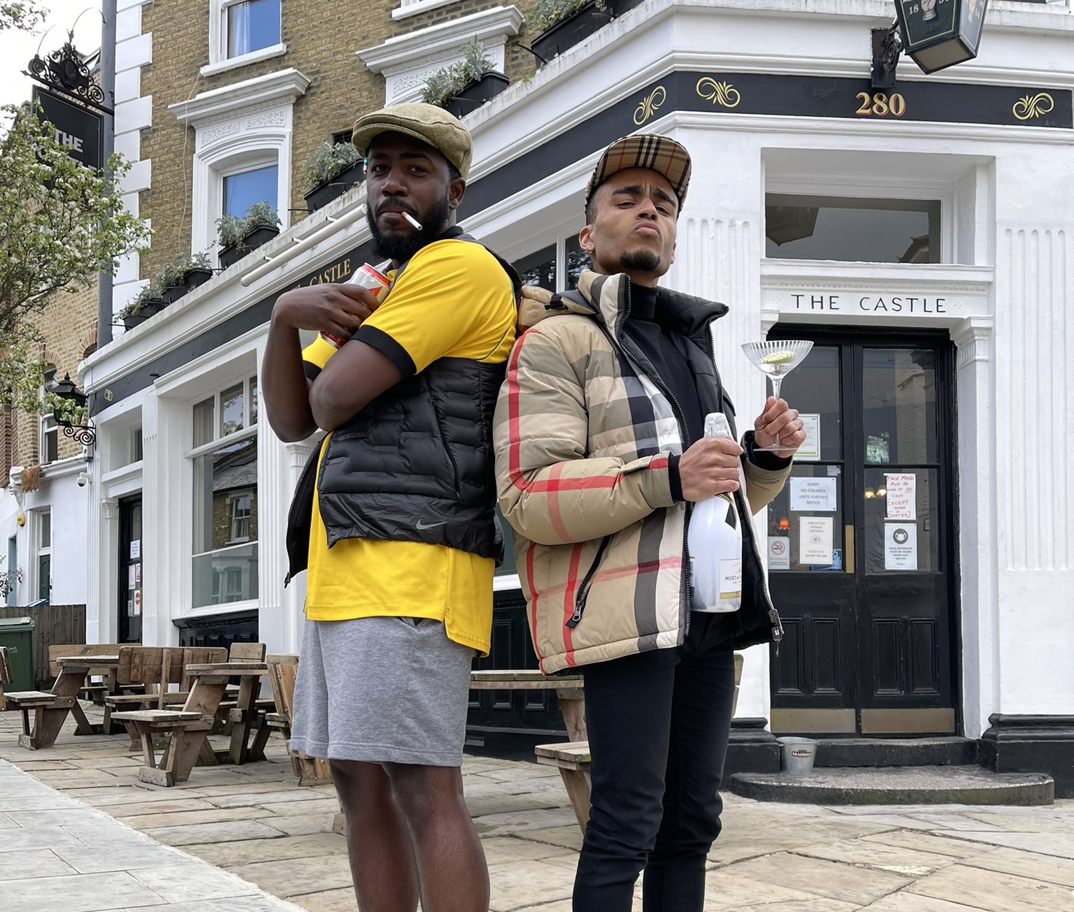
Closing Thoughts
“social media provides some form of technological solution to the lack of voice that people of color have encountered in traditional media for decades.” (Chen 120)
“many young people in Britain do not see themselves reflected by the satirists on their TV screens … To me it feels liberating to combat the status quo.‘’ (Chawawa qtd in Kwai)
Is social media the most effective means of performers finding an audience?
Is it a form of ghettoization/exploitation?

Slide 10
Works Cited
Banks, Mark. 2017. “What is Creative Justice?” CAMEo Research Institute for Cultural and Media Economies, University of Leicester.
Chem, Gina Masullo. “Social Media: From Digital Divide to Empowerment” in The Routledge Companion to Media and Race. Ed. Christopher P. Campbell. London and New York: Routledge, 2017. 117-125.
Joseph, Chante. “’It’s Been a Battle to Express My Personality’: Munya Chawawa, Instagram’s Finest Satirist”. Theguardian.com. 8 Dec 2020. Available: https://www.theguardian.com/music/2020/dec/08/munya-chawawa-instagrams-finest-satirist-unknown-p
Kwai, Isbella. “The Saturday Profile: For a U.K. Satirist and His Online Fans, Comedy Is Catharsis”. The New York Times. April 9 2021. Available at: https://www.nytimes.com/2021/04/09/world/europe/munya-chawawa-british-comic-profile.html
Marshall, P. David, Christopher Moore, Kim Barbour. Persona Studies: An Introduction. Hoboken, NJ: Wiley, 2019.
Marwick, Alice. “The Algorithmic Celebrity: The Future of Internet Fame and Microcelebrity Studies” in Microcelebrity around the Globe (2019) 161-170.

