Slide 1
The term ‘Diaspora’
The social condition of diaspora – represented as a triadic relationship:
Diasporic Consciousness
Place of origin
Place of settlement

Slide 2
Issues of production and consumption:
Audiences and media representation or what audiences ‘do’ with representation
Textuality and content:
Stereotyping and ideology
Types of images used to represent ethnic minority groups
New kinds of representations
Aesthetics and pleasure and tensions
Power and politics:
Who controls, is controlled by, media representation?
Digital Media:
Analogue to the digital – histories
New media, convergence and remediation

Slide 3
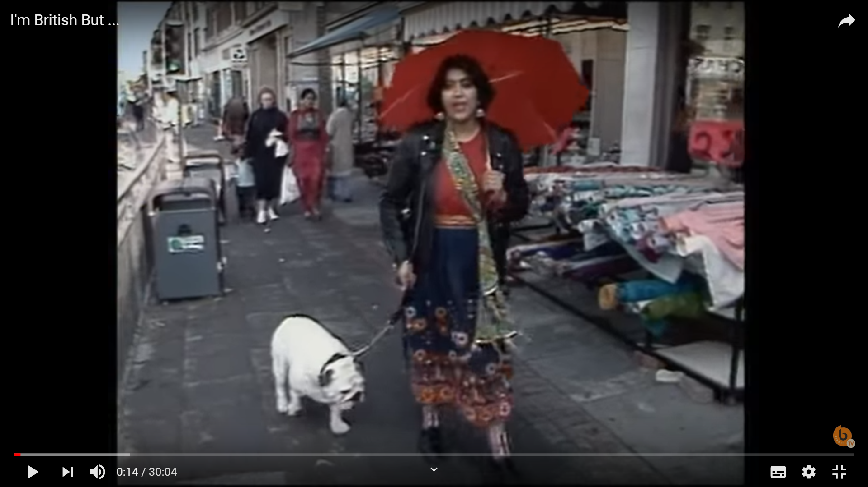
Gurinder Chadha (1989) I’m British But…
https://www.youtube.com/watch?v=lIbTHhayK3w

