Slide 1
Critical Incident - Definition
Critical incidents are learning situations that lead to significant learning and personal growth.
A critical incident does not need to be a serious or dangerous event; rather “critical” is to be interpreted as relevant or important that would require more in-depth reflections.

Slide 2
Critical Incident
BCU Assessment tracker is used to identify key areas of progression
Associate Teacher shows how they are progressing toward the BCU Curriculum Key Themes
The Critical Incident is the Associate Teacher’s opportunity to show and prove how they are progressing and developing.

Slide 3
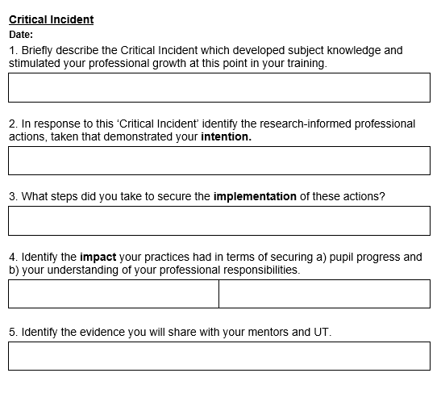
The Critical Incident template is in the Associate Teacher’s Progress Journal and needs to be completed by the AT to be discussed at both their Review and Progress Meetings. Please refer to the next slide for each Critical Incident focus from Review Meetings 1, 2, 3 and Progress Meetings 1, 2, 3.

Slide 4
Critical Incident Focus
CI Review Meeting 1 – Behaviour
CI Progress Meeting 1– Linked to Phonics/Subject Specialism/An area of student reflection/learning
CI Review Meeting 2 – Adaptive teaching linked to a subject
CI Progress Meeting 2 - Linked to Phonics/Subject Specialism/An area of student reflection/learning
CI Review Meeting 3 – Assessment linked to a subject
CI Progress Meeting 3 - Linked to Phonics/Subject Specialism/An area of student reflection/learning

