Slide 1
Key Note
CPD sessions will be bespoke to the relevant part of the training year.
If you were unable to attend Mentor CPD1 and you haven’t yet accessed the recording please do so as Mentor CPD1 covers:
The BCU ITE Curriculum and how this has been designed with our phases and curriculum themes
Introduction of the curriculum maps
Introduction of the assessment tracker
How to use the LORs (Learning Observation Records) and WMMRs (Weekly Mentor Meeting Record)
Expectations for planning

Slide 2
A reminder…
The sequencing of our BCU ITE Curriculum into phases (which ensures that we go beyond the minimum requirement of the Core Content Framework)
ECT
Phase 11 - Becoming an Early Career Teacher and sustaining your professional development
Phase 10 - Sustained independent professional practice – embedding composite teaching practice
Sch A
Professional Enquiry CBT & Assignment
Sch A
Phase 9 - Consolidation of critically reflective and inclusive teaching practice
Phase 8 - Remember, compare and apply knowledge of teaching and learning strategies within a new school environment
Sch B
Sch A
Phase 7 - Remember and apply an understanding of how to meet the needs of all learners
Phase 6 - Remember and apply an understanding of how to implement curricula in the classroom – planning, teaching and reflecting
Subject Pedagogy CBT & Assignment
Sch A
Professional Studies CBT & Assignment
Sch A
Phase 5 - Remember and apply ways to set high expectations, and ways to manage behaviour
Phase 4 - Know, remember and understand how to meet the needs of all learners within your wider role within a school
Sch A
Phase 3 - Know, remember and understand how to plan for curriculum delivery that meets the needs of all learners
Phase 2 - Know, remember and understand how pupils learn and the Associate Teacher’s role in the process
Diagnostic Asmt
ISE
Phase 1 - Preparing to become an Associate Teacher

Slide 3
The BCU ITE Curriculum Themes
A reminder…
A | Associate teacher uses critical enquiry and research informed practice to develop their understanding of effective teaching and learning
B | Associate teacher’s classroom practice establishes effective behaviour management using high expectations and awareness of pupil wellbeing
C | Associate teacher knows more, remembers more and applies subject knowledge and subject-specific pedagogy to impact on pupils’ progress
D | Associate Teacher uses knowledge about how pupils learn to plan and assess learning to ensure that all pupils make progress
E | Associate Teacher implements effective adaptive teaching approaches to meet all learners’ needs, including SEND (Special Educational Needs and Disability) and EAL (English as an Additional Language) learners.
F | Associate Teacher demonstrates professional behaviours and contributes effectively to the wider life of the school.
Our Curriculum Themes ensure that our curriculum content encompasses the breadth of the Core Content Framework and beyond

Slide 4
Key Dates for Phases 7 and 8
School A Placements end on Friday 10th February 2023 (the end date may vary for some School Direct routes)
School B Placements start on Tuesday 14th February and finish at the end of term (Easter holidays)
ATs will return to their first placement after Easter.
Mondays are always with BCU mostly Subject Pedagogy but sometimes Professional Studies (school placements are Tuesday – Friday)
End of Placement/Phase 7 Review from School Mentor – to be received by Friday 10th February
If you are hosting a ‘School B’ AT, the end of Phase 8 review is due for submission by Friday 31st March.

Slide 5
ATs should build towards 9 hours when they start teaching in School B (Phase 8) with 5 hours supporting
In Phase 7, ATs should now be teaching the following:
7 hours leading
7 hours supporting (where possible, this number can be reduced where curriculum time is limited)
ATs need experience in all three key stages where possible (i.e. Key Stage 3, 4 & 5)

Slide 6
Assessment Towards QTS
A reminder…
This year, Associate Trainee progress towards achieving QTS is monitored and assessed in the following ways:
The Curriculum Map (used to ensure that School-Based Training aligns with Centre-Based Training)
Use of the Assessment Tracker (assessment against the BCU ITE Curriculum Themes)
Use of Weekly Mentor Meeting Records (to document AT progress on a weekly basis)
Learning Observation Records (LORs – used for lesson observation feedback)
Critical Incident Forms (used alongside review and progress assessment forms from Subject Mentors)

Slide 7
The Curriculum Map
@BCUPGCESec
A reminder…
Each Associate Teacher will have a curriculum map for their subject saved in their OneDrive – these were updated last term to ensure they are as useful as possible
The orange side outlines the Centre-Based Learning for the whole year by phase
The green side outlines how learning from the orange side is being applied in school

Slide 8
The Curriculum Map 1
@BCUPGCESec
A reminder…
The Curriculum Map will triangulate between school mentors, the Associate Teacher, and BCU tutor to ensure that School-Based Training is complimenting and enhancing Centre-Based Training - the right hand column that evidences this will be used by mentors and ATs to show where there have been opportunities for the BCU Curriculum to be implemented in school.
The Curriculum Map should be used weekly so that you and your Associate Teacher can remind yourselves about what they have learned so far and they can then focus on how to apply that learning in the school placement.
This map will support your knowledge of the BCU ITE curriculum.
Curriculum map example….

Slide 9
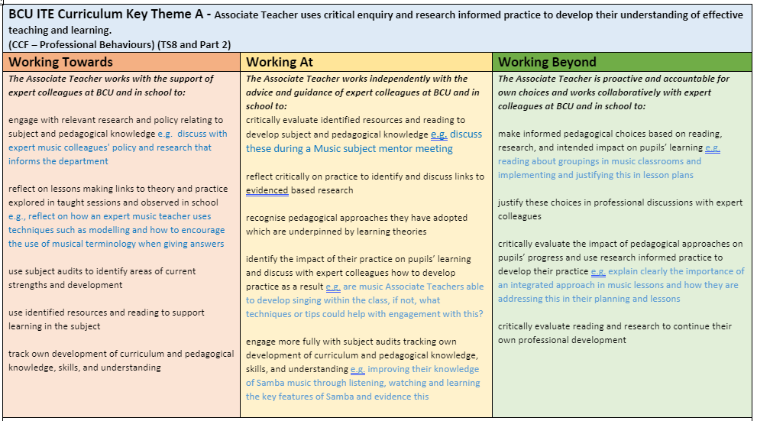
A reminder 1
@BCUPGCESec
The Assessment Tracker
The Assessment Tracker includes a page that looks like this for each BCU ITE Curriculum Theme
There are three levels of achievement for each theme
Text in black is the same across all subjects
Text in blue is relevant to your subject
All Themes to be assessed at least here by the end of School 1 (Feb half-term)
All Themes to be assessed at least here by the end of School 2 and to be awarded QTS
You might be achieving here in some areas by the end of School 2

Slide 10
A reminder 2
@BCUPGCESec
Working Beyond
Working At
(minimum achievement for QTS)
Working Towards
At least 3 themes assessed as ‘Working Towards’ (must include Theme F)
All themes assessed as at least ‘Working Towards’ to pass SBT1)
At least 3 themes assessed as ‘ ‘Working At’ (must include Theme F)
All themes assessed as ‘Working At’ to be on track for QTS)

Slide 11
Learning Observation Record 1
@BCUPGCESec
A reminder…
Please ensure that the AT is observed at least twice a week (some School Direct routes may have a different policy) and use a Learning Observation Record (LOR) to feedback (see example)
Use the Assessment Tracker and the BCU ITE Core Curriculum as a guide for providing feedback and focus the feedback on the impact on the pupil’s learning in the context of the subject.
ATs will provide an LOR for the observer before their lesson begins, as they will have filled in the details at the top of the LOR.
The AT needs to identify which BCU ITE Core Curriculum Themes they want the feedback to focus on.

Slide 12
Learning Observation Record 2
@BCUPGCESec
Feedback from use of the LOR in Phases 5-7
BCU Curriculum themes not always identified and/or the narrative of the feedback does not link to the identified themes.
Feedback is not always subject-specific enough. Setting subject-specific targets does not mean setting subject knowledge targets, it means that targets and feedback should be in the context of the subject (if you take away the name of the subject from the top of the form, is it still evident what subject is being taught?)
Feedback isn’t always structured across the three columns

Slide 13
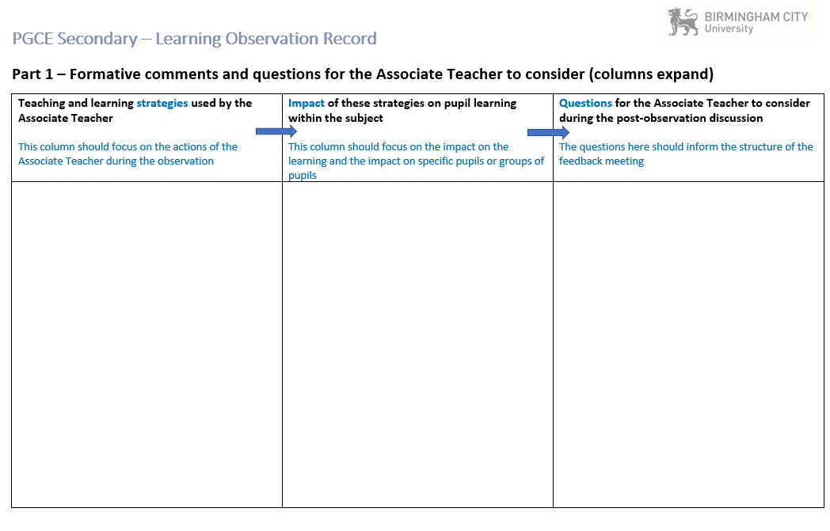
Learning Observation Record
@BCUPGCESec
Feedback to be structured into these three columns

Slide 14
Weekly Mentor Meeting Record
@BCUPGCESec
Instead the AT will download one meeting record per week and store the completed version in their OneDrive
We want to ensure that subject-specific targets are set on a weekly basis
Associate Teachers are responsible for completing this document but they should complete it WITH their mentor in their weekly mentor meeting

Slide 15
Weekly Mentor Meeting Record 2
@BCUPGCESec
Feedback from use of the LOR in Phases 5-7
ATs not always completing the record of their own observation on the final page
As with the LORs, some targets set are not subject-specific or SMART
In your subject sessions (or undergraduate session) later on, we will be discussing these documents more to support you in using them with the Associate Teachers

Slide 16
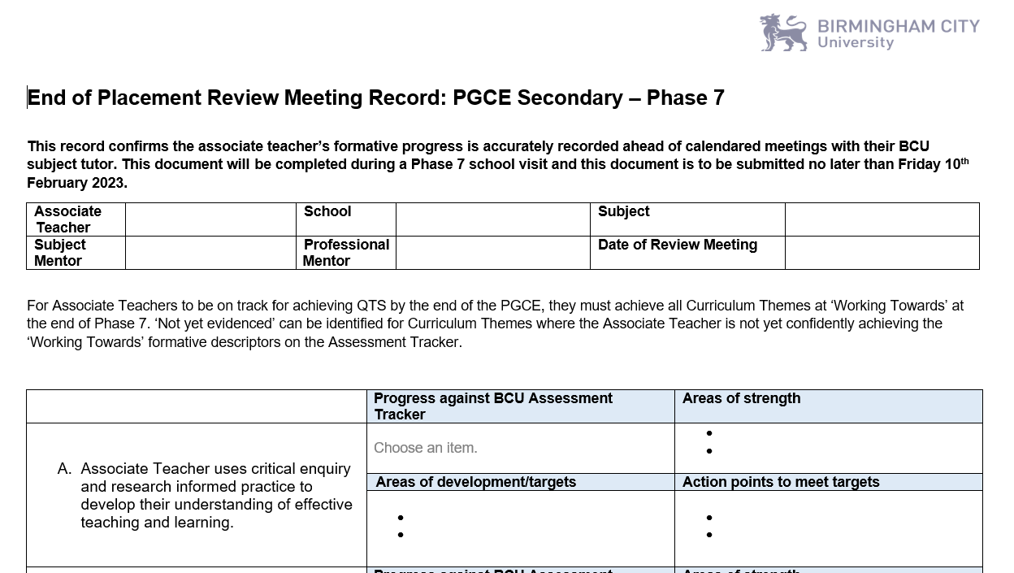
Phase 7 End Point Review Meeting
@BCUPGCESec
Phase 7 will be an ‘End Point’ assessments
For each curriculum theme, use the Assessment Tracker to identify if the AT is ‘Working Towards’ or ‘Working At’. If the AT is not yet meeting the ‘Working Towards’ criteria, select ‘Not yet evidenced’
Identify areas of strength, development/targets and action points to support the AT going into the next phase

Slide 17
Primary Experience
In Phase 7, all ATs will need to spend one day in a feeder primary school. For some School Direct ATs, this may take place in Phase 8.
PMs should support the AT with contacting a feeder primary school.
One day can be spread over two half-days.
ATs have a letter to provide to the headteacher once a school has agreed to support the AT.
ATs have some tasks to undertake which involve looking at KS2-KS3 transition and early literacy.

Slide 18
SEND Days
As outlined in the partnership handbook, all ATs will spend 4 placement days focusing entirely on SEND.
For some ATs with contact with special schools, this could be a mini 4-day placement in a special school.
For ATs staying in their own placement, with negotiation with the PM, the AT should spend 4 days working specifically in the context of SEND (more details to follow on this for PMs later on).
SEND days should take place in Phases 9-10 but can take place earlier if it works better for the placement.

Slide 19
Can you help?
We are in urgent need of placement opportunities for the following Undergraduate students, if your school/department can accommodate any of the students below, please email Gemma Taylor directly on Gemma.taylor@BCU.ac.uk
Y1 Biology: 2 Birmingham based students needing a 30 day placement to start ASAP
Y3 Biology: 1 biology placement required within the Halesowen/Quinton/Northfield area to start ASAP, 60 day placement.
Y3 PE – 1 male student, Birmingham based requiring a placement opportunity, starting ASAP.

Slide 20
5:00pm:
Subject Mentors – follow the link for your subject-specific session (with subject tutors)
Professional Mentors – follow the link for your session (with me)
Undergraduate Mentors – follow the link for the undergraduate session (with Gemma Taylor)

