Slide 1
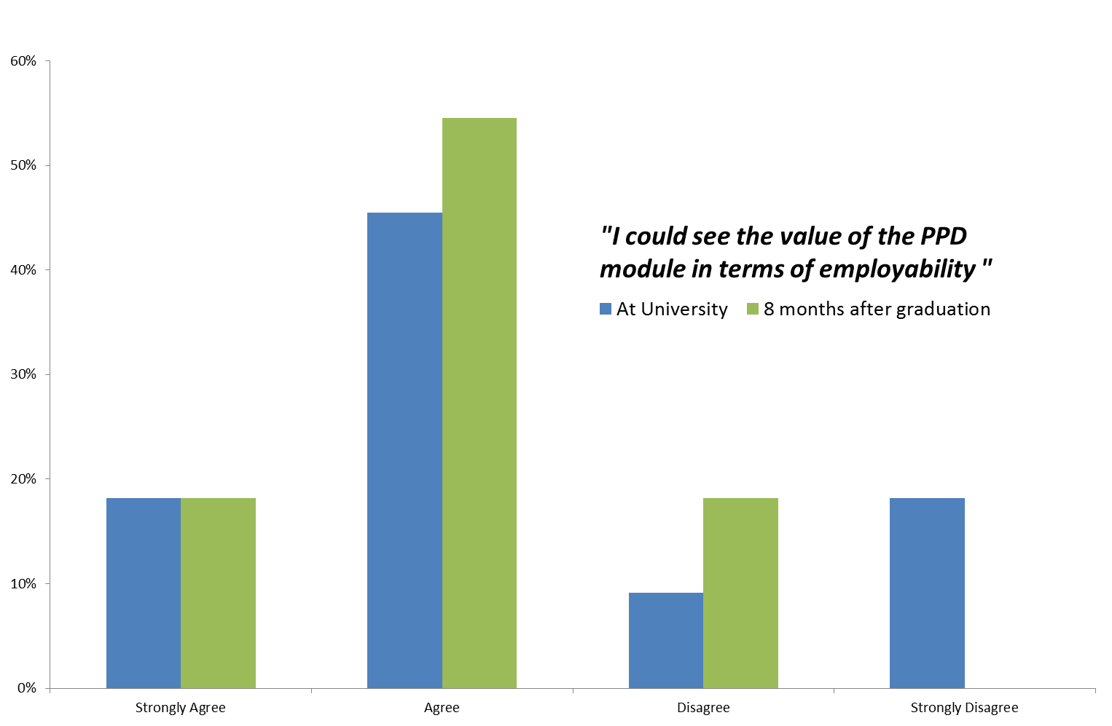
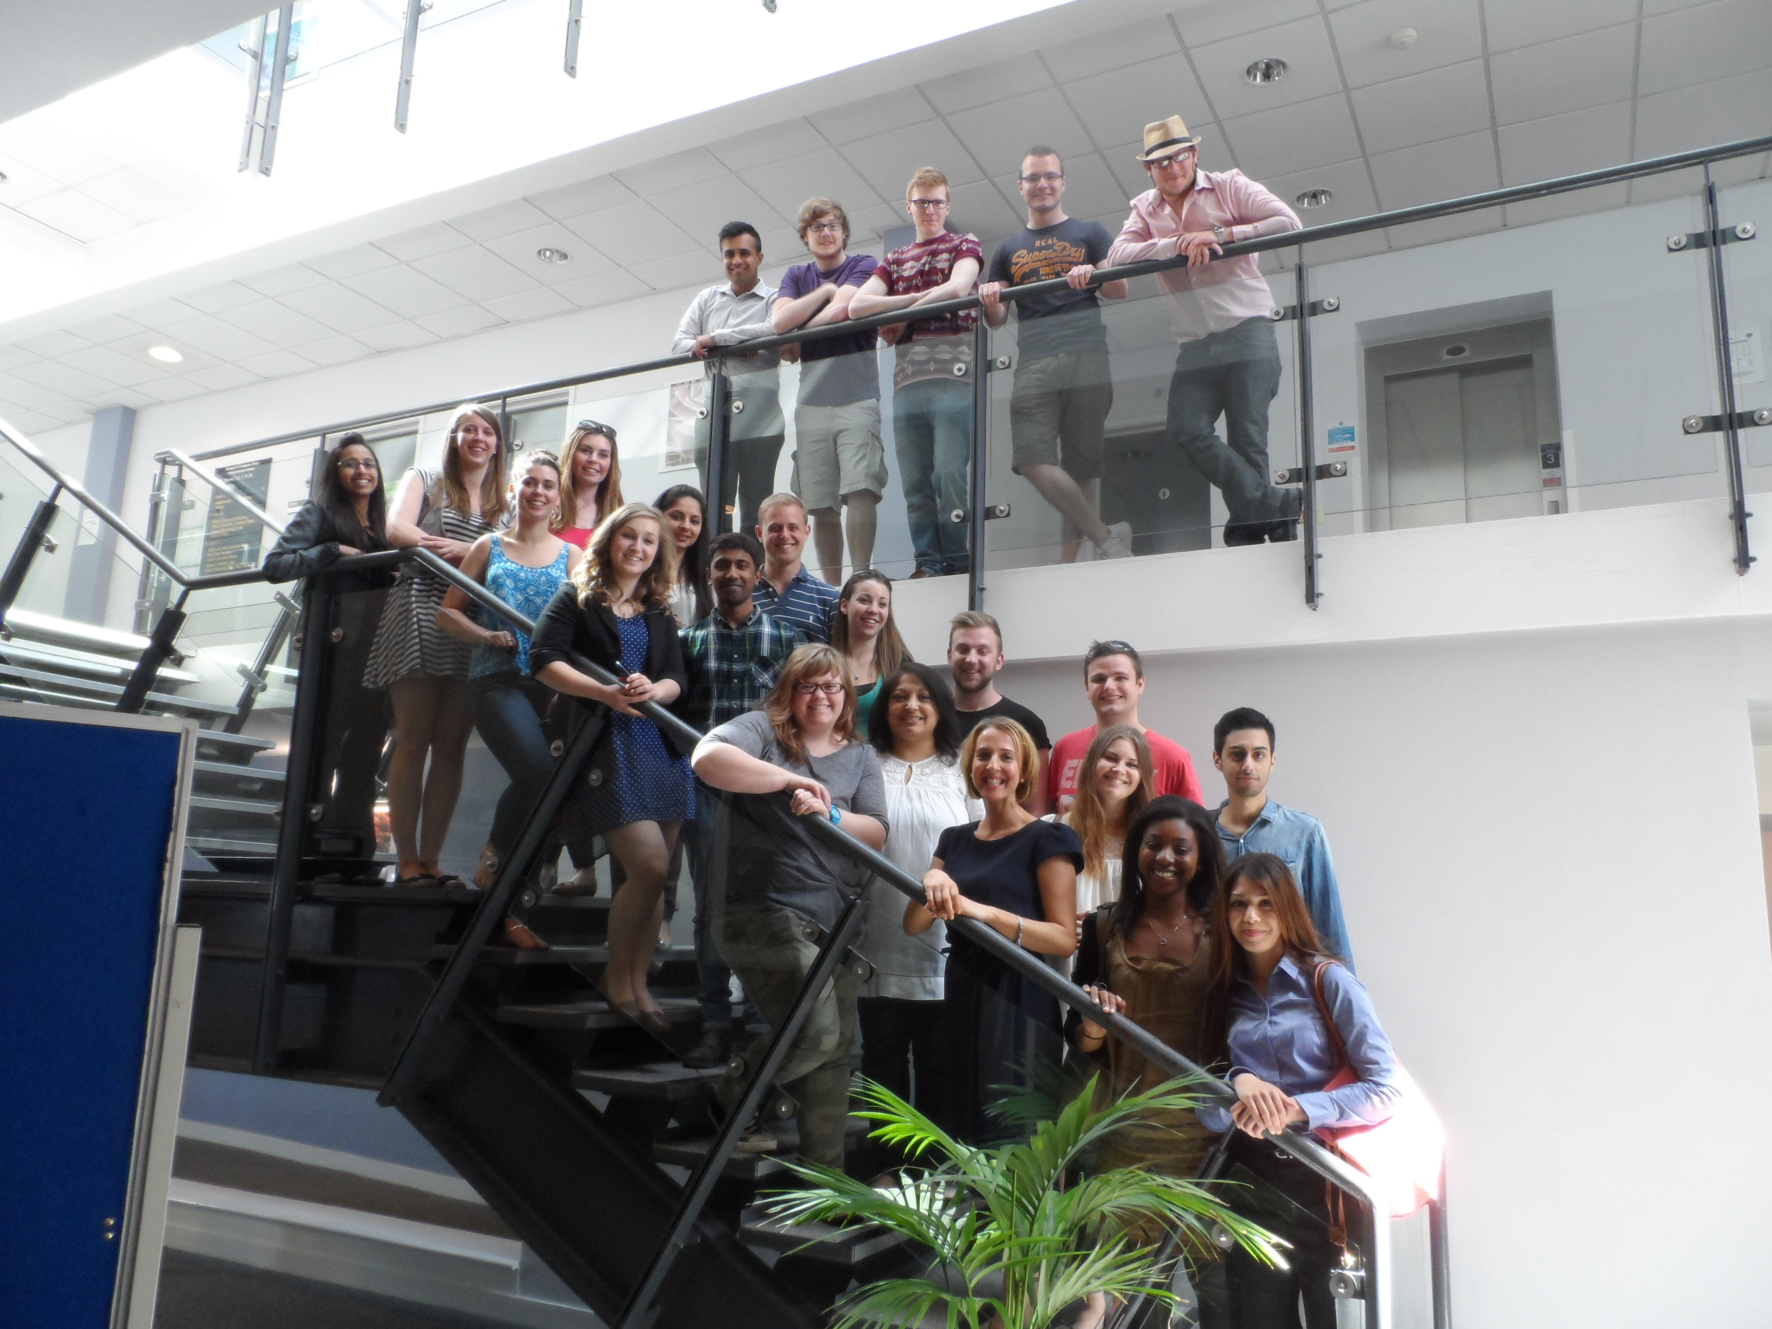
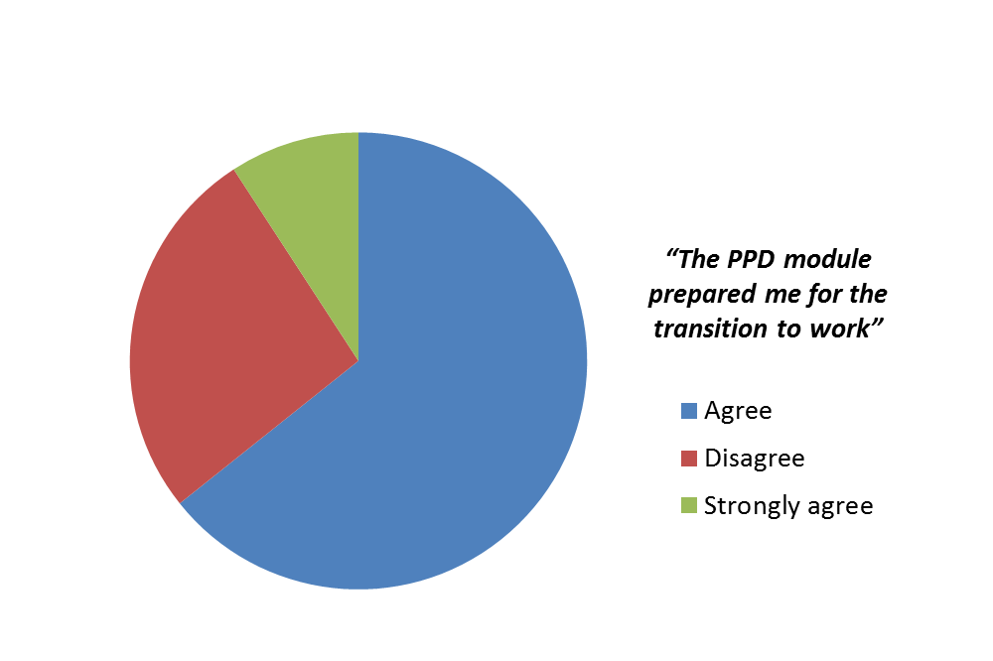
School of Medicine Division of Medical Sciences & Graduate Entry Medicine
Sharing expertise derived from professionalism teaching to improve the employability of our graduates
P. Hagan, D.P. McLaughlin, D.S. Tarmey,
Introduction
Methods in training the “professional doctor” can be adapted to develop professional skills in all graduates. In the establishment of our BSc programmes in Healthcare Science and Medical Physiology & Therapeutics, we used our experience of the medical professionalism curricula to develop a compulsory 20 credit final year professional development module; the first of its kind at Nottingham for a non-clinical programme.
Overview of the new PPD module for our non-clinical students
The module seeks to prepare students for the types of PPD activities that they will encounter in the global workplace. There is an emphasis on the development of core practical skills/competencies and the use of reflective practice, action planning and analysis of outcomes to monitor development and effectiveness.
Students are required to keep a PPD portfolio & maintain a record of practical skills/competencies gained over the course of the final year. The portfolio must contain copies of coursework & action plans agreed during meetings with their personal tutor.
Module learning outcomes
to demonstrate knowledge and understanding, through critical analysis/appraisal of: theories of reflective learning to support PPD activities, the use and value of reflective practice as a scientist
to demonstrate competency in: at least 5 practical skills
to demonstrate the ability to: undertake critical, reflective self-evaluation and maintain appropriate records of personal and professional development for inclusion in a portfolio
“Developing a portfolio was particularly good for the reflective writing piece. I found that I had to look at my journey throughout university as a whole and the progress and development that I had made for the three years; both personal and professional.”
“The reflection practice has come in very handy”
“Final year is when students begin to realise that the PPD module is relevant to them and does indeed benefit them, particularly when preparing for their journey beyond university, which can sometimes be a lost thought until that final year.”
“Perhaps a section on interview skills including practice interview sessions”
www.nottingham.ac.uk

