Slide 1
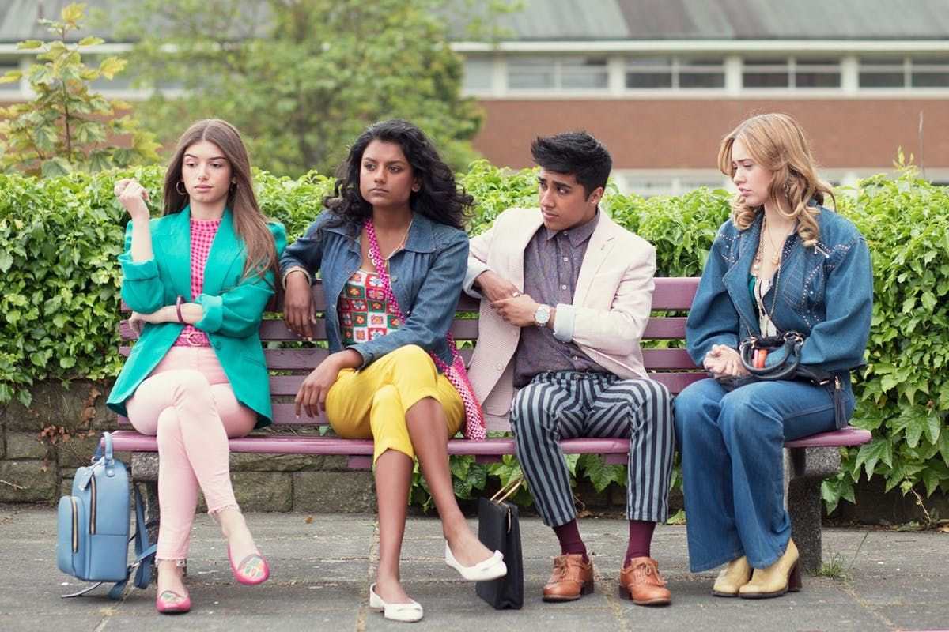
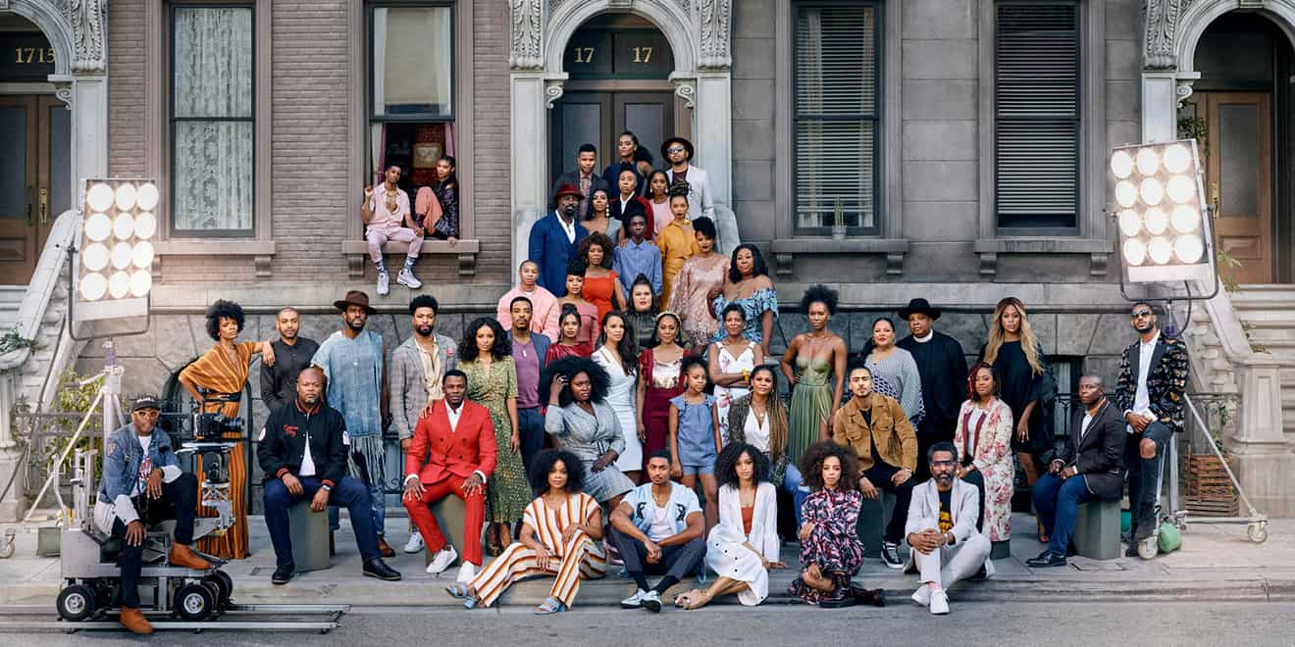
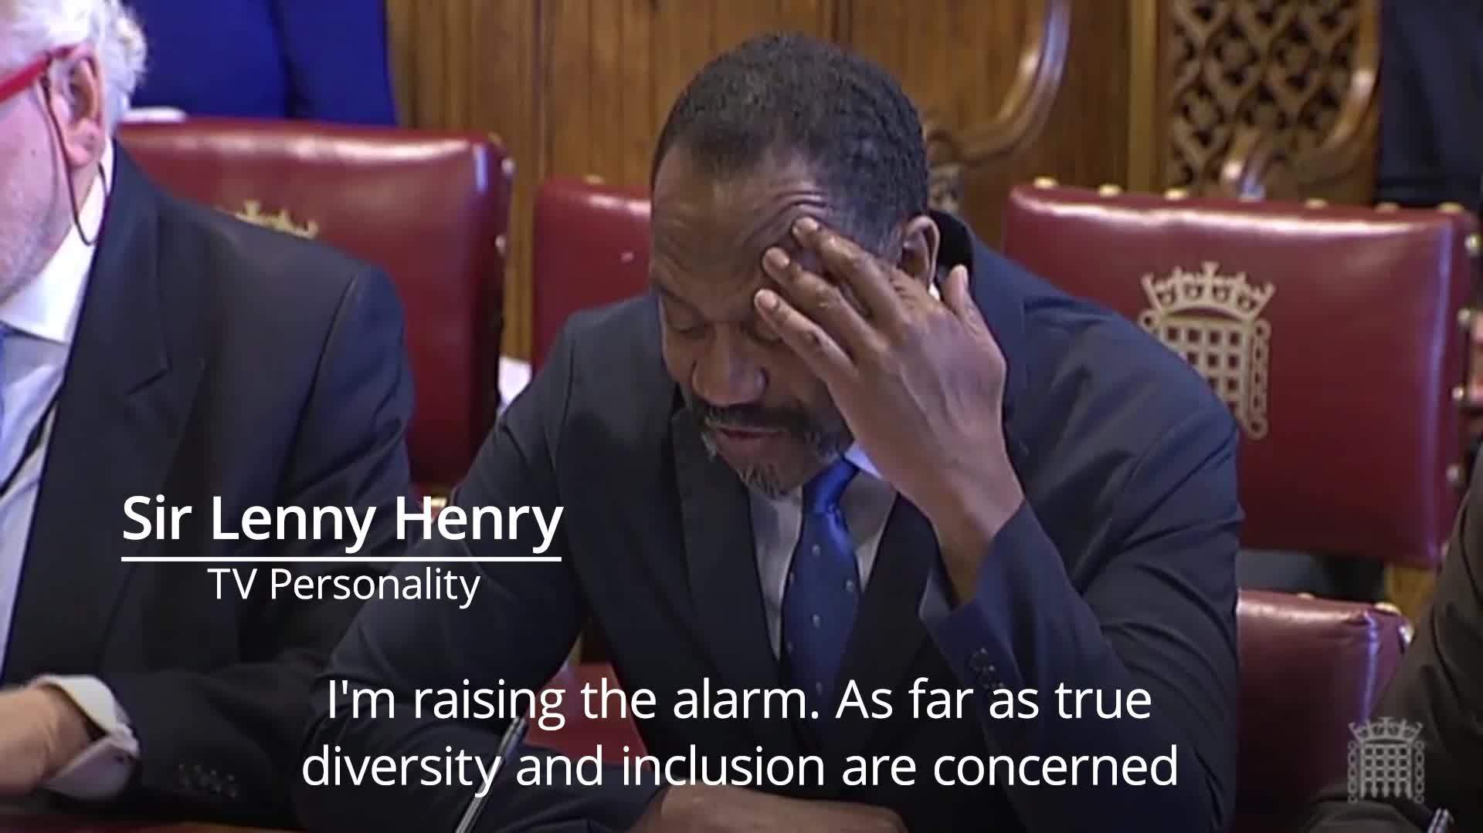
Streaming Diversity?
David Simmons, Research Coordinator

Slide 2
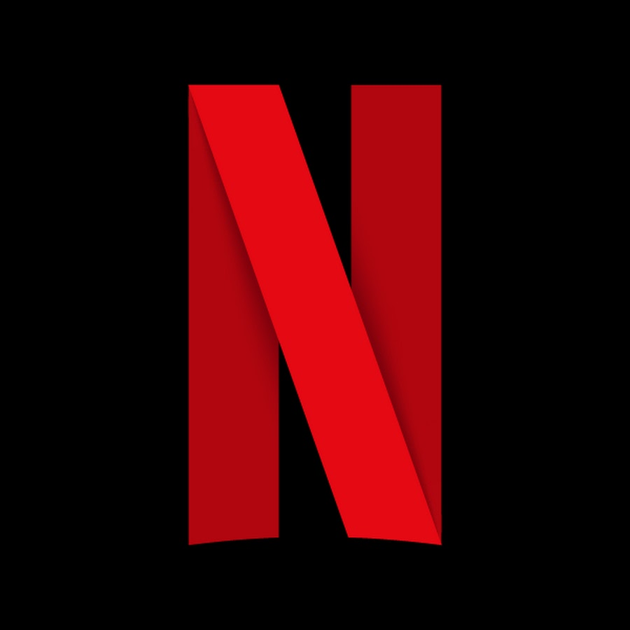
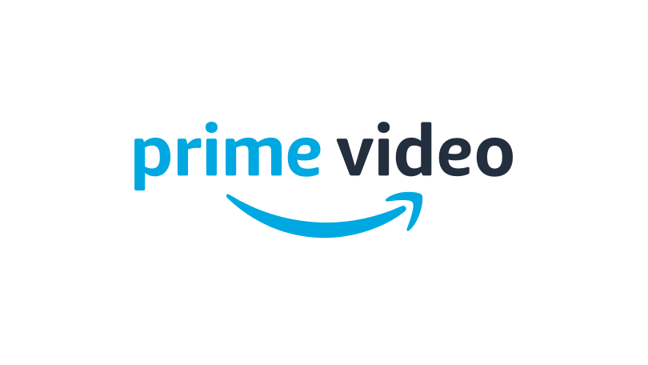
“We live, we might say, in a society of many commodities, many knowledges, and many cultures. Multiplicity is to be applauded only when it brings diversity, and the two are not necessarily the same, though they are closely related. Multiplicity is a prerequisite of diversity, but it does not necessarily entail it—more can all too often be more of the same. Equally, diversity thrives on multiplicity, but does not necessarily produce it.” (John Fiske, 1994, 239)
Is multiplicity in the contemporary media landscape bringing greater diversity?
Notes:
I want to start with this quote from John Fiske who writes about the contemporary media landscape
So that is the question that is underpinning my discussion here and that we might consider as we go through the day

Slide 3
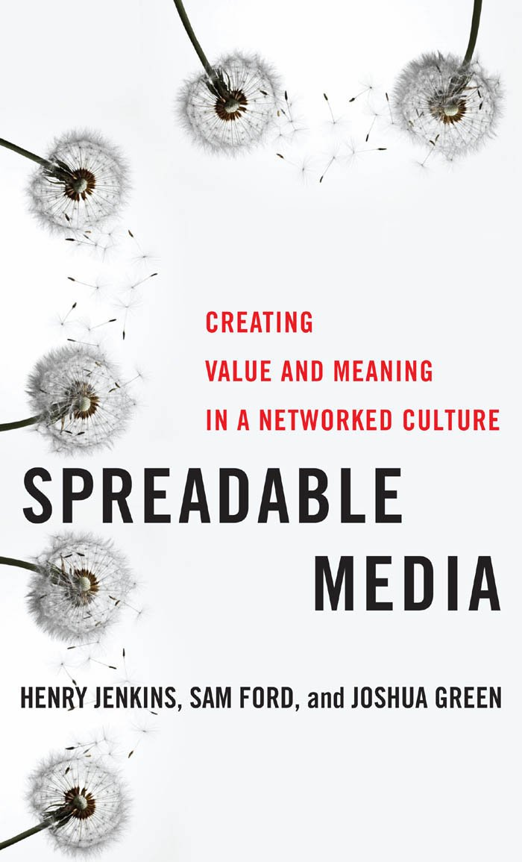
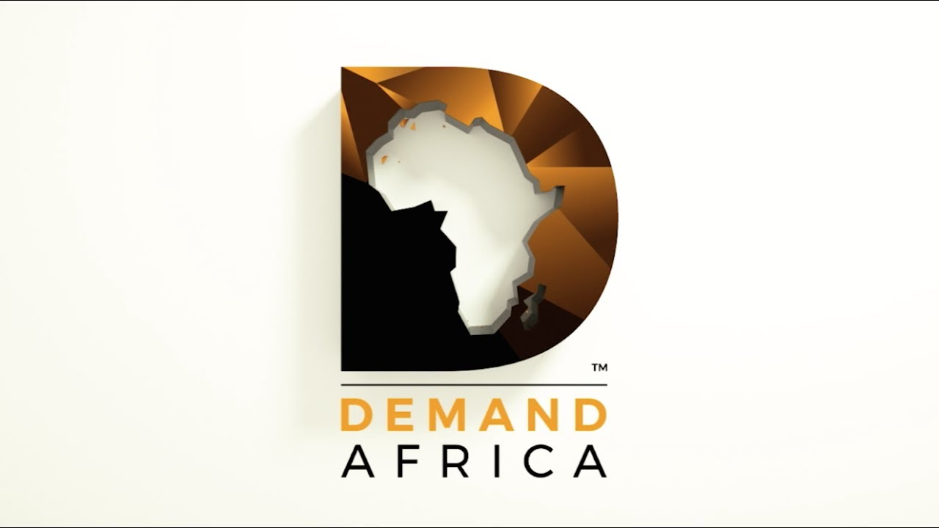
Spreadable Media (2013)
Chapter 7
Draws from the work of Arjun Appadurai
Spreadability and Diversity
Transnational Mediaflows
the authors suggest that the era of spreadable media has increased the diversity of offerings of transnational media
Ease with which someone in the UK can now access a host of VOD services from around the world? YuppTV, The Africa Channel, Demand Africa, LycaTV
Logical consequence of Jenkins argument is that transnational media flows will have a knock on effect on more traditional broadcasters such as the BBC, and VOD services such as Netflix
Notes:
Fiske’s discussion of the relationship between multiplicity and diversity seems to speak to the much more recent work by Henry Jenkins Sam Ford and Joshua Green in their hugely influential book, Spreadable Media. In particular in chapter 7 they explore the concept of transnational mediaflows and argue that the increased emphasis upon online services and platforms has increased the diversity of content that is being produced and which is accessible by those with access to high speed internet
For instance, it is now relatively easy for someone based in the Uk to access a host of VOD services that provide programming from around the world straight to their TV, computer or phone. Services like YuppTV and Demand Africa offer a range of south Asian and African content respectively while LycaTV offer a number of Filipino, Tamil, and African language channels all under one roof

Slide 4
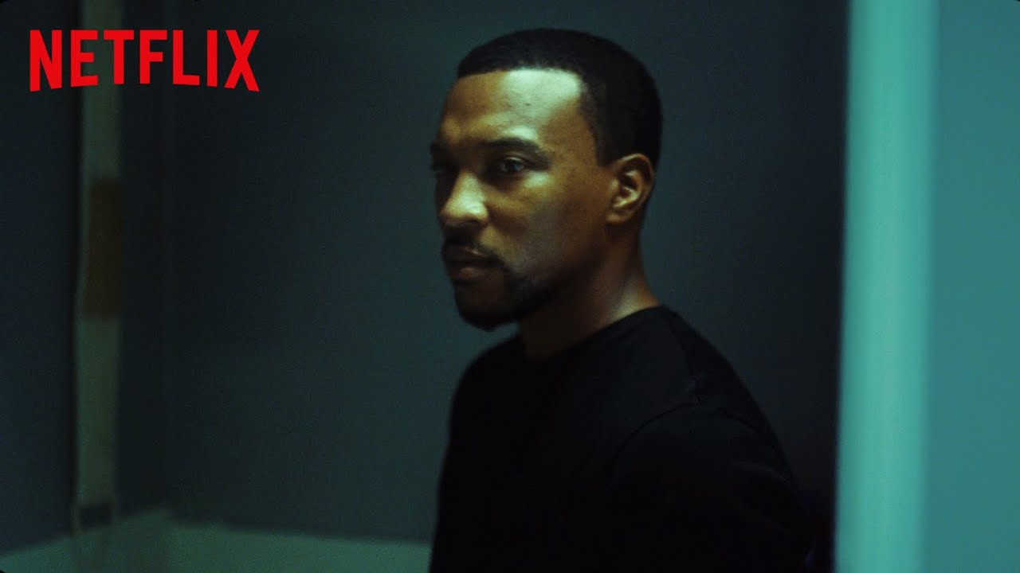
In an online interview in 2014 Jenkins suggested that some of the big questions remaining around spreadable or participatory media concern issues that are pertinent to our work here today:
“…involves struggles over representation as we push media companies to be more responsive to the public and to embrace a broader range of different forms of content that reflects the diversity of our culture.” (2014)
Notes:
Yet significantly, In a 2014 interview Jenkins expressed slightly more caution when discussing issues of diversity, stating that one of the key concerns for contemporary media

Slide 5
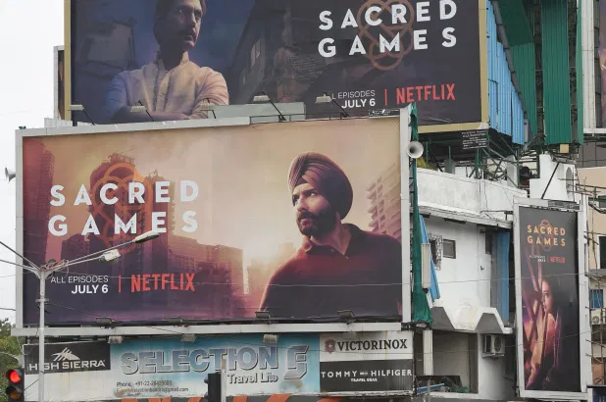
What relevance does this to have to streaming and VOD companies?
“To succeed, subscriber-funded services must offer enough programming that viewers find the service worthy of their monthly fee. Each show doesn’t need a mass audience – which is the measure of success for advertiser-funded television – but the service does need to provide enough value that subscribers continue to pay.” (Lotz, 2017)
So VOD services are constantly seeking out programmes that will get a different niche audience to subscribe or continue to subscribe.
Simon Albury, chair at the Campaign for Broadcasting Equality CIO charity, has suggested that in contrast to large traditional mainstream media organisations like the BBC:
"Subscription VODs are enabling BAME people to have their voice.“ (qtd in Shah)
Notes:
My focus here is going to be on how these concerns might relate to larger streaming companies such as Netflix.
To date much of the discussion around VOD services has seen them as enabling greater diversity in programming
As we can see with the quotes on this slide:
“It’s easy to see why Netflix and Amazon would want to expand their presence in India, and not just because it is home to 1.3 billion people. As in much of the viewing world, streaming has exploded in the country — at least 30 companies now offer video streaming services there, up from nine in 2012” (Arora, 2019)

Slide 6
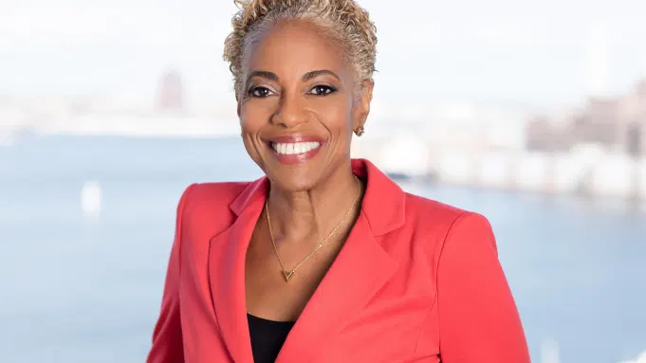
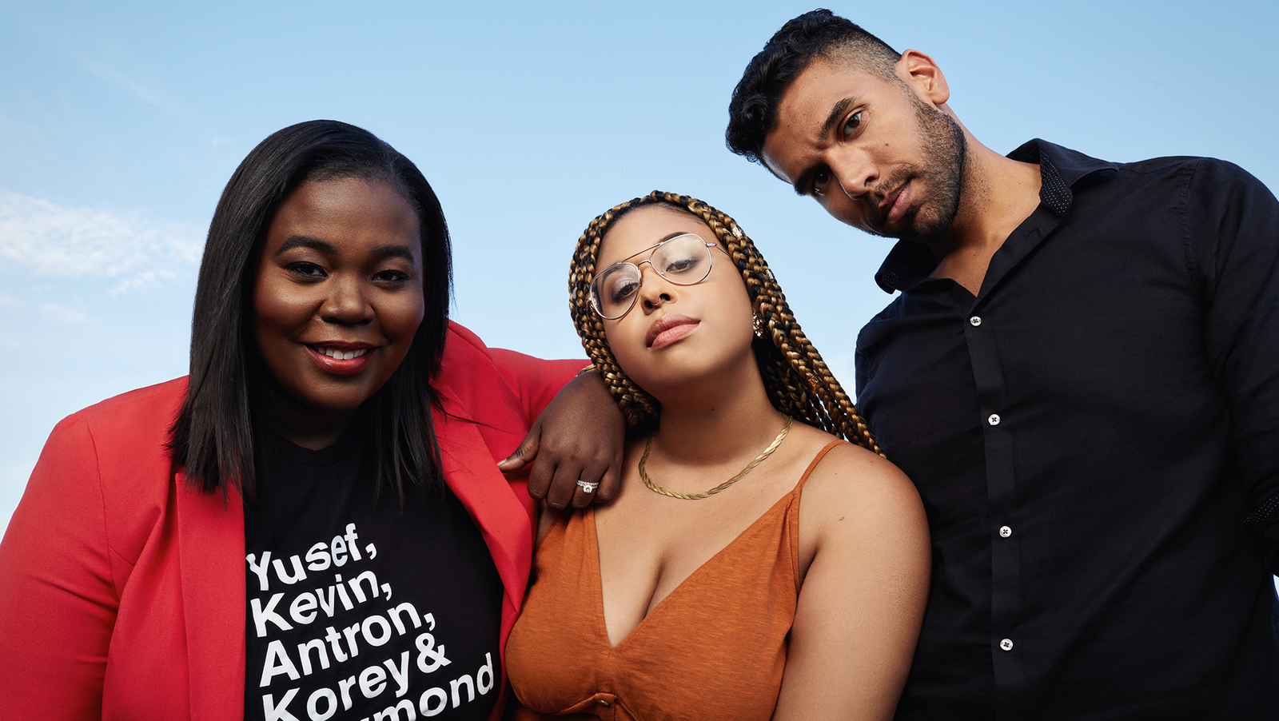
Netflix, Streaming Media and Diversity?
In 2018 Netflix hired Verna Myers as vice president for inclusion.
Maya Watson Banks, Jasmyn Lawson and Miles Worthington, managers of Brand and Editorial
The “Strong Black Lead“ Initiative, 2018-
social media presence has emphasised diversity through the construction of content designed to be spreadable, including YouTube interviews with the stars of their most popular shows (#FirstTimeISawMe), a regular podcast, and engaging with viewers via @strongblacklead (over 100,000 followers)
Notes:
Netflix in particular has been very successful in leveraging social media as an effective means of speaking to those with an interest in more diverse programming
On to slide
IN 2018 Netflix hired Verna Myers as vice president for inclusion, and from 2018 onwards Netflix has run the Strong Black Lead Initiative which has used social media platforms and content designed to be spreadable on platforms such as Youtube and Twitter to emphasise the company’s interest in diversity
Examples of this include the FirstTimeISawme hashtag and the strong black lead twitter channel
Netflix has the ability to target programming at specific demographics using its viewership data, comedian and actor Lenny Henry said during the House of Lords Communications Committee hearing
https://www.youtube.com/watch?v=Hx7Nbm_px1c
Watership Down
Giri/Haji
Troy: Fall of a City
Dracula

Slide 7
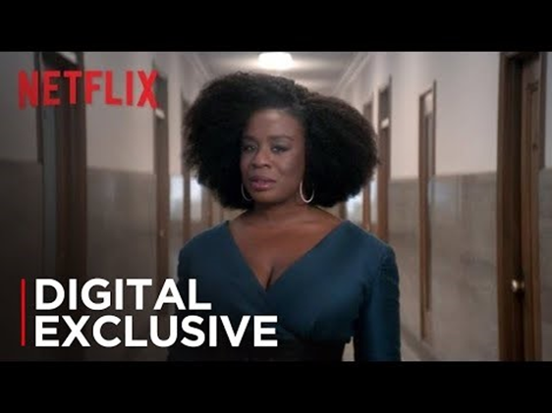
2018 “A Great Day in Hollywood” video released. Over 500,000 views on Youtube
2019 “Make Room” video released. Over 100,000 views on Youtube
Coverage across a number of outlets including Variety, Vogue, Oprah.com, and the BBC
Notes:
In 2018 Netflix produced the “A Great Day in Hollywood” video and in 2019 the “Make Room” video, both were released onto Youtube and social media platforms
Each video embodies the sort of direct address that Jenkins suggests is a recurrent characteristic of successful spreadable media, and each seems designed to create the impression that Netflix is a utopian space for diversity both in front of and behind the camera.
https://www.youtube.com/watch?v=OeyxR8WJiaI
Caleb mclaughlin
https://www.youtube.com/watch?v=Hx7Nbm_px1c
Uzo Aduba

Slide 8
Diversity and Multiplicity?
“The formula for Strong Black Lead’s success sounds simple enough: Gain the recognition and confidence of people of color by not just saying you support them, but by showing it, both in the work environment, the product, and the messaging. But it’s also about understanding the many shades and layers of its audience—because, as McLaughlin put it in “A Great Day in Hollywood,” there is “no one way to be Black.” (Jean-Phillipe, 2019)
Notes:
Perhaps ironically given the emphasis upon diversity, both of these videos, particularly, the first, which directly references the 1958 photograph by “A Great Day in Harlem” by Art Kane which featured 57 Jazz artists might be accused of reflecting the U.S. focus of the platform, and therefore rather than embodying the transnational flow that Jenkins et all discuss in spreadable media Netflix instead becomes part of the one way flow that Milly Buonanno discusses as a soft form of cultural imperialism in her book The Age of Television (2007)

Slide 9
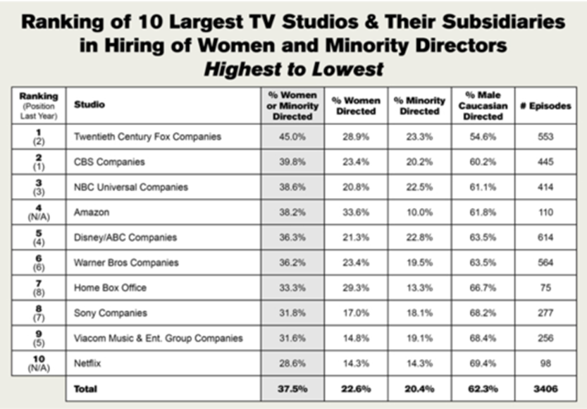
In 2017, Netflix was ranked lowest among 10 U.S. studios for the diversity of its film and TV directors, according to a Directors Guild of America study.
Notes:
Indeed, it is important to note that in some key areas, there remains serious issues related to a lack of diversity at Netflix and at other well known VOD companies
In a 2017 study by the Directors Guild of America Netflix was ranked lowest among 10 U.S. studios for the diversity of its film and Tv directors
While a more recent study by the university of southern California found that Amazon, Hulu and Netflix still lagged behind other broadcasters in terms of Under Represented groups working behind the camera

Slide 10
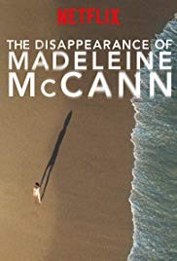
Top 10 Most Popular Releases of 2019 (UK):
The Disappearance of Madeleine McCann
6 Underground
Murder Mystery
The Witcher
The Irishman
After Life
Stranger Things 3
Our Planet
Sex Education
Conversations with a Killer: The Ted Bundy Tapes: Limited Series
Notes:
A little closer to home, while other national top 10s of Netflix’s most watched shows in 2019 included such diverse fare as Orange is the New Black, Always be my Maybe, Sacred Games and When they see us, the UK top 10 was notable for its lack of diversity, with only Sex Education possibly passing the Ava Duvernay test

Slide 11
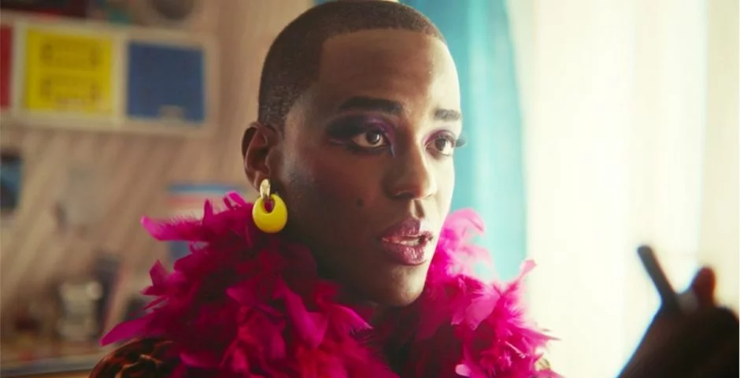
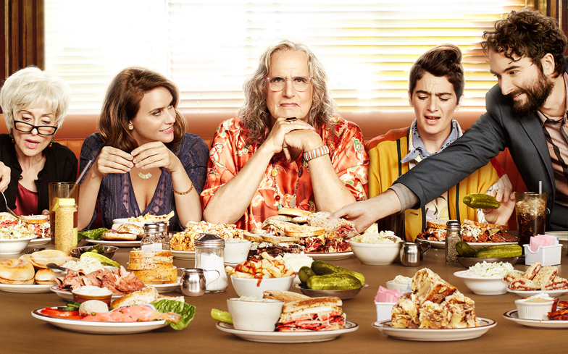
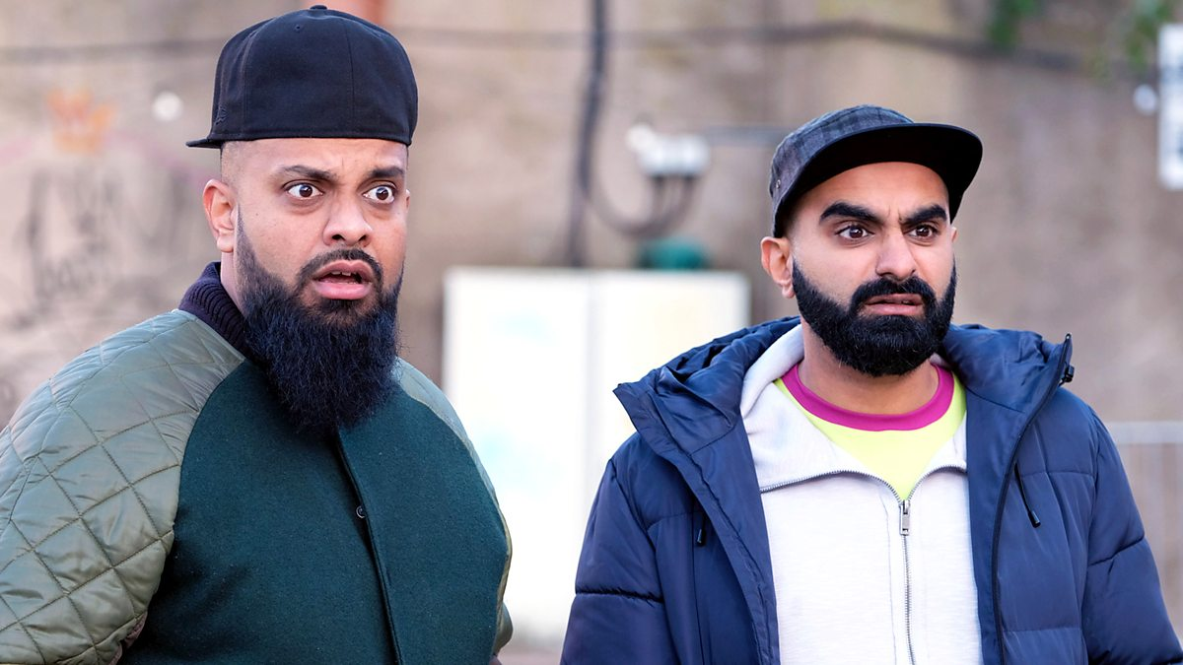
September 2019 Netflix revealed it will be spending £400 million on making more than 50 TV shows and films in the U.K.
Ramon Lobato suggests “The general pattern is that audiences still want television in their own language, with familiar faces and culturally relevant stories.” (Netflix Nations: 182)
What sort of shows should Netflix (and other VOD providers) be making?
How can such content providers ensure they represent a diversity of experience relevant to UK audiences?
With the growing number of ‘specialist’ VOD, providers (such as Hotstar, YuppTV, BenTV and Demand Africa) should larger companies like Netflix worry about diversity?
In what ways can VOD providers utilise spreadable media/social media to promote diversity?
Notes:
So, in light of the information that in….
I’d like to end with the following questions

Slide 12
Works Cited
Anderton, Joe. “Netflix UK and Ireland Confirms Its Most Popular Releases of 2019 – and The Crown Season 3 Didn’t Make the Cut.” Digital Spy. 30/12/2019. Available at: https://www.digitalspy.com/tv/ustv/a30359470/netflix-uk-ireland-most-popular-releases-2019/
Anonymous. “DGA 2016-2017 Episodic TV Director Diversity Report: Employer Hiring of Women and Minority Directors Up in Record 2016-2017 TV Season.” Shoot Publicity Wire. Nov 14 2017. Available at: https://www.shootonline.com/spw/dga-2016-17-episodic-tv-director-diversity-report-employer-hiring-women-and-minority-directors
Fiske, John. Media Matters: Race and Gender in U.S. Politics. 2nd Ed. London and New York: Routledge, 2016.
Jean-Phillippe, McKenzie. “The Team Behind Netflix’s Strong Black Lead Wants to Bring More Melanin to Your Queue.” The Oprah Magazine. Aug 9, 2019. Available at: https://www.oprahmag.com/entertainment/a28634227/strong-black-lead-netflix-team/
Jenkins Henry, Sam Ford and Joshua Green. Spreadable Media: Creating Value and Meaning in a Networked Culture. New York: New York University Press, 2013.
Lobato, Ramon. Netflix Nations: The Geography of Digital Distribution. New York: New York University Press, 2019.
Lotz, Amanda. “The Unique Strategy Netflix Deployed to Reach 90 Million Worldwide Subscribers.” The Conversation. April 5 2017. Available at: http://theconversation.com/the-unique-strategy-netflix-deployed-to-reach-90-million-worldwide-subscribers-74885
Shah, Saqib. “BBC Losing Viewers to Netflix due to lack of diversity, says industry reps.” S&P Global Market Intelligence. 12 June 2019. Available at: https://www.spglobal.com/marketintelligence/en/news-insights/trending/CkNeWLg_hZTnlPX7lNU9Bw2
Stein, Louisa, moderator. 2014. "Spreadable Media: Creating Value and Meaning in a Networked Culture" [roundtable]. Paul Booth, Kristina Busse, Melissa Click, Sam Ford, Henry Jenkins, Xiaochang Li, and Sharon Ross, respondents. Transformative Works and Cultures, no. 17. Available at: https://doi.org/10.3983/twc.2014.0633.

