Slide 1
BA1 & BA2 Primary & Early Years : School Based Training Mentor Briefing
January 2024

Slide 3
Year 1 Tutor Team
Mark Stares – Year 1 Tutor and Senior Lecturer in Primary Education
Mark.Stares@bcu.ac.uk
Canis Kamran – Year 1 Tutor and Senior Lecturer in Primary Education
Canis.Kamran@bcu.ac.uk

Slide 4
Year 2 Tutor Team
Kath Minett-Waller – Year 2 Tutor and Senior Lecturer in Primary Science Education
Kath.Minett-Waller@bcu.ac.uk
John Barrington – Year 2 Tutor and Lecturer in Primary Education
John.Barrington@bcu.ac.uk

Slide 5
Primary Partnership Website
All documentation related to placements can be found on our Primary Partnership website:
Primary Partnership Website
You can also access all of our mentor CPD resources through this link as well as information about the BCU curriculum.

Slide 6
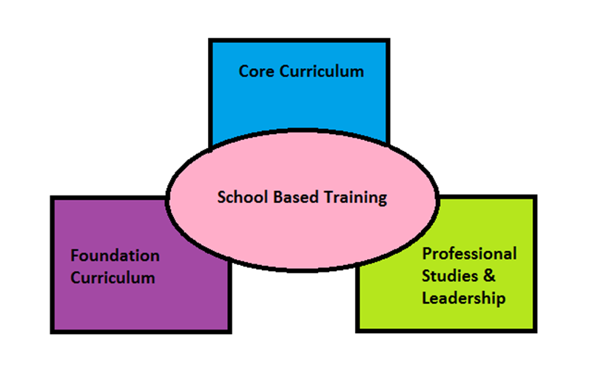
The BCU ITE Curriculum
Notes:
As we’ve said before, we have planned our BCU curriculum to ensure that all aspects of the ITT CCF are embedded either within our university based learning or school based training and that we have sequenced this in a way to make learning across the course meaningful and to enable you to revisit and build upon prior learning.
The next few slides give an example of what this might look like, using one subject from the Foundation module as an example.
To accompany spiral curriculum image: ref: Bruner - learning is a continuous process and that a student is learning to learn. Bruner believed that students learned using knowledge they already had. Using previous knowledge the student continually building on what they have already learned and expand their base of knowledge.
Building schemas

Slide 7
The BCU ITE Curriculum
BCU ITE Curriculum Key Themes
A. Associate Teachers use critical enquiry and research informed practice to develop their understanding of effective teaching and learning.
B. Associate Teacher’s classroom practice establishes effective behaviour management using high expectations and awareness of pupil wellbeing.
C. Associate Teacher knows more, remembers more and applies subject knowledge and subject specific pedagogy to impact on pupils’ progress.
D. Associate Teacher uses knowledge about how pupils learn to plan and assess learning to ensure that all pupils make progress.
E. Associate Teacher implements effective adaptive teaching approaches to support all learners’ needs, including SEND (Special Educational Needs and Disability) and EAL (English as an Additional Language) learners.
F. Associate Teacher demonstrates professional behaviours and contributes effectively to the wider life of the school.

Slide 8
Associate Teachers will share their subject specific development journal (SSDJ) with you so that you can see what has been covered during their university sessions during Year 1 and Year 2 and they can reflect on how this links to their practice in school.

Slide 9
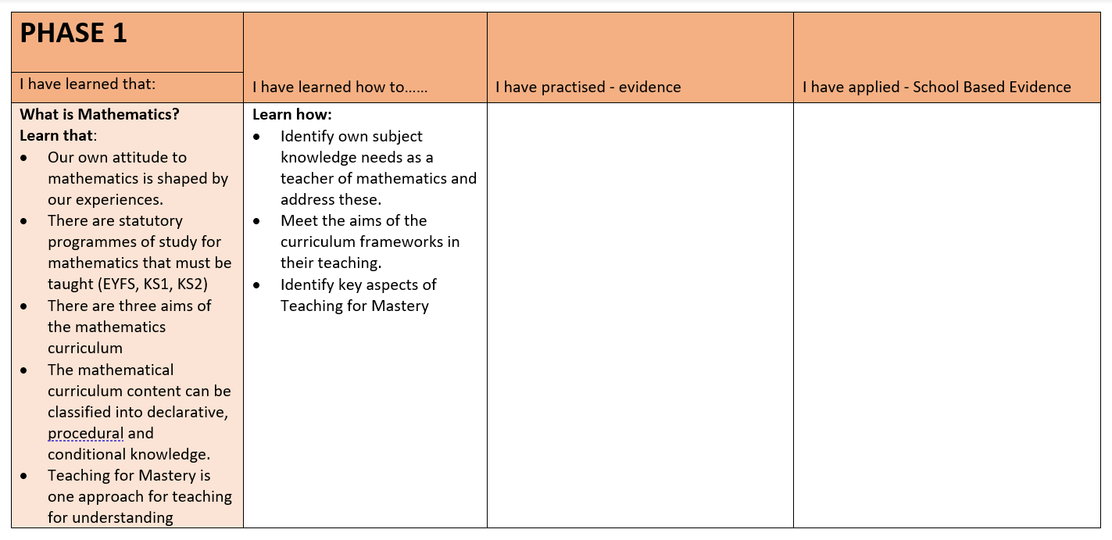
PHASE 2 Science | I have learned how to…… | I have practised - evidence | I have applied - School Based Evidence
I have learned that:
Session1 - they will be assessed for this module and how and when this will take place. - disciplinary knowledge is embedded within the NC programme of study,and needs to be taught explicitly rather than absorbed through practice. - substantive knowledge provides the context for developing disciplinary knowledge - there are different types of scientific enquiry - and appropriateness is dependent on the nature of the substantive knowledge being taught - children's attention and observation skills will be promoted through effective teacher questioning. This session: Substantive Knowledge - Life processes and living things - Plants Disciplinary Knowledge - Observation - Asking questions NB: Focus: 5-11 route Sessions need to cover Substantive knowledge, and more challenging concepts Life-processes: Chemical Processes: grouping materials and particle theory; Physical processes: forces (including magnets, gravity, air and water resistance, and friction) Rocks, fossils and soils Earth in Space | navigate the statutory curriculum documents (National Curriculum and EYFS) Self-reflect and plan for personal development with science subject knowledge. plan for process skills explicitly, and link with the teaching of substantive knowledge and conceptual understanding. create explicit appropriate learning objectives that incorporate elements of working scientifically alongside substantive knowledge plan investigative science and process skill across different types of enquiry, with choices appropriate to the nature of the investigative activity planned | 1 Date/s; | 1 Date/s;
 |  | 2 Date/s; | 2 Date/s;
 |  | 3 Date/s; | 3 Date/s;

Slide 10
BA Year 1 dates
Preliminary Visiting Days
Monday 15th January; Monday 22nd January; Monday 29th January; Monday 5th February; Monday 19th February; Monday 26th February; Monday 4th March; Monday 11th March; Monday 18th March; Tuesday 19th March; Wednesday 20th March
UT Sign Off Meeting
Week Beginning 18th March
Block Placement
Monday 15th April- Friday 24th May
Review Meeting Week Beginning 29th April
Progress Meeting Week Beginning 20th May

Slide 11
BA Year 2 Dates
Preliminary Visits: 17th, 18th, 24th and 25th January
29th January – 2nd February
UT Sign Off: WB: 29th January
Block Placement: 5th February – 9th February
19th February – 22nd March
Review Meeting: Week beginning 26th February
Progress Meeting: Week beginning 18th March

Slide 12
Safeguarding
Prior to placement Associate Teachers will have completed Home Office Prevent training and Level 1 Safeguarding Training
Associate Teachers will receive a Safeguarding Confirmation Letter from BCU and be expected to bring this into school with them
Notes:
Express importance – trainees will not go into school if this isn’t completed

Slide 13
Year 1 Professionalism and Expectations
We do have high expectations in regard to our student's professionalism and commiment, however please remember that they may only be 19 years of age. They will have had different life experiences, for example, some may never have used public transport before or been in a professional setting with children. Part of the course is the opportunity for them to mature both professionally and personally.
We have spoken and highlighted the following with students:
Making first contact with the school
Negotiating with the Class Teacher/Mentor arrival and leaving times (we have suggested 8.15am-4.00pm).
Dress Code
Being pro-active
Social Media

Slide 14
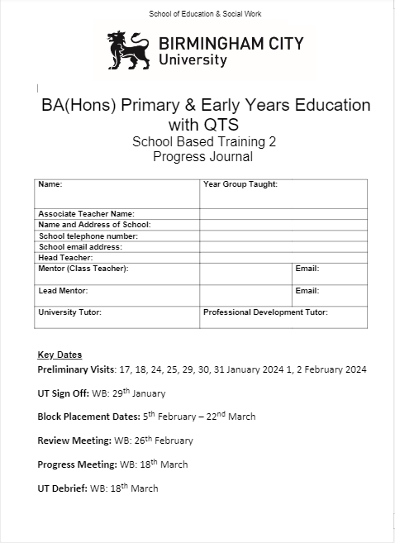

Slide 15
Progress Journal
It is the Associate Teachers responsibility to keep their Progress Journal up to date.
The Associate teacher should share their Progress Journal with their UT and Mentor via their OneDrive Associate Teacher Folder
Preliminary Tasks
Associate Teacher Learning Observation
Checklist of tasks that need to be completed for sign off (WB: 29.01.24)
BCU Assessment Tracker
Attendance register
Targets page
Weekly Meeting and Target Setting
Review/Progress Meetings
Critical Incidents

Slide 16
SBT Prelim Tasks
These are to be completed during PPSE days.
Linked directly with pre-approval checklist. (UT Sign off)
The Prelim Tasks are:
Safeguarding Prelim Task
Behaviour Prelim Task
Professional Behaviours
Learning Environment Prelim Task
Foundation and Phonics Learning Observations
All prelim task must be completed prior to the UT sign off meeting. (WB: 29.01.24)

Slide 17
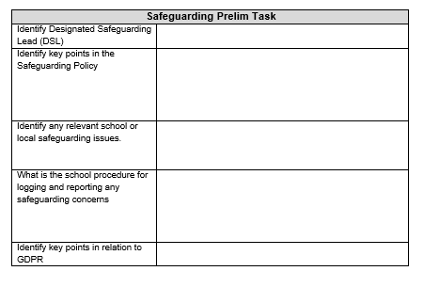

Slide 18
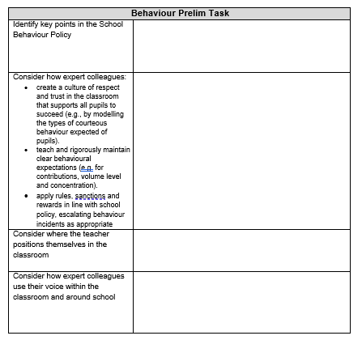

Slide 19
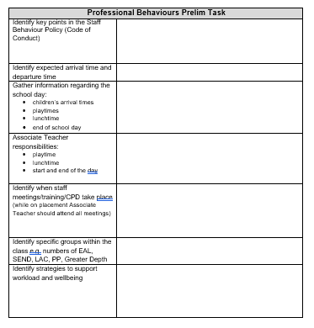

Slide 20
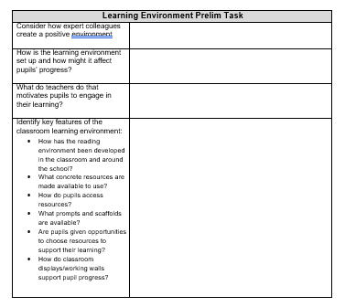

Slide 21
Associate Teacher Learning Observation
The minimum expectations in the preliminary visits of Learning Observations are:
One Core Subject
One Foundation Subject
One Phonics Session
Notes:
Refer trainees to pp3-8 of TP Booklet.

Slide 22
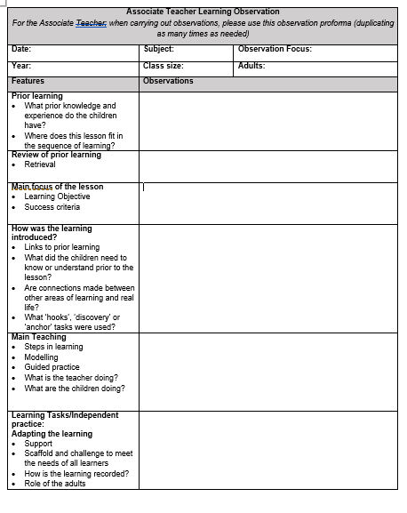
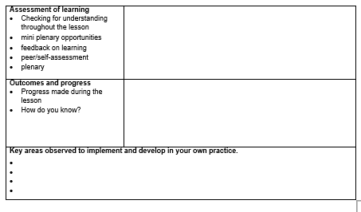

Slide 23
How to prepare for the School Based Training Block:
Develop an appropriate teaching timetable through negotiation between mentor (class teacher) and Associate Teacher.
Discuss targets and generate strategies for in-school support, this could include arranging to observe other colleagues in school.
Identify subject knowledge needs and appropriate activities/resources/ideas to support the planning process.
Identify a schedule for Weekly Meeting and Target Setting.
Identify relevant staff meetings that should be attended.
If, for any reason, you feel that the Associate Teachers is not ready to start the block experience, please contact the University Tutor.

Slide 24
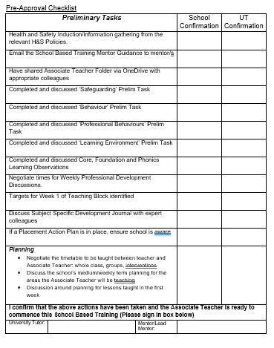
UT Sign off Meeting - Online
Associate Teacher should contact UT to arrange a time to meet via TEAMs
Targets should have been discussed
Associate Teachers will have to talk through the Pre-Approval checklist
Associate Teachers will be in school on this day but will need time to meet with their UT

Slide 25
Lesson Planning
Associate Teachers are expected to plan in full for all teaching commitments.
It is expected that the BCU Lesson/sequence of learning planning proforma.
This MUST be made available prior to teaching in good time for mentors to check and suggest/make amendments prior to teaching (recommended 48hrs prior to teaching – (to be agreed between Mentor and AT)
Planning MUST be available for all Observed lessons (UT visits)

Slide 26
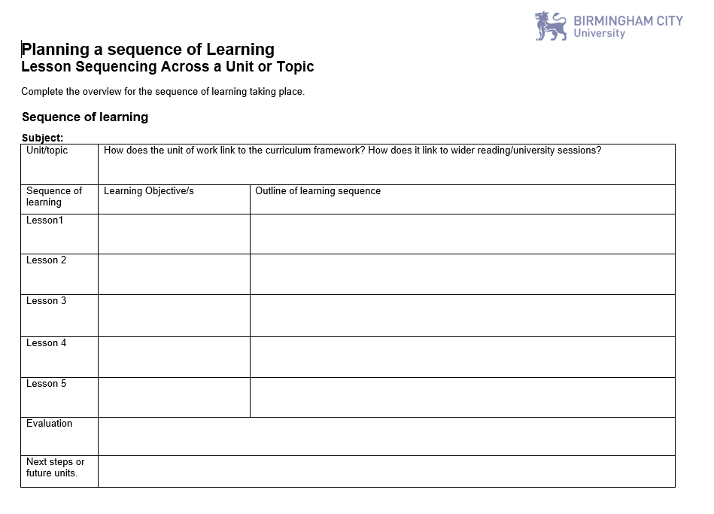

Slide 29
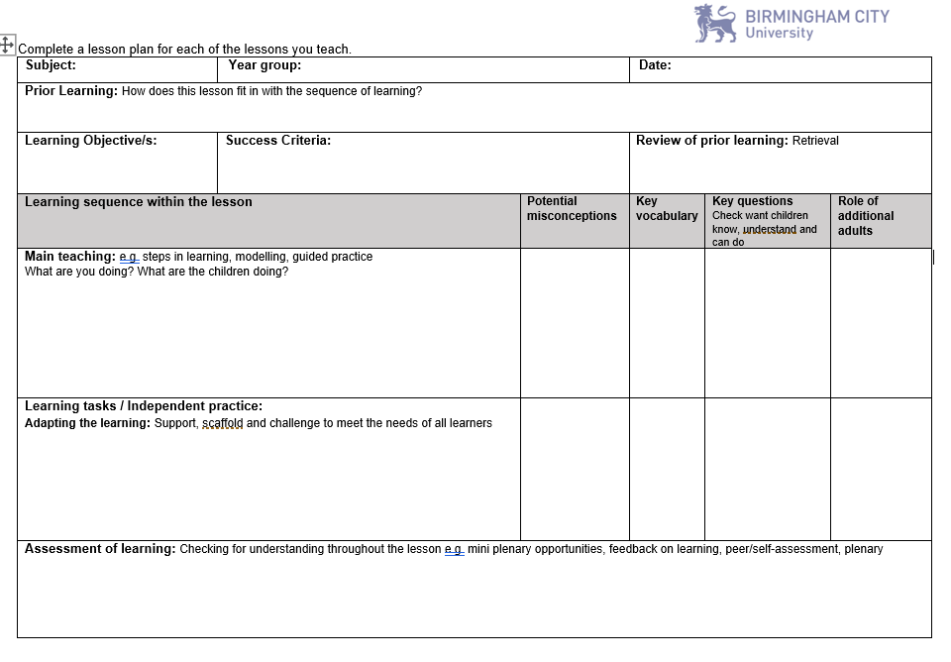

Slide 30
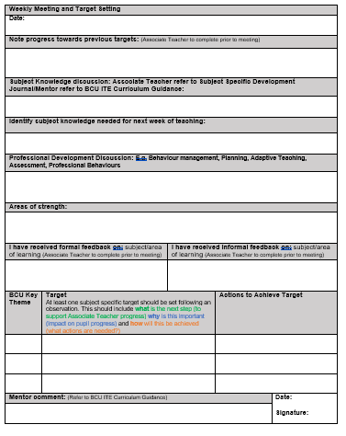
Weekly Meeting & Target Setting
These meetings provide an opportunity to identify what has been learnt and how the Associate Teachers has learnt it.
It is also an opportunity to discuss strengths and skills, knowledge and practice needed to develop.
Review targets set from the week before and set new targets
Please comment on progress towards the BCU curriculum
SSDJ and PSDJ to be available for reflection and discussion

Slide 31
Weekly Meeting & Target Setting
Associate Teachers should be sharing their Subject Specific Development Journal (SSDJ)at the Weekly Meetings. They should be talking to you about how their subject knowledge has developed with links to learning from university and how they have applied it in the classroom.

Slide 32
Weekly Meeting & Target Setting
Comments should be made relating to Professional Studies such as Behaviour Management, relationships with parents/carers, the wider roles and responsibilities of a teacher, planning and assessment.

Slide 33
Target Setting

Slide 34
Focus on Target Setting
Target Setting: At least one subject specific target should be set following an observation. This should include what is the next step (to support Associate Teacher progress) why is this important (impact on pupil progress) and how will this be achieved (what actions are needed?)
PE EXAMPLE:
To scaffold the learning to enable all children to demonstrate the skill of jumping from 2 feet to 2 feet using the STEP model.
MATHS EXAMPLE
To use concrete resources for column addition to ensure secure procedural knowledge by modelling methods using concrete resources and provide opportunities for pupil to use them alongside the abstract.
HISTORY EXAMPLE
To embed effective use of timelines in your history teaching in order to develop and secure children’s chronological knowledge by revisiting university taught sessions for specific examples and including them within your history planning and teaching.

Slide 35
Teaching on placement SBT1
From the start of the block placement Associate Teachers should be teaching one lesson per day
By the end of the placement, Associate Teachers will be teaching a 50% timetable
Teaching should be predominately whole class teaching, but can include elements of team teaching, teaching of small groups and interventions.

Slide 36
Teaching on placement SBT2
Associate Teachers will start at a 50% teaching timetable moving to a 60% teaching commitment.
By week three Associate Teachers should be teaching 60% of the time whether that is whole class, intervention groups or one to one intervention.
This school-based learning is designed to build upon Associate Teachers’ knowledge and understanding of teaching and learning, assessment and behaviour management strategies developed through the taught programme and from previous School Based Training.
Associate Teachers have had input on research informed practice and some experience of:
planning and assessing the core and the foundation subjects
the national curriculum and the challenges that schools face in developing planning and assessment processes
theories related to behaviour management strategies, learning, formative and summative assessment processes, safeguarding, SEN
planning, teaching, and assessing small groups, one to one interventions and whole classes.
Associate Teachers on 3-7 route will have had experience of teaching, planning and assessment in EYFS.

Slide 37
Lesson observations
Please use the BCU Lesson Observation Feedback Form
Subject Feedback Prompts are there to support with subject specific observation feedback – these can all be accessed on the Primary Partnership Website
Primary and Early Years partnerships - Overview - School of Education and Social Work | Birmingham City University (bcu.ac.uk)
First formal lesson observation in Week 1 of School Based Training block
One formal observation per week
One joint observation per School Based Training UT and a school mentor

Slide 38
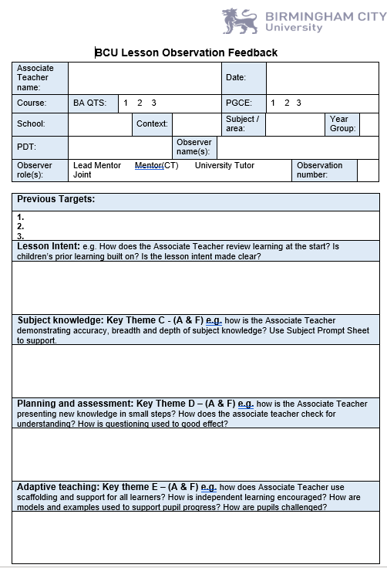
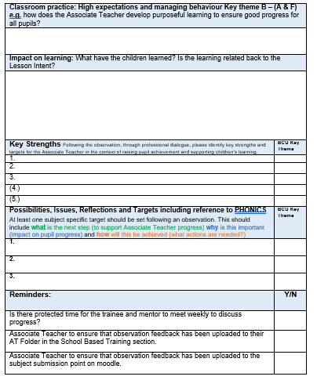

Slide 39
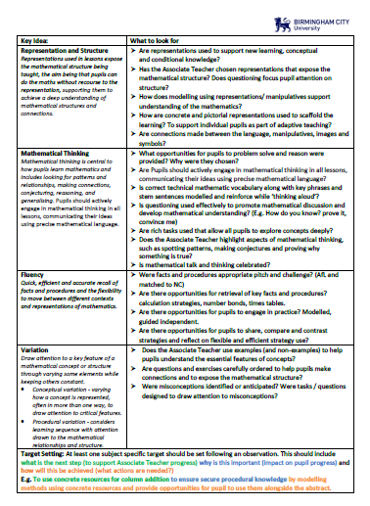
Subject Specific Feedback Prompts

Slide 40
Critical Incident - Definition
Critical incidents are learning situations that lead to significant learning and personal professional growth.
A critical incident does not need to be a serious or dangerous event; rather “critical” is to be interpreted as relevant or important that would require more in-depth reflections.
These are to be supported by relevant/current reading and reading (refer back to SSDJ)
Supported with upto 5 pieces of evidence

Slide 41
Critical Incident
At each Review/Progress Meeting Associate Teachers will present to whoever is completing the meeting a Critical Incident that demonstrates progress towards the BCU Curriculum Key Themes and ultimately the Teachers Standards.
The Critical Incident must show that the Associate Teacher can present and discuss with expert colleagues:
INTENTION
IMPLEMENTATION
IMPACT

Slide 42
Critical Incident
Prior to each Review/Progress Meeting the Associate Teacher will need to prepare a Critical Incident.
They can use evidence to support their Critical Incident.
Up to 5 pieces of evidence maximum to demonstrate progress towards the BCU Curriculum Key Themes.
Critical Incident gives an opportunity for the Associate Teacher show how they are progressing and developing.

Slide 43
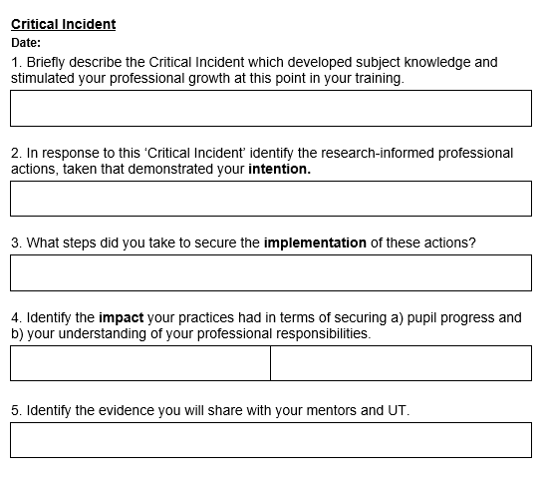

Slide 44
Progress Tracker
The purpose of the Progress tracker is to track and record the progress each AT is making against the BCU Key Themes.
The tracker will be revisted nad updated at the end of each weekly meeting. This will evidence what the AT has achieved to date and will also allow you to consider next step targets.

Slide 45
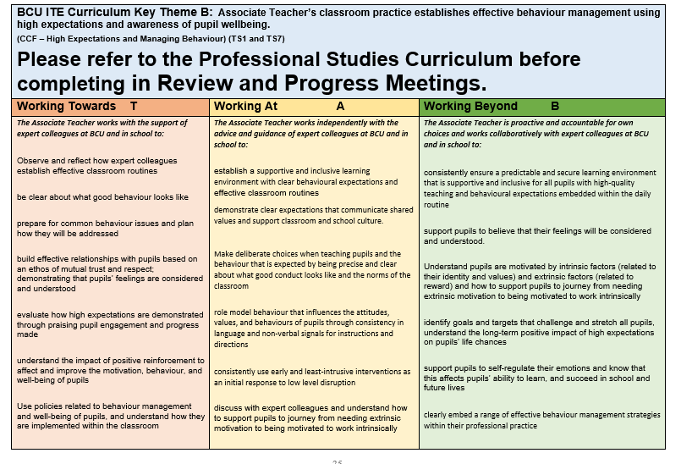
The BCU Assessment Tracker

Slide 47
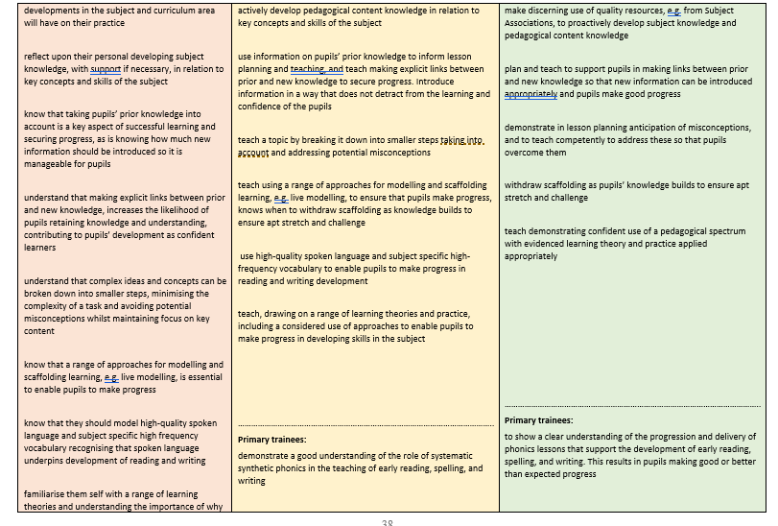

Slide 48
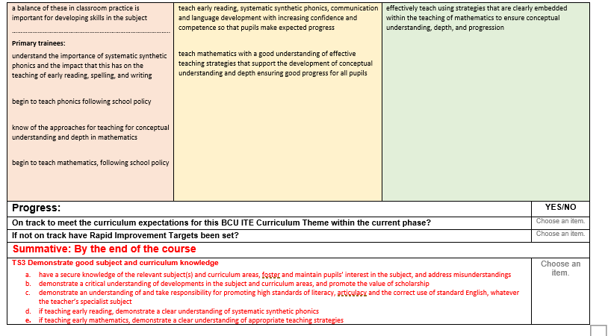

Slide 49
Review Meeting 1 and Progress Meeting 1
Review Meeting 1:
UT (either in-person or online), class teacher/mentor, and Associate Teacher. Observation feedback discussion. Sharing Critical Incident. Progress against BCU Key Themes.
Progress Meeting 1:
UT (either in-person or online), class teacher/mentor, and Associate Teacher. Observation feedback discussion. Sharing Critical Incident. Progress against BCU Key Themes.
Notes:
Reinforce the importance of trainees preparing fully for their weekly professional development discussions by completing the weekly reflection grid.

Slide 50
Review Meeting 2 and Progress Meeting 2
Review Meeting 1: WB: 26th February 2024
UT (either in-person or online), class teacher/mentor, and Associate Teacher. Observation feedback discussion. Sharing Critical Incident. Progress against BCU Key Themes.
Progress Meeting 1: WB: 18th March 2024
UT (either in-person or online), class teacher/mentor, and Associate Teacher. Observation feedback discussion. Sharing Critical Incident. Progress against BCU Key Themes.
Notes:
Reinforce the importance of trainees preparing fully for their weekly professional development discussions by completing the weekly reflection grid.

Slide 51
Assessment of School Based Training​
Review Meetings and Progress Meetings
When making a judgement for the Review / Progress Meeting consider the Associate Teacher’s overall performance to date and make a ‘best fit ‘judgement based upon performance against all of the BCU Curriculum Key Themes as recorded in the BCU Assessment Tracker.
Review the Associate Teacher’s progress and attainment against Part 2 of the Teachers’ Standards.

Slide 52
Assessment of School Based Training
Review Meeting 1 (BA Y1 Associate Teachers)
When making a judgement for the Review Meeting consider the Associate Teacher’s overall performance to date and make a ‘best fit ‘judgement based upon performance against all of the BCU Curriculum Key Themes as recorded in the BCU Assessment Tracker.
Review the Associate Teacher’s progress and attainment against Part 2 of the Teachers’ Standards.
Review Meeting 1 (SBT1) Associate Teachers who are on track to be awarded QTS at the end of the course will be demonstrating their competence in some of the BCU Curriculum Themes at Working Towards level.
Associate Teacher requiring improvement is not able to demonstrate their competence in some elements of the BCU Curriculum Themes at Working Towards level and/or not fully engaged or responding to advice and feedback. The Associate Teacher will be subject to the Rapid Improvement process and targets and strategies for improvement will be identified and a Rapid Improvement Targets (RIT) form will be completed.

Slide 53
Assessment of School Based Training
Progress Meeting 1 (BA Y1 Associate Teachers)
Progress Meeting 1 (SBT1) – Associate teachers who are on track to be awarded QTS at the end of the course will be demonstrating their competence in 75% of each BCU Curriculum Theme at the Working Towards level.
Associate Teachers requiring improvement are demonstrating their competence in less than 75% of each of the BCU Curriculum Themes at Working Towards level and/or not fully engaged or responding to advice and feedback. The Associate Teacher will be subject to the Rapid Improvement process and targets and strategies for improvement will be identified and a Rapid Improvement Targets (RIT) form will be completed to be shared with the next placement school.
Associate Teachers not demonstrating their competence in at least 50% of elements in each of the BCU Curriculum Themes at Working Towards level and/or not fully engage or responding to advice and feedback will have failed SBT1.

Slide 54
Assessment of School Based Training
Review Meeting 2 (BA Y2 Associate Teachers)
Associate teachers who are on track to be awarded QTS at the end of the course will be demonstrating their competence in 75% of each BCU Curriculum Theme at the Working Towards level.
Associate Teachers requiring improvement are demonstrating their competence in less than 75% of each of the BCU Curriculum Themes at Working Towards level and/or not fully engaged or responding to advice and feedback. The Associate Teacher will be subject to the Rapid Improvement process and targets and strategies for improvement will be identified and a Rapid Improvement Targets (RIT) form will be completed.

Slide 55
Assessment of School Based Training
Progress Meeting 2 (BA Y2 Associate Teachers)
Associate teachers who are on track to be awarded QTS at the end of the course will be demonstrating their competence in all elements in all of the BCU Curriculum Themes at the Working Towards level and elements in the Working At Level.
Associate Teachers requiring improvement are demonstrating their competence in all elements of all of the BCU Curriculum Themes at Working Towards level and/or not fully engaged or responding to advice and feedback. The Associate Teacher will be subject to the Rapid Improvement process and targets and strategies for improvement will be identified and a Rapid Improvement Targets (RIT) form will be completed to be shared with the next placement school.
Associate Teachers not demonstrating their competence in 75% of each BCU Curriculum Theme at the Working Towards level and/or not fully engaged or responding to advice and feedback will have failed SBT2.

Slide 56
Rapid Improvement Target
Issued if Associate Teachers:
Are not making expected progress;
Are not demonstrating high standards of personal and professional conduct.
All RIT’s should be emailed to:
primaryandearlyyearsbayear2team@bcu.ac.uk
Details of the process will be explained if necessary.
Notes:
Having several RIT’s for the same areas with no development can result in a failed placement

Slide 57
Termination of Placements
Where a termination of placement occurs the circumstances are considered by the Placement Review Panel and recommendations made regarding further placements and actions to be undertaken.
Resitting a School Based Training placement, as a consequence of a failed first attempt, will incur a cost to the trainee of £1125. The trainee may be eligible for funding, but this should be discussed with Student Finance England direct to confirm details and determine whether there is eligibility.
There may be exceptional circumstances where this fee can be waived; however the tutor will confirm this in writing to the trainee where such a circumstance will apply.

Slide 58
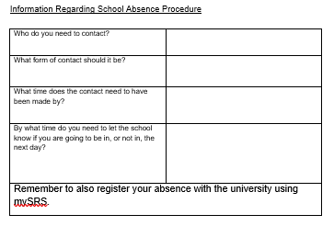
Attendance and Absence Procedure
Associate Teachers should follow the School Absence Procedure.
This is one of the first tasks they should do on their prelim visits.

Slide 59
Mentor Support - Access to all our University documentation, mentor CPD and partnership information.
Primary Partnership Website

Slide 60
Mentor Support - upcoming support sessions
CPD 3 | Monday 22 January or Tuesday 23 January 4.00 - 5.00 pm | Focus: Bespoke: Supporting new schools and mentors working with PGCE SBT2 and BA Year 1 and 2 Associate Teachers.
CPD 4 | Tuesday 5 March or Thursday 7 March 3.45 - 4.45 pm | Focus: Challenging our Associate Teachers to use their developing subject knowledge to have an impact on the learners in their class. How does the Progress meeting demonstrate professional competency?
Drop-in | Monday 22 April or Tuesday 23 April 4.00 - 5.00 pm | Focus: Questions and answer drop-in session to support all mentors in school.
CPD Sessions will be recorded and can be accessed at any time via
Mentor CPD and Support

Slide 61
Useful Contacts
Course Teams:
BA Year1
Primaryandearlyyearsbayear1team@bcu.ac.uk
BA Year2
Primaryandearlyyearsbayear2team@bcu.ac.uk
HELS Placements Team
HELS.Placements@bcu.ac.uk
Primary Partnership Lead:
Anne Whitacre
anne.whitacre@bcu.ac.uk

Slide 62
And finally…….
Any Questions?

