Slide 1
aMAZing Art Activities!
Lets get creative and visualise your stories!
What aMAZing things will you make?

Slide 2
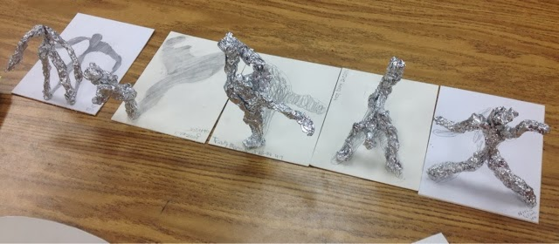
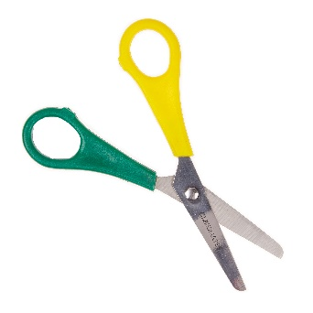
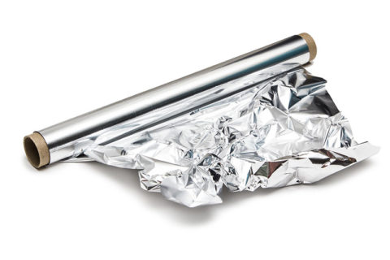
Materials:
Aluminium Foil
Scissors
Directions to make a figure:
Check out this video on youtube! https://www.youtube.com/watch?v=kYDayHvcjY4
Tear a large sheet of tinfoil
Cut from the centre of the shorter edge of the piece to 1/3 of the way towards the centre, these are the ‘legs’.
Scrunch up the tinfoil into two legs, and scrunch up the rest of the body and a head.
Tear another smaller piece of tinfoil and fold it long ways.
Scrunch up this piece into one long piece for the arms, and wrap it around the torso.
Cut the arms to length desired if too long.
Fold ends of legs and arms to make hands and feet.
Can you decorate it? Perhaps draw a background for your tin person? Can you add any household materials to give it hair/clothes? Can you put the person on a piece of paper and create shadows?
These are just a few ideas…. We can not wait to see what you create!
FOIL SCULPTURES

Slide 3
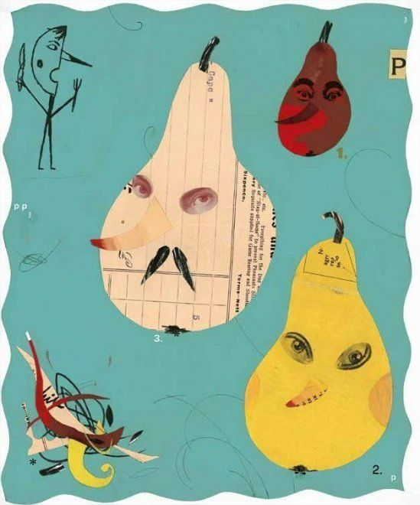
Materials:
Magazines, newspapers, old books, photographs, leaflets, cardboard, stamps (to name but a few)
Scissors
Glue
Directions to make a collage:
Choose a base for your collage
Cut or tear strips of paper. Make them different widths. Cut one side and tear the other. It’s up to you!
Layer the paper on the base.
Arrange until you like the look.
Glue into place. Add accent pieces, embellish your art to finish it off.
Best thing about a collage is that there are no rules…. Have fun!!!
COLLAGE

Slide 4
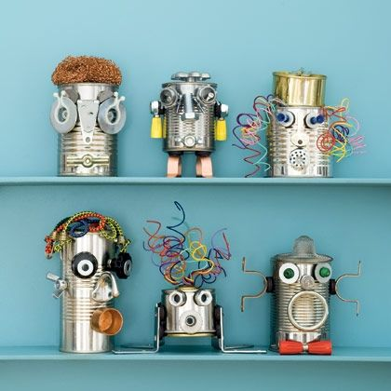
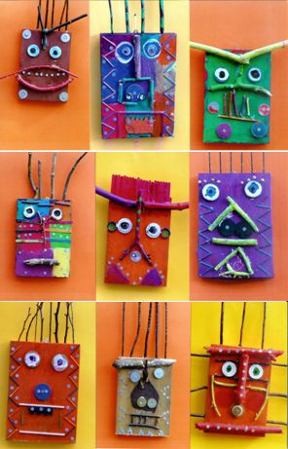
Materials:
Any household recycled materials! For example, tin cans, milk bottles, toilet roll tubes, leaflets, plastic tubs, tin foil, string… have a rummage and see what you can find!
Scissors
Glue
Any sort of sticky tape
Directions to make a recycled sculpture:
Think about how you can change the materials into different shapes… you can stand on them, rip them, cut them, fold them.
Start sticking shapes together…sometimes it is best not to over think and let you imagination run wild
Keep adding different objects until to have a shape you are happy with
Can you decorate it?
Check out this guide from the Royal Academy of Arts!
https://www.royalacademy.org.uk/article/family-how-to-make-recycled-sculpture-art-kids-phyllida-barlow-sustainable
JUNK SCULPTURE

