Slide 2
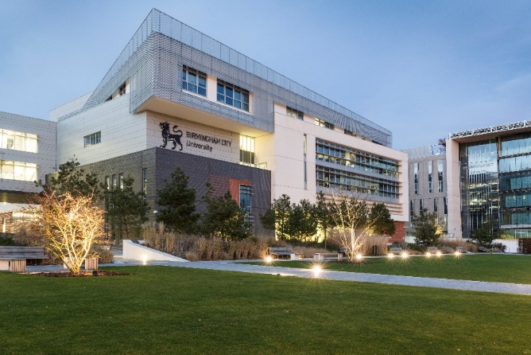
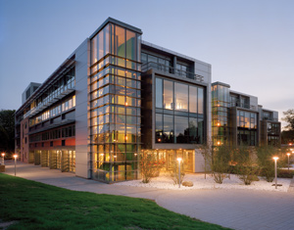
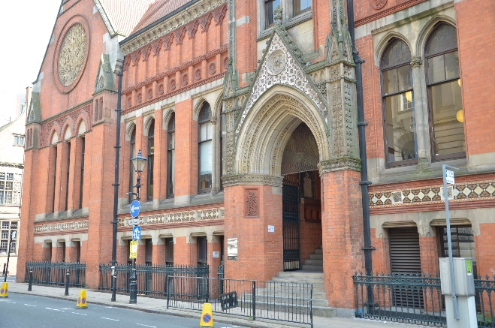
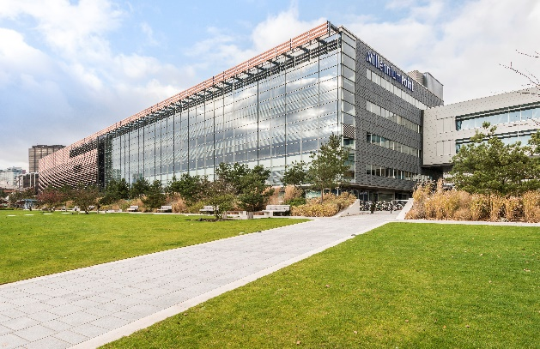
Birmingham City University
Notes:
Welcome
Health and Safety
Student Thoughts – Move round the room and tick the relevant boxes in statements

Slide 3
What I will cover today…
Personal statements in the UCAS process
What are personal statements?
What are admissions tutors looking for?
Areas to cover in a personal statement
Hints and tips for a good personal statement

Slide 4
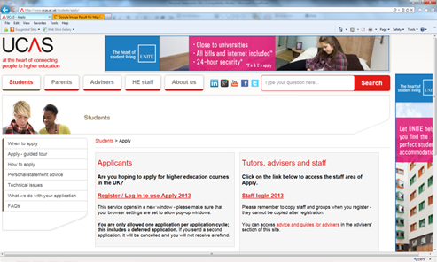
The UCAS application form
7 sections to complete
Personal details
Choices
Education
Employment
Personal Statement
Reference
Pay/send

Slide 5
Personal Statements
Competition for places is very high!
Most courses do not interview; the Personal Statement is your responsibility (Not your teachers’, tutors’, School/College).
An Admissions Tutor can see hundreds of forms in a day.
An interesting but succinct personal statement makes all the difference.
A good personal statement will give you the edge over your other fellow applicants.
Notes:
so this may be your main opportunity to make an impression on the Admissions Tutors.
so it is imperative that yours is easy to read, otherwise it might be put to the bottom of the pile!

Slide 6
The Assistant Registrar for Undergraduate Admissions from University of Warwick says:
'For highly competitive courses which attract applications from many more candidates than there are places, comparing all applicants' personal statements helps us to identify the most committed and suitable candidates.'

Slide 7
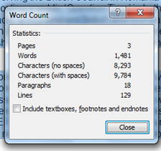
Personal Statements
You can enter up to 4,000 characters or 47 lines of text (includes blank spaces/lines).
You will not be able to use features such as bold, italic or underlined text.
Don’t include information that is available elsewhere on the form.
Use structured text, not bullet points.
It’s easier if your statement is word processed offline, then pasted into the Apply system.
Notes:
You’ll fork over £23 to apply to 5 separate courses/institutions for the 2013 application cycle, or £13 for one, but it’s better common sense & value for money to pay the extra tenner and have four more choice to rely on. Anyway, after your forth or so personal statement draft is penned comes the next step; open days.

Slide 8
What are admissions tutors looking for?
Students with the academic potential to benefit from the course.
Students who are motivated towards studying this particular kind of course.
Students with relevant experience for the course.
The personal skills a student can bring to the course.
The interests that a student has.
Remember that although each university cannot see the student’s other choices, they will all see the personal statement.
Notes:
E.g. Law and maths: You may like both subjects because you enjoy solving problems, using theory and natural or man-made laws to come to a correct conclusion. Again try to give specific examples in the form of a short narrative. When you have written all your paragraphs or narratives, rewrite them to make them shorter: you have a character limit!

Slide 9
The Course (1)
The part of most interest to the admissions tutor
The more competitive the course, the more you should write about the subject
Should be around 30 – 50% of the personal statement
Your enthusiasm for the subject and how it first developed

Slide 10
The Course (2)
Which parts of the subject are of particular interest to you?
If studying the subject at the moment mention particular coursework or assignments you have enjoyed.
Mention any extra reading around the subject you have done.
If the course ties in with any career aspirations you may say how you became interested in this career.
Notes:
If you not enjoying this particular coursat the moemnt, do you really want to do it for the next 3 years!
3: Name drop some authorities.

Slide 11
Experience relevant to the course
Work experience is really important for courses leading to the professions e.g. medicine, nursing, physiotherapy, teaching.
For other courses, attendance at conferences or any other out of school visits related to your chosen subject is important.
Say what insights this has given you into your chosen area of study/profession.
Think about any experience you can gain that will strengthen your application.
Notes:
Part-time work or even work with family could also be mentioned if it’s relevant. Travelling abroad could be mentioned where relevant.

Slide 12
General skills and attributes
Personal:
Caring
Responsible
Trustworthy
Enthusiastic
Approachable
Hard working
Related to work/studies
Good communicator
Team worker
Good organiser
Problem solver
Self motivated
Leadership
Initiative
Notes:
But a.
I am a kind person – not really very illuminating! How, when, examples. Specific and measureable outcomes are really good.
dd examples, fully developed. SituationProblemResponseEvaluation

Slide 13
Skills/Attributes/Interests –
You as a person
Evidence from part time work.
Sports and other leisure pursuits .
Volunteer or Charity work.
Student reps/prefects/mentoring.
Social activities.
Think about the skills that you have gained from these activities!
Notes:
Give specific examples. Dig deep for those examples and if you don’t have enough then perhaps some volunteer/part –time work might be useful for you now.
IT skills, administrative skills/organisational – but be specific e.g. time management – kept schedule updated, Geography project, we were behind on our deadlines for collecting data, I called a meeting, encouraged use of a online diary/group website. As a result my peers completed their tasks in a timely fashion, the assignment was completed on time and we received high marks

Slide 14
Qualities for Higher Education
Academic Skills: ability to handle information, ability to defend your opinion, knowledge of subject area, time management.
Core Skills: Numeracy, literacy, IT, communication.
Personal Characteristics: Motivation, self-organisation, creativity, flexibility.
Social Skills: Teamwork, negotiation skills, helping and supporting others.

Slide 15
Qualities for Higher Education
I have well-developed computer skills.
What skills? Be specific!
I am very communicative.
Concrete/formal examples, please!
I supported staff at a nursery/playgroup.
How?
I helped my sports team get sponsorship.
How?
I work well by myself and in a team.
This is bland and really uninformative.

Slide 16
And Finally…
Be yourself
Do NOT plagiarise! UCAS uses a similarity detection program
Personal Statements are checked against a library of those already in the system, and from a variety of websites and paper publications
Each new statement is added to the library after processing
Check spelling/grammar/sentence length thoroughly
Keep a copy
Notes:
Turn it in

Slide 17
SPRE - a story
Situation – Problem – Response - Evaluation
On request, I have also arranged and written, taught and tested in consultation with lecturers and professors from a diverse range of departments including, Law, Fine Art, the Birmingham School of Acting, The School of Education and Birmingham Conservatoire. One recent example from autumn term 2010, meant a series of meetings with a lecturer from BCU BIAD who required help for her struggling overseas M.A students. After conducting a linguistic analysis of genre, materials and past student submissions, I wrote and taught six sessions to enable students to meet task requirements. Most subsequently passed their assignment, my feedback was described as ‘excellent’ and I have been asked to continue with my assistance this term.
Notes:
SPRE, example is fairly specific, tells a story.
S2:27
S3:25
S4: 23
UCAS: recommends 12-20 words a sentence.

Slide 18
Top 10 most common opening sentences
1. I am currently studying a BTEC National Diploma in ... (used x464)
2. From a young age I have always been interested in ... (309)
3. From an early age I have always been interested in ... (292)
4. Nursing is a very challenging and demanding career ... (275)
5. For as long as I can remember I have been fascinated with ... (196)
6. "Fashion is not something that exists in dresses only” ... (189)
7. Nursing is a profession I have always looked upon with ... (178)
8. For as long as I can remember I have been interested in ... (166 )
9. I am an International Academy student and have been studying since... (141)
10. Academically, I have always been a very determined and ... (138)
Notes:
700,000 students applied for university last year – that's a lot of times for tutors to have to read "I have always been fascinated by ...[insert subject]".
Telegraph
UCAS also has advice.

Slide 20
Punctuation/Spelling/Grammar
Dear John: I want a man who knows what love is. All about you are generous, kind, thoughtful people, who are not like you. Admit to being useless and inferior. You have ruined me. For other men, I yearn. For you I have no feelings whatsoever. When we are apart, I can be forever happy. Will you let me be. Yours, Gloria
Do NOT rely on spellcheck
Try reading your sentences out loud
Try listening to them (Google – text to speech)
Get other people to read your work
Notes:
The words stay exactly the same – spellchecker could not help you here – yet the meaning is entirely different!

Slide 21
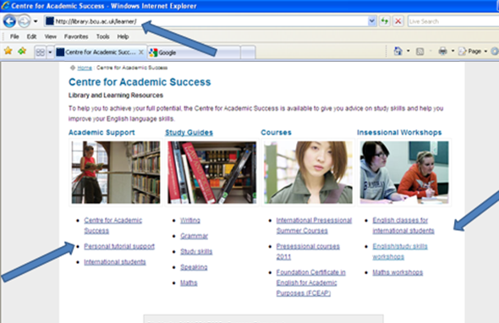
Centre for Academic Success

