Slide 1
Delivering change through interdisciplinary research

Slide 3
Institute for Creative Economy
Institute for Sustainable Futures
Institute for Health and Quality of Life

Slide 4
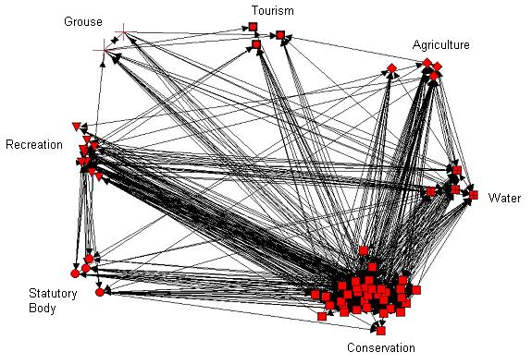
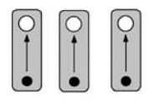
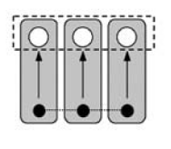
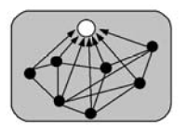
Mono-disciplinary
Multi-disciplinary
Interdisciplinary
Transdisciplinary
Goals
Disciplines
Increasing integration of knowledge
(Tress et al., 2005)

Slide 5
50%
20%

Slide 6
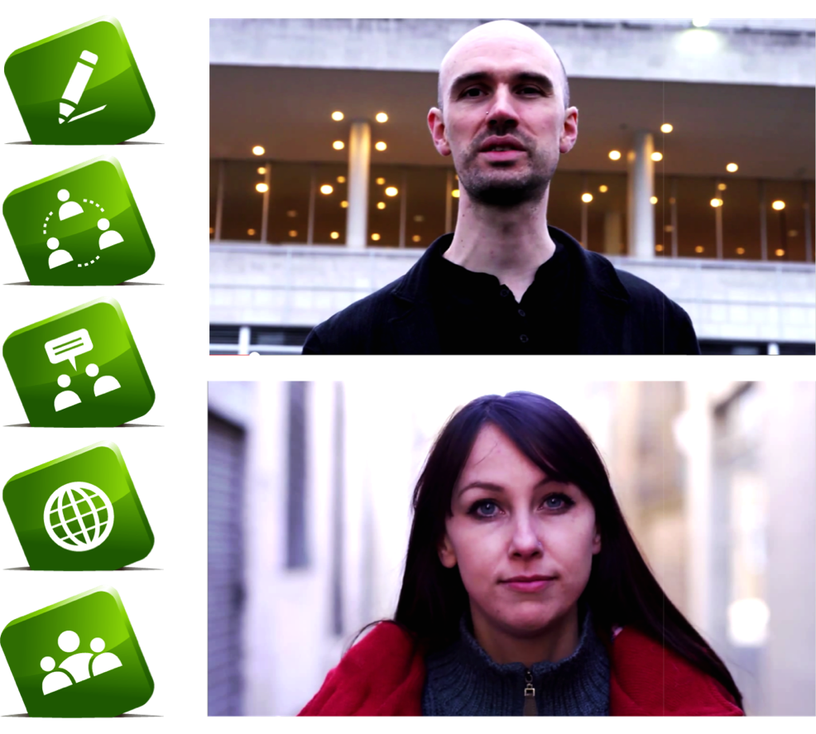
University of Maastrict (the Netherlands)
ETH Zurich (Switzerland)
University of Nottingham
University of Newcastle
University of Sheffield
University of Stirling
University of Leeds
University of Glasgow
University of Hull
University of Portsmouth
University of Exeter
University of Lancaster
University of Manchester
University of East Anglia
University of Reading
Kings College London
University of the Highlands and Islands
Natural Environment Research Council (NERC)
Biotechnology & Biological Sciences Research Council (BBSRC)
Science & Technology Funding Council (STFC)
British Geological Survey
British Ecological Society
Centre for Ecology & Hydrology
London School of Hygiene and Tropical Medicine
UK Climate Impacts Programme
Permaculture Association
Scottish Government
James Hutton Institute
Moredun Research Institute
Scotland’s Rural College
Natural England
Department for Environment & Rural Affairs (DEFRA)
National Oceanography Centre
Scottish Association for Marine Science (SAMS)

Slide 8
5 Principles for achieving impact

Slide 9
Analysis of interviews with 32 researchers and stakeholders across 13 environmental management projects
Social network analysis & interviews tracing how >70 research findings were communicated via social networks and put into policy/practice
Analysis of 53 interviews & questionnaires with land degradation projects:
Researchers, facilitators & stakeholders in 11 projects with varying participation in similar contexts in Spain and Portugal
Facilitators of a participatory process replicated in 13 different countries
Meta-analysis of 300 international cases
Notes:
The original research analysed how different approaches to knowledge exchange in a wide range of environmental research projects led to different types of impact. These findings were evaluated by knowledge exchange experts from a wide range of disciplines (including education, health, linguistics, ecology, political science and philosophy) and from across the UK research funding community including key knowledge exchange specialists from a number of Research Councils, to ensure that the principles that emerged were as widely applicable as possible.
This led to the production of the Living With Environmental Change partnership’s Knowledge Exchange Guidelines, and to the development of knowledge exchange strategies in collaboration with a number of other funding programmes.

Slide 10
1 Design
Know the impacts you want to achieve and design knowledge exchange into research from the start
Notes:
A well designed Knowledge Exchange (KE) process can help foster a sense of trust between all those involved, creating a sense of shared ownership over research questions and the findings that emerge from the research. However, KE activities must be designed and effectively integrated into research projects from the outset to ensure adequate tailoring to project goals and the needs of stakeholders and likely research users.
Projects should offer as many opportunities as possible for stakeholder engagement throughout the research cycle, from proposal development and research planning, to data collection, analysis and/or interpretation of results (e.g. prioritising, ranking, evaluating findings), and the evaluation and dissemination of project outcomes. To enable this, time should be invested in building a skilled project team capable of effective KE. Where these skills are not available within the team, it may be necessary to invest in training or hire a KE specialist.
Where possible, it is useful to build flexibility into the design of research projects, including opportunities to adapt project goals to changing stakeholder needs and priorities (for example, by leaving gaps in project design to be specified at a later date).
Projects need to be clear and realistic about the knowledge exchange and beneficial impacts they want to achieve, and be prepared to negotiate KE goals with stakeholders to meet their needs and priorities. It is important to manage expectations during goal setting, and there needs to be clarity and openness with stakeholders about what the project hopes to achieve, explaining how and when stakeholders can engage with research, and how stakeholders may benefit from the results.

Slide 11
2 Represent
Systematically represent research user knowledge needs and priorities in research
Notes:
It is essential to systematically identify potential research users and other key stakeholders as early as possible in the research process, ideally prior to the development of funding proposals, so that stakeholders can help shape the proposed research, and demonstrate their support to funders (see Principle 1).
There is evidence that a diverse group of well-informed people from different backgrounds are likely to provide the most relevant and innovative ideas.

Slide 12
3 Engage
Build long-term, trusting relationships based on two-way dialogue between researchers & stakeholders and co-generate new knowledge together
Notes:
A KE process can benefit from a safe space in which those involved can effectively listen to each other, share knowledge and skills, explore new ideas, learn, adapt and apply the knowledge they gain. For KE to achieve sustained, long-term impact, a culture of knowledge exchange must be promoted, where stakeholders are valued, two-way knowledge exchange is promoted and projects work to a shared purpose with stakeholders.
There is evidence that effective engagement with the likely users of your research can increase the likelihood that recommendations arising from the work are accepted and implemented on the ground. This evidence also shows that the people you engage with will take valuable lessons away from their experience, and develop new networks and alliances that they can benefit from for many years later.

Slide 13
4 Impact
Focus on delivering tangible results as soon as possible that will be valued by as many of your stakeholders as possible
Notes:
For knowledge exchange to be perceived as effective by stakeholders, it needs to deliver tangible outputs that are of real value to as many stakeholders as possible. Delivering a number of useful outcomes as soon as is practical (but without compromising the rigour and integrity of the research) may help researchers gain the respect and ongoing support of stakeholders

Slide 14
5 Reflect & Sustain
Monitor and reflect on your knowledge exchange, and consider how to sustain a legacy of knowledge exchange beyond project funding
Notes:
Time must be built into KE activities for participants to reflect on the effectiveness of the KE process and its outcomes. There are a number of challenges to this, given the many different aspects of KE that can be evaluated, the significant time-lag that often occurs between a KE process and eventual outcomes (e.g. formulation of government policy), and the non-linear relationships between KE process and outcomes that are affected by many other political, social, cultural and institutional factors. Ongoing evaluation of knowledge exchange activities may however help a project identify and adapt to shortcomings in the design of knowledge exchange or problems raised by stakeholders about the nature of the research being conducted, and harness new opportunities for generating impact as they arise (Principle 4). By building in opportunities for regular feedback about KE activities throughout the project, it may be possible to re-assess who holds a stake or is likely to use the research, to ensure that stakeholder representation remains relevant throughout the research cycle (Principle 2).

Slide 15
1 Design 2 Represent 3 Engage 4 Impact 5 Reflect & sustain
Notes:
A well designed Knowledge Exchange (KE) process can help foster a sense of trust between all those involved, creating a sense of shared ownership over research questions and the findings that emerge from the research. However, KE activities must be designed and effectively integrated into research projects from the outset to ensure adequate tailoring to project goals and the needs of stakeholders and likely research users.
Projects should offer as many opportunities as possible for stakeholder engagement throughout the research cycle, from proposal development and research planning, to data collection, analysis and/or interpretation of results (e.g. prioritising, ranking, evaluating findings), and the evaluation and dissemination of project outcomes. To enable this, time should be invested in building a skilled project team capable of effective KE. Where these skills are not available within the team, it may be necessary to invest in training or hire a KE specialist.
Where possible, it is useful to build flexibility into the design of research projects, including opportunities to adapt project goals to changing stakeholder needs and priorities (for example, by leaving gaps in project design to be specified at a later date).
Projects need to be clear and realistic about the knowledge exchange and beneficial impacts they want to achieve, and be prepared to negotiate KE goals with stakeholders to meet their needs and priorities. It is important to manage expectations during goal setting, and there needs to be clarity and openness with stakeholders about what the project hopes to achieve, explaining how and when stakeholders can engage with research, and how stakeholders may benefit from the results.

Slide 16
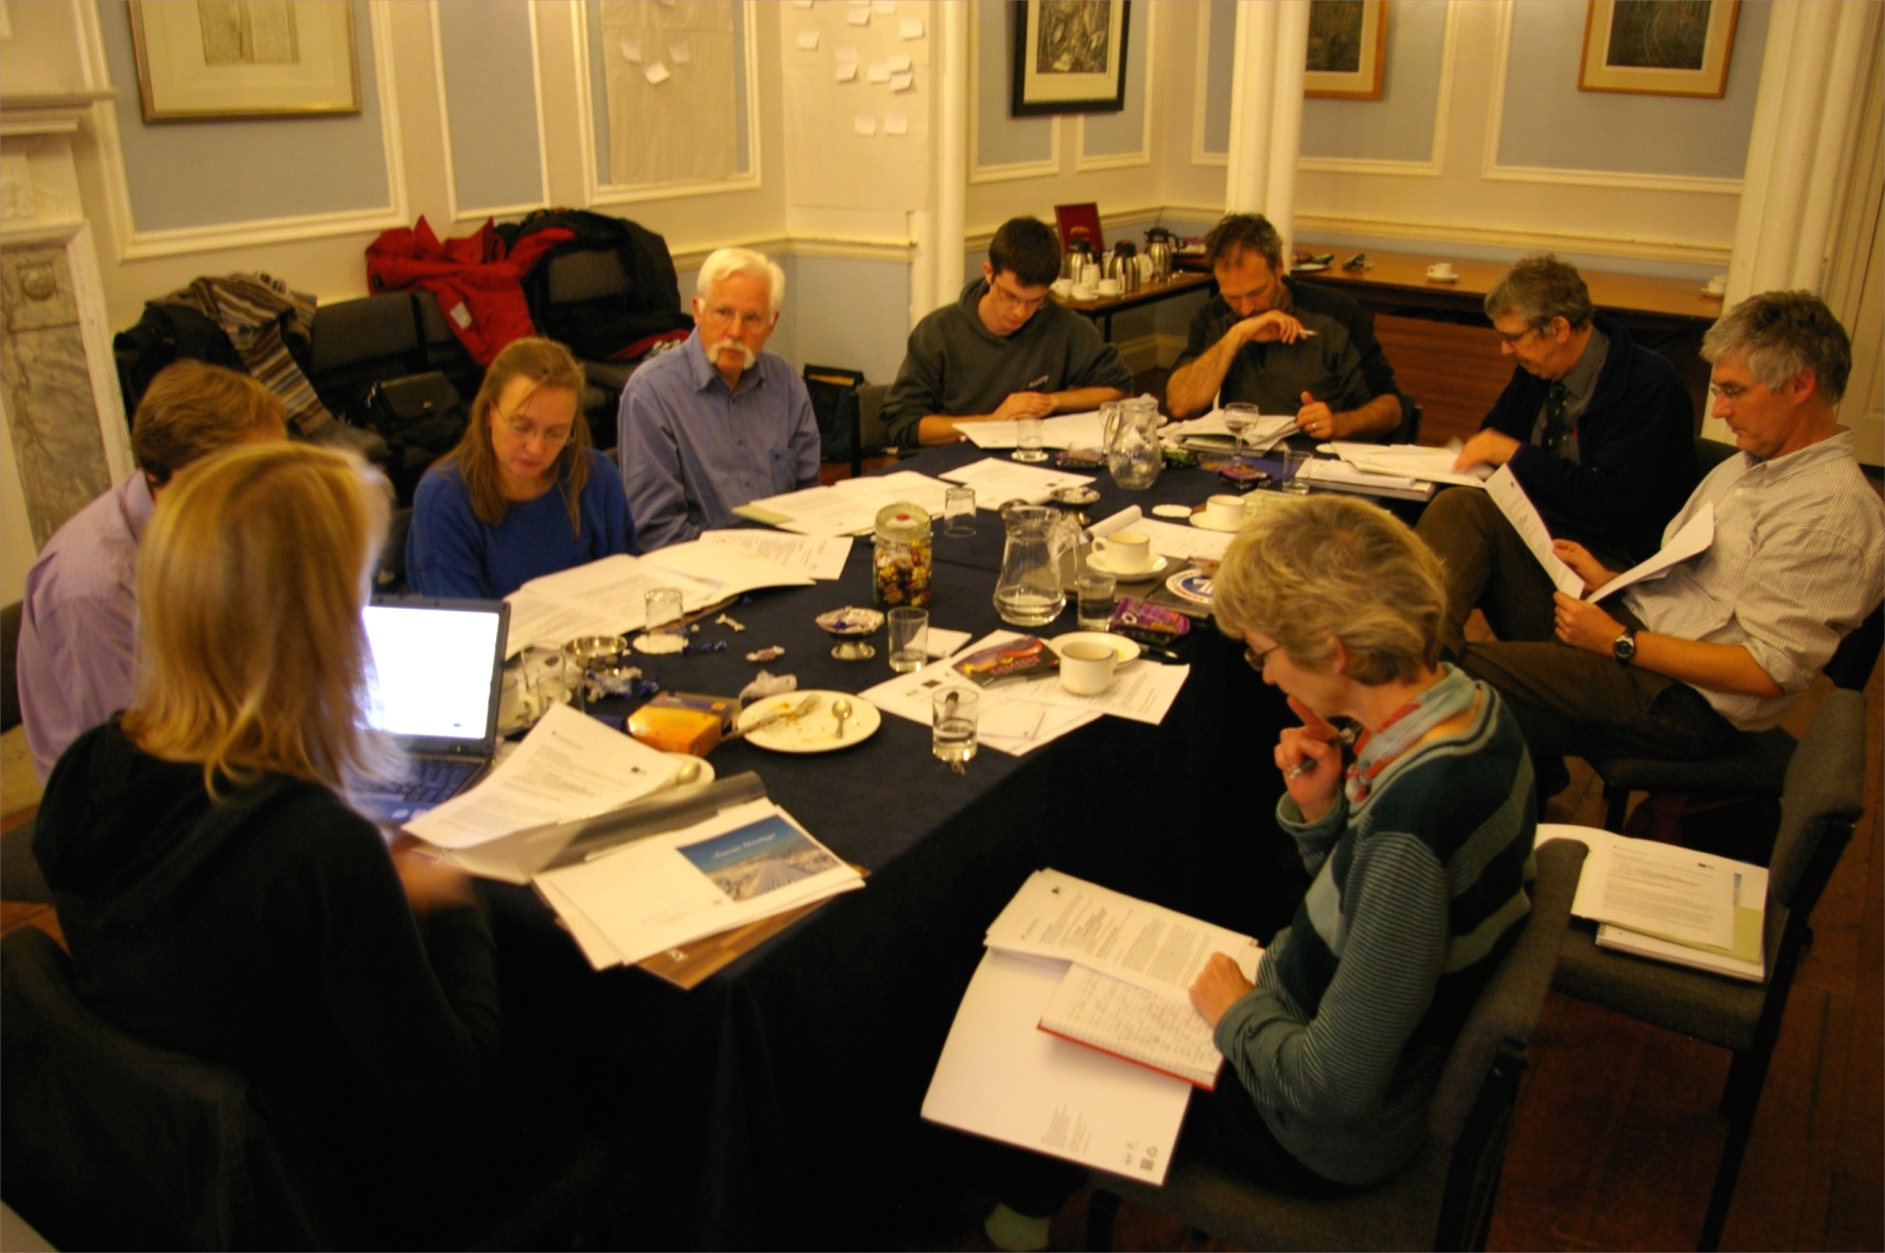

Slide 17
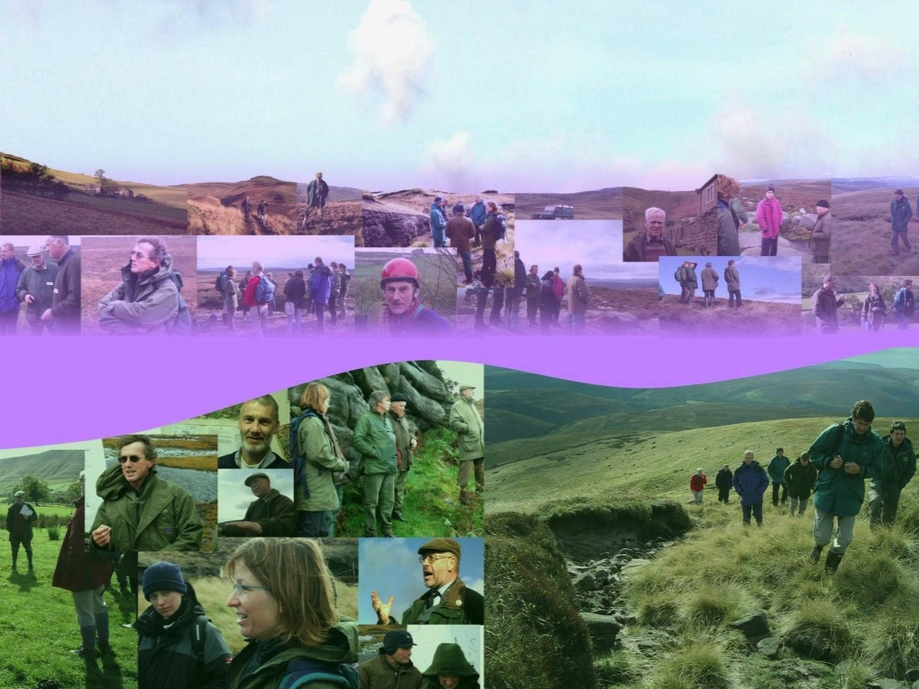

Slide 18
Pathway to Impact

Slide 19
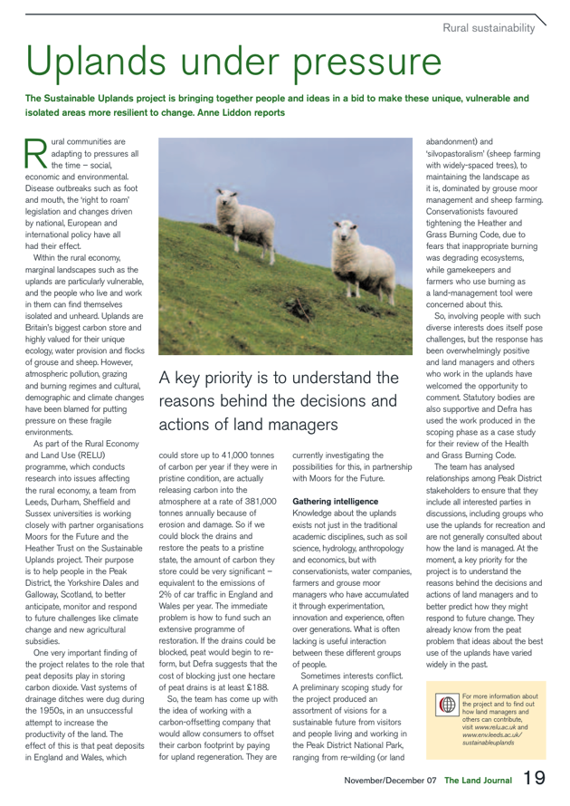
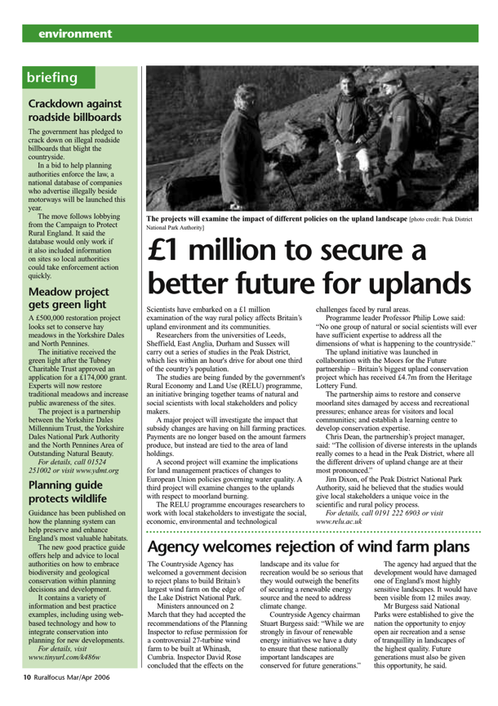
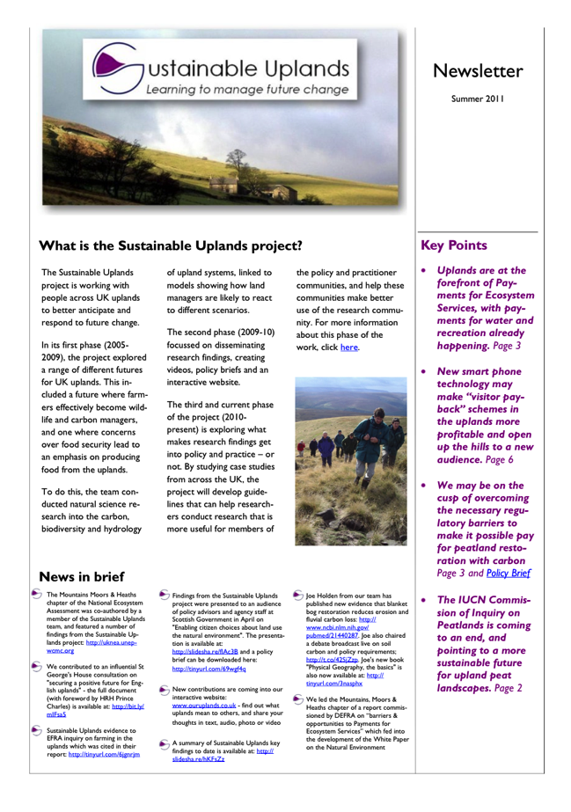

Slide 20
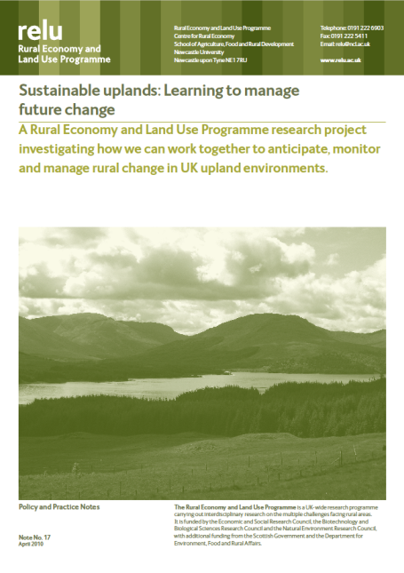
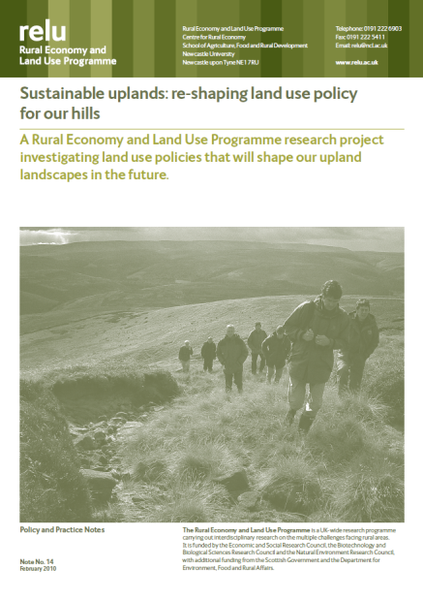
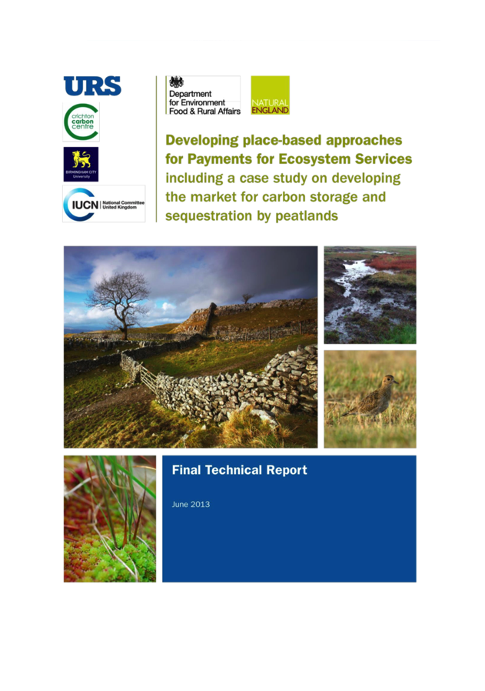
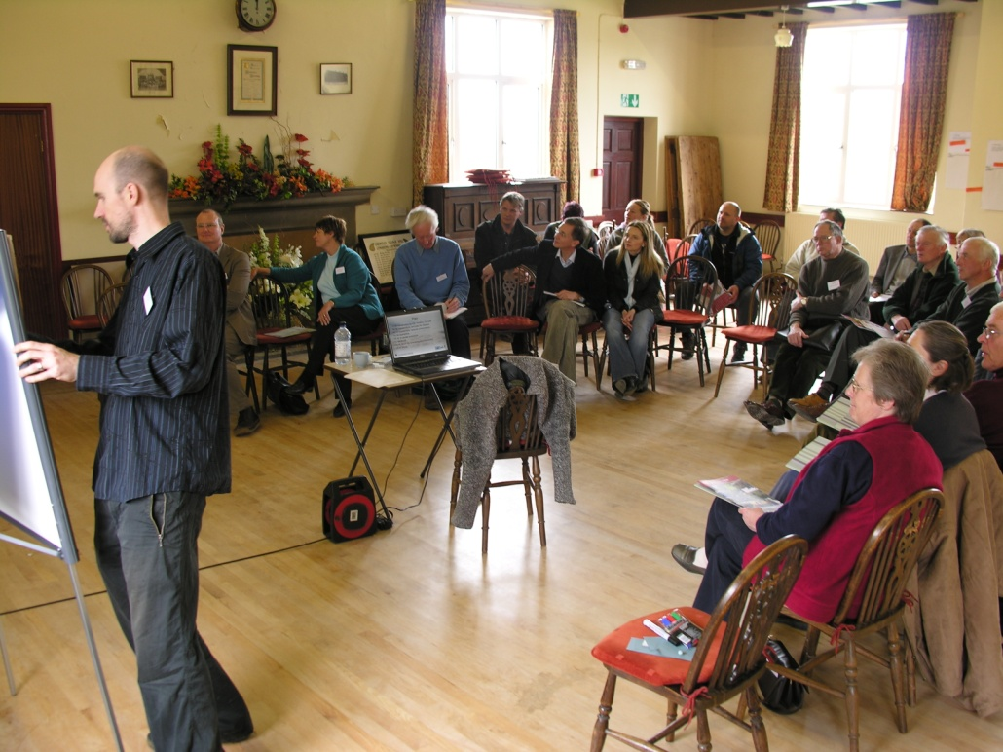

Slide 22
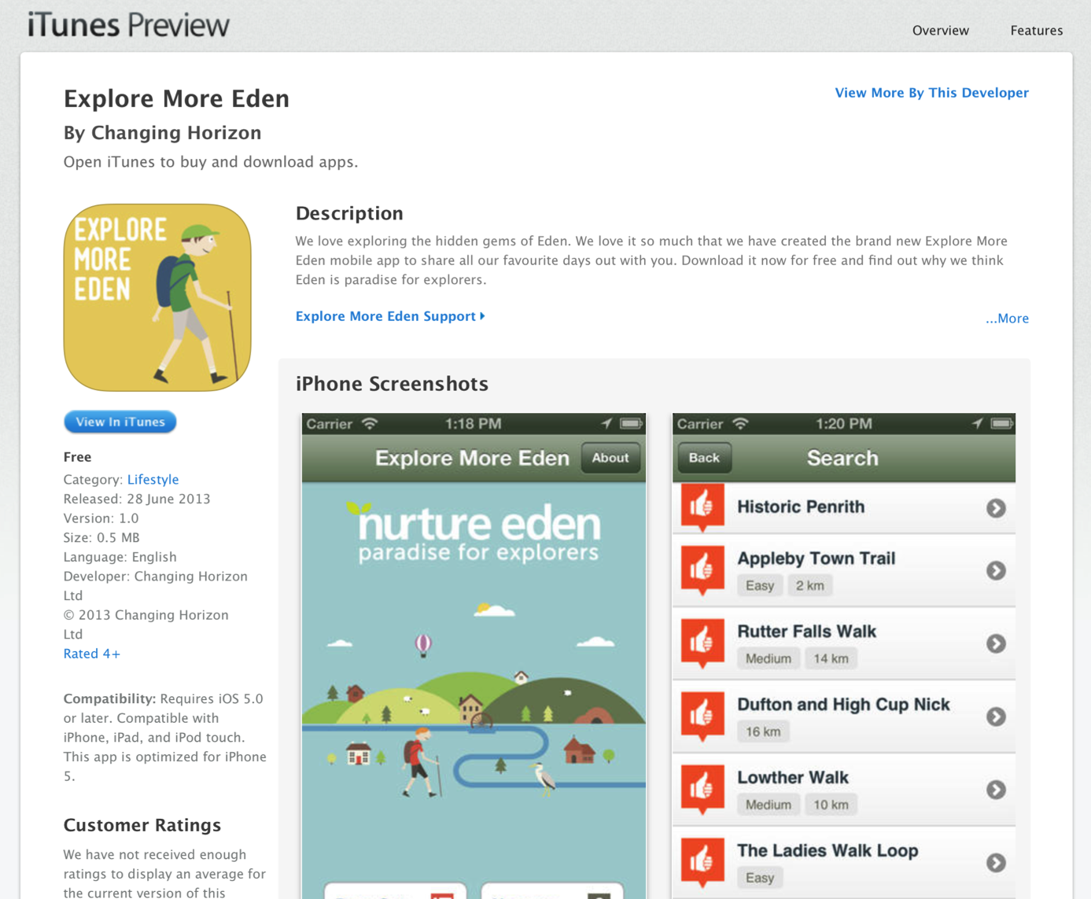

Slide 23
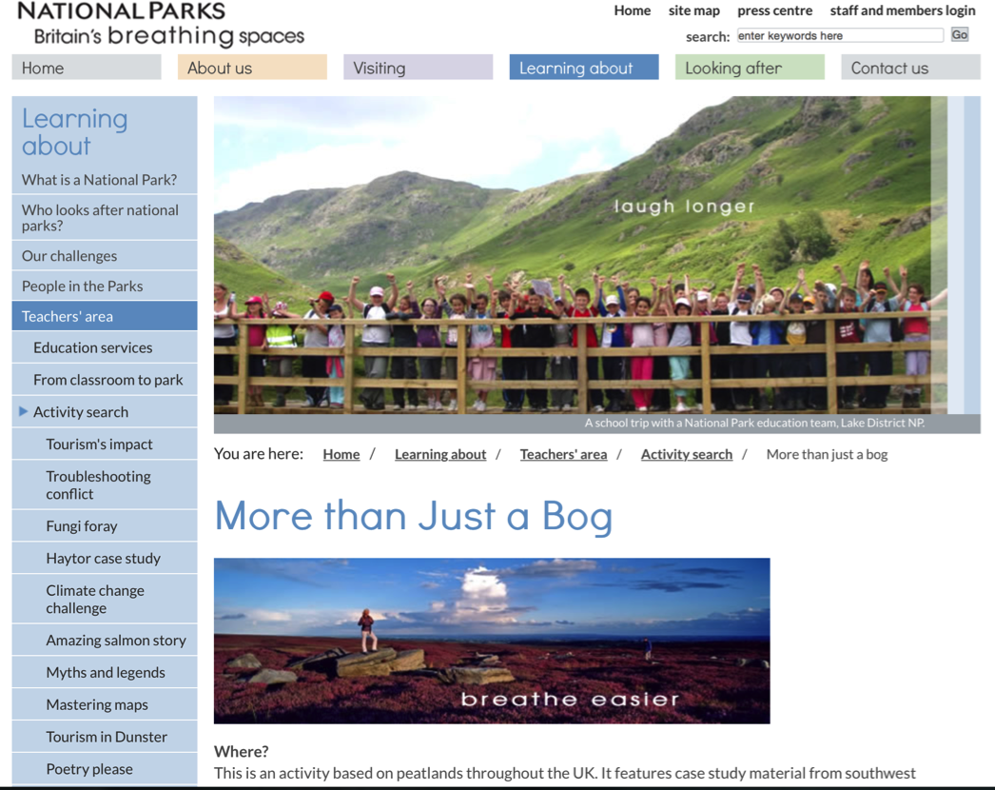
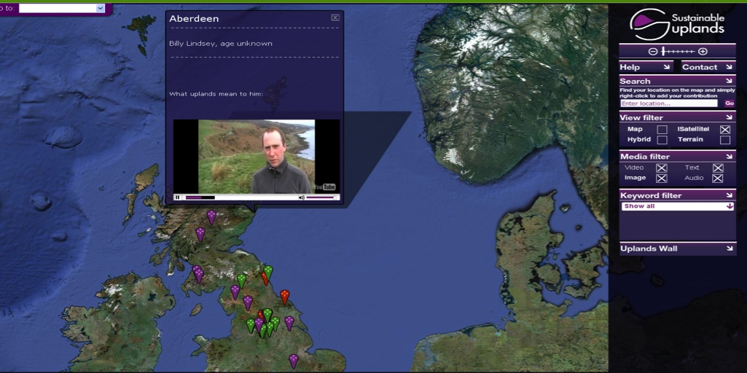

Slide 24
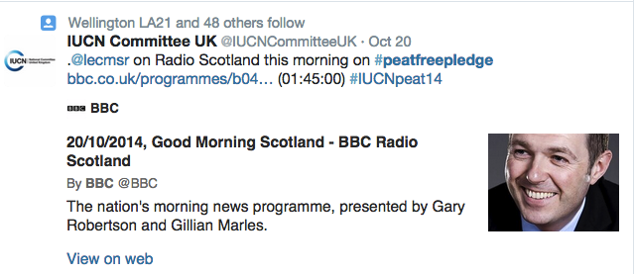
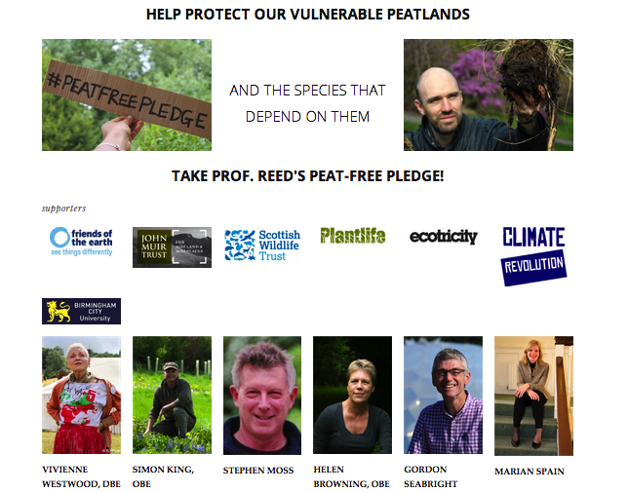
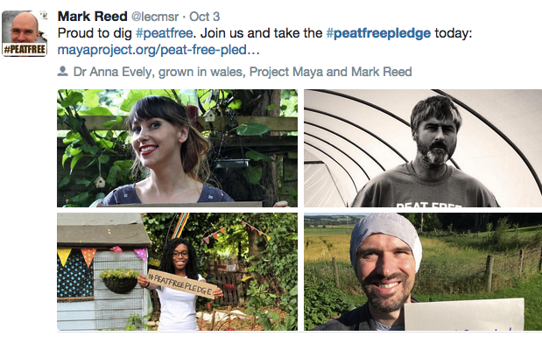
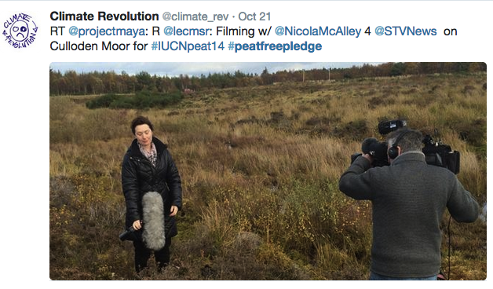
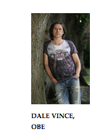
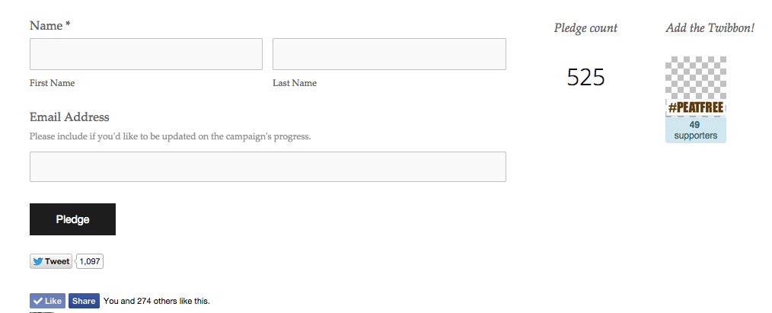
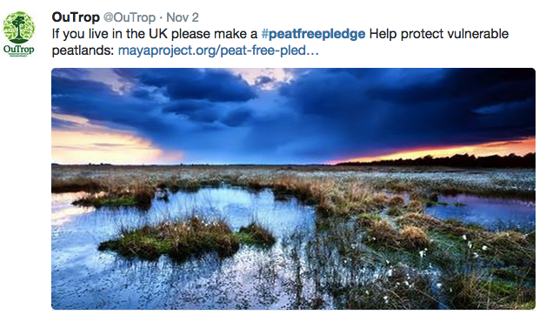

Slide 25
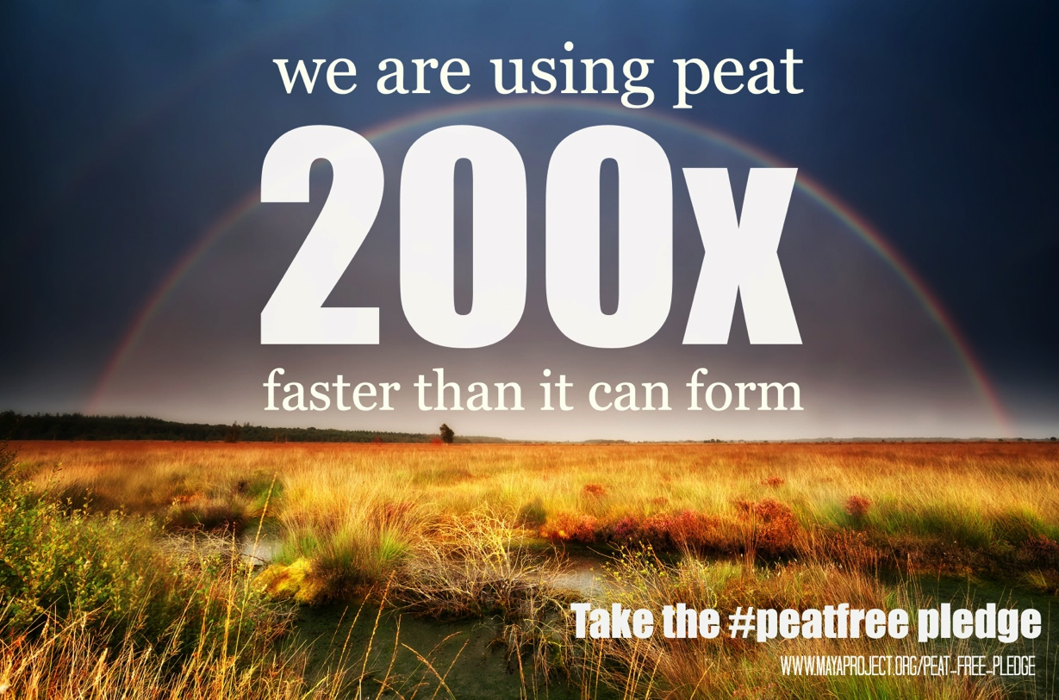

Slide 26
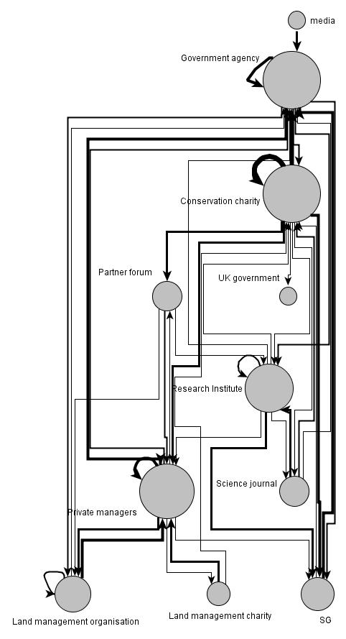
How are policy-makers & practitioners learning about our research?
Not from journals
Cultivate direct relationships where possible…
…and work through trusted knowledge brokers
Notes:
-----
Substantial value can be derived for many stakeholders after projects have been completed, through on-going communication and interpretation of findings. Where possible, ‘legacy arrangements’ can support continued engagement between researchers and research users, to extract and augment value from the previous research through interpretation activities and supplementary analysis. It can help if the time-scale over which engagement needs to be sustained is considered from the outset. For example, if a project plans to develop a network that will have the potential to work together beyond the time-frame of the initial project, it will be necessary to forge collaborations with organisations who share this goal, but who can also fund or administer such a network long after the project has ended.

Slide 27
1 Design 2 Represent 3 Engage 4 Impact 5 Reflect & sustain
Notes:
A well designed Knowledge Exchange (KE) process can help foster a sense of trust between all those involved, creating a sense of shared ownership over research questions and the findings that emerge from the research. However, KE activities must be designed and effectively integrated into research projects from the outset to ensure adequate tailoring to project goals and the needs of stakeholders and likely research users.
Projects should offer as many opportunities as possible for stakeholder engagement throughout the research cycle, from proposal development and research planning, to data collection, analysis and/or interpretation of results (e.g. prioritising, ranking, evaluating findings), and the evaluation and dissemination of project outcomes. To enable this, time should be invested in building a skilled project team capable of effective KE. Where these skills are not available within the team, it may be necessary to invest in training or hire a KE specialist.
Where possible, it is useful to build flexibility into the design of research projects, including opportunities to adapt project goals to changing stakeholder needs and priorities (for example, by leaving gaps in project design to be specified at a later date).
Projects need to be clear and realistic about the knowledge exchange and beneficial impacts they want to achieve, and be prepared to negotiate KE goals with stakeholders to meet their needs and priorities. It is important to manage expectations during goal setting, and there needs to be clarity and openness with stakeholders about what the project hopes to achieve, explaining how and when stakeholders can engage with research, and how stakeholders may benefit from the results.

Slide 28
www.markreed.webeden.co.uk

