Slide 1
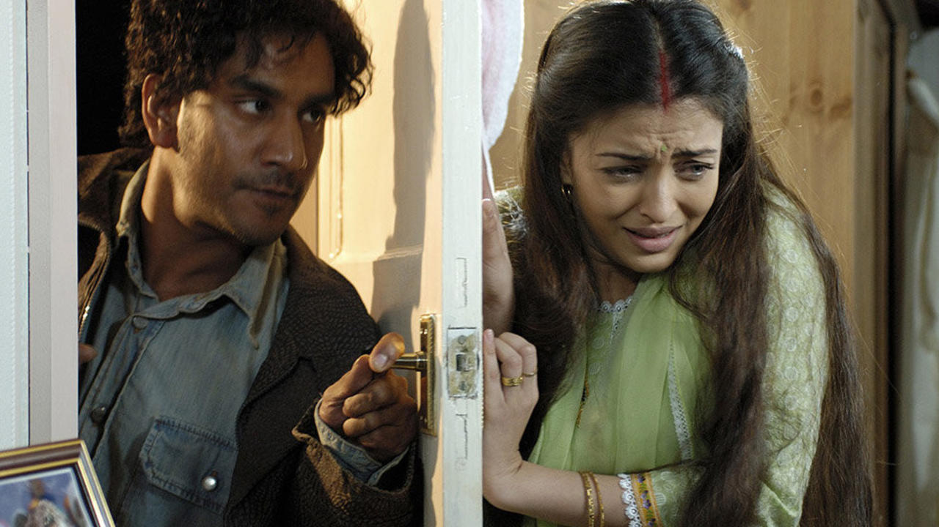
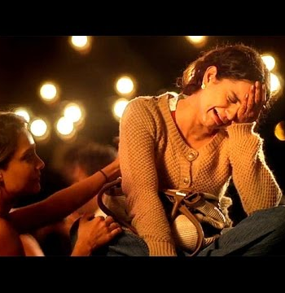
In Search of Agency and Self: Mapping Gendered Conjugal Violence in Diasporic Diegesis
Dr. Priyanka Tripathi
Associate Professor
Department of Humanities and Social Sciences​
Indian Institute of Technology Patna, India​

Slide 2
Provoked is a filmic representation of the real case of Regina vs. Ahluwalia (1992) and is based on Kiranjit Ahluwalia’s autobiography, The Circle of Light (1997). The film focuses on her experience of domestic violence and imprisonment that lead to an alteration in British Law, redefining ‘provocation’
Provoked (2006)

Slide 3
Namaste London is the subversive rendition of the woman position within the sham marriage dynamics and pits the female lead in search of her identity
Namaste London (2007)

Slide 4
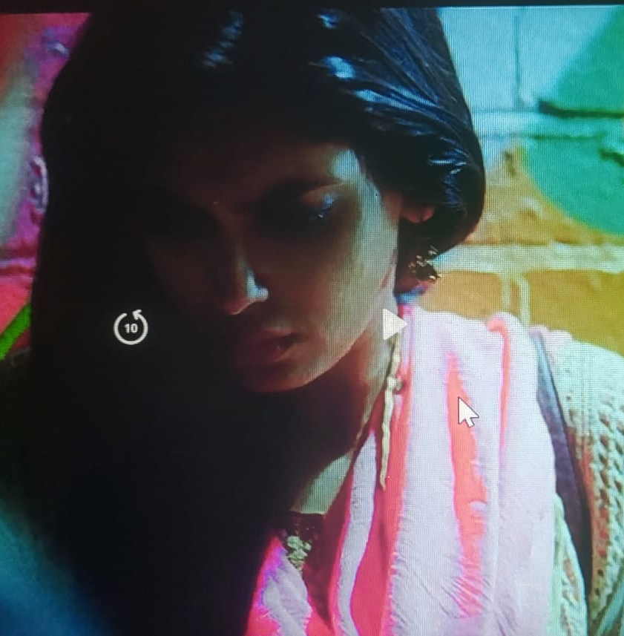
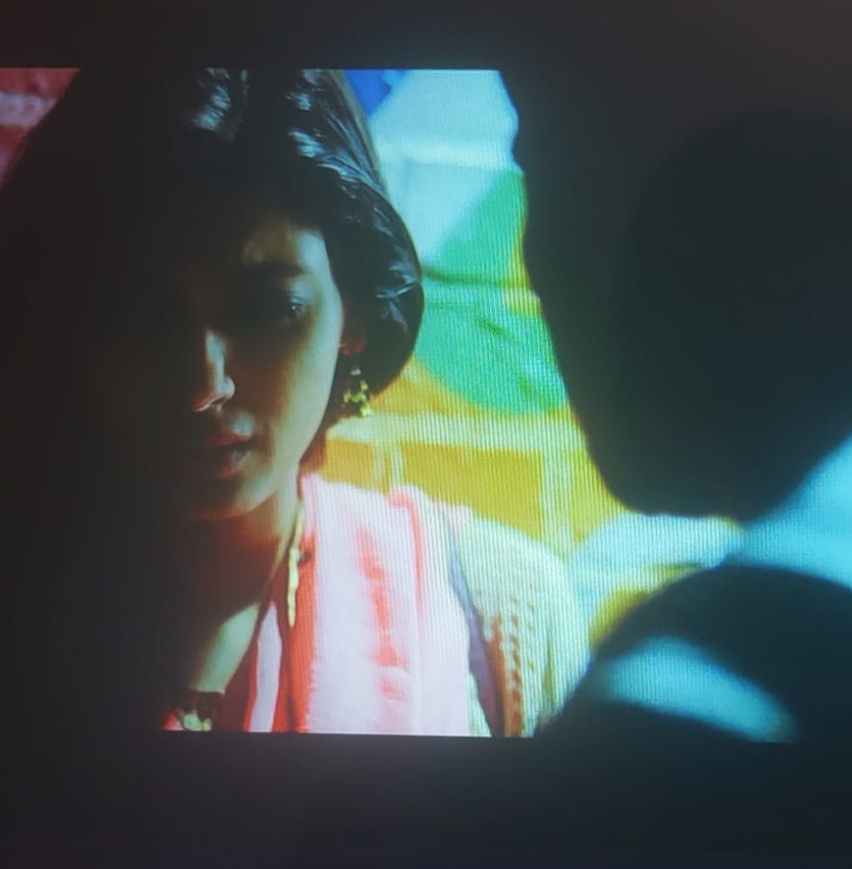
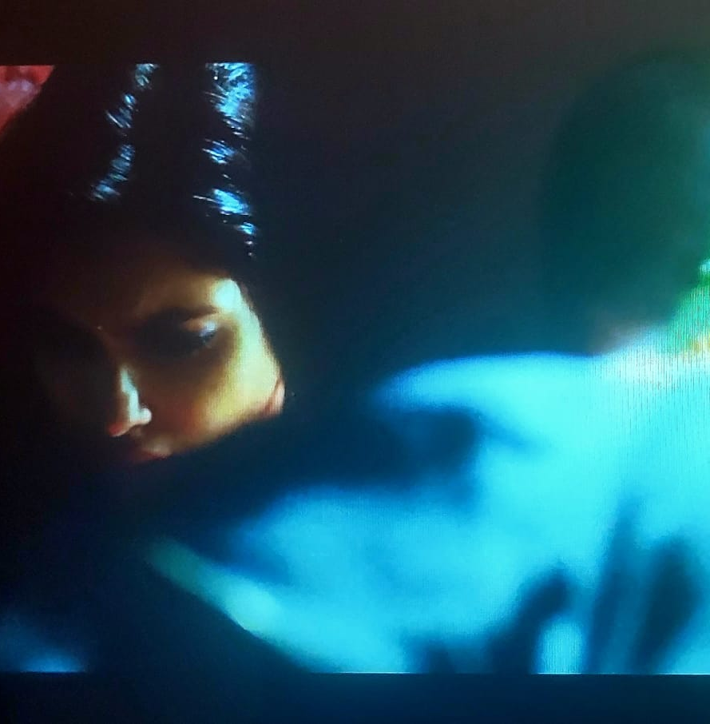
In Cocktail , the introductory sequence gives us a glimpse of a sham marriage where the newly married female protagonist travels to London for uniting with her husband but instead gets abandoned by him on her arrival
Cocktail (2012)

Slide 5
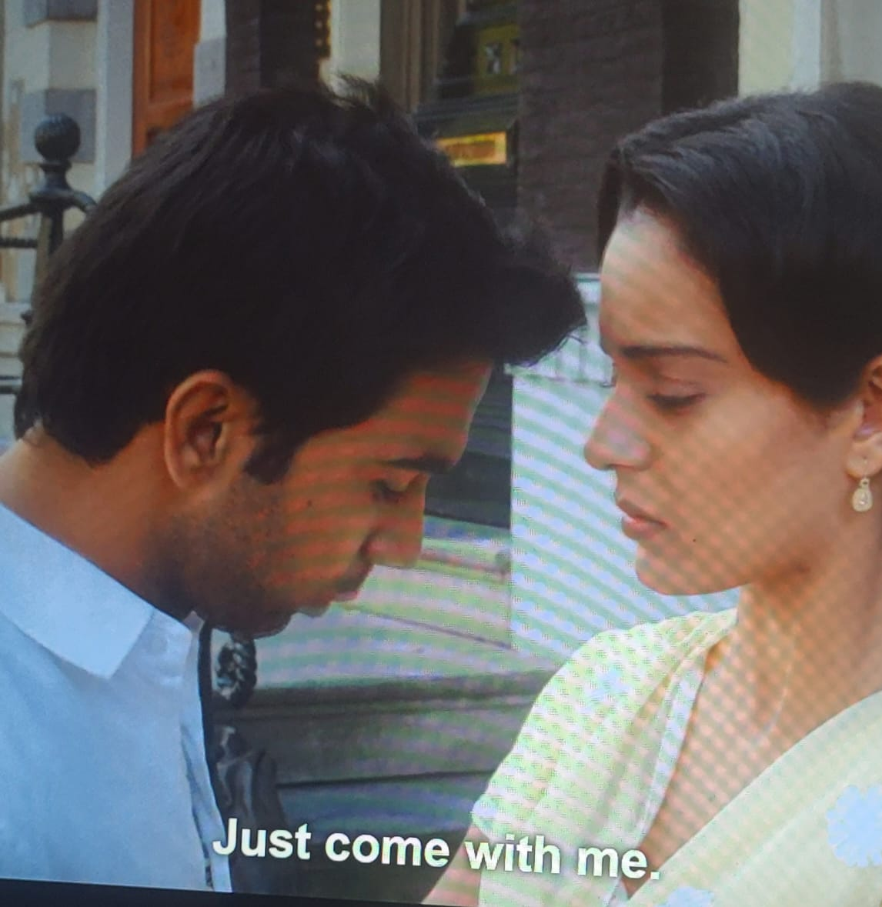
Queen explicates the idea of the search for self-identity for the female lead within the diasporic space as it emanates her from the shackles of an imminent conjugal bind she fortunately escaped. ​
Queen (2013)

Slide 6
Discussion
‘spectrum of arranged marriage in British Asian diaspora’ through an intersectional reading of select films
domestic violence in the diasporic space/the data available on various portals in understanding the systemic, legislative, and cultural issues that specifically plague South Asian women in Britain
changing nature of the resistance from the limits of domesticated liberation to one of self-identification/realization

