Slide 1
BCU Mentor Support
2023-24

Slide 2
BCU ITE Curriculum
At BCU we have designed the ITE curriculum as a carefully crafted coherent sequence of experiences and activities that will support Associate Teachers to succeed in the classroom. Our curricula encompasses the full entitlement described in the ITT Core Content Framework as well as integrating additional analysis and critique of theory, research and expert practice that we feel is appropriate.
We believe that the quality of teaching is the most important factor in improving outcomes for pupils. We recognise that it is an entitlement of all Associate Teachers to work with and learn from expert colleagues as they practise, rehearse and refine approaches. We give high importance to mentoring that enables Associate Teachers to receive high quality clear and structured feedback from expert colleagues as they apply knowledge and understanding of the evidence in the classroom to understand how practice can be improved.
Associate Teachers are supported to embody our four professional core values: committed, creative, confident, and collaborative and develop the skills and knowledge needed to be a Primary School Teacher.

Slide 3
BCU ITE Curriculum
THE BCU ITE Curriculum complies with the ITT Core Content Framework (DfE, 2019). Each module within the ITE Curriculum ensures that Associate Teachers acquire research-led subject, pedagogical and curriculum knowledge, and develop a clear insight into how to implement this knowledge as they develop their teaching skills with the support of expert colleagues across the BCU regional partnership.
The ITE Curriculum at BCU comprises six themes which are embedded throughout the university-based sessions and your school-based training modules.
Notes:
Overview of curriculum

Slide 4
BCU ITE Curriculum Key Themes
A. Associate Teachers use critical enquiry and research informed practice to develop their understanding of effective teaching and learning.
B. Associate Teacher’s classroom practice establishes effective behaviour management through the use of high expectations and awareness of pupil wellbeing.
C. Associate Teachers knows more, remembers more and applies subject knowledge and subject specific pedagogy to impact on pupils’ progress
D. Associate Teachers uses knowledge about how pupils learn to plan and asses learning to ensure that all pupils make progress.
E. Associate Teachers implement effective adaptive teaching approaches to support all learners, including SEND (Special Educational Needs and Disabilities) and EAL (English as Additional Language) learners.
F. Associate Teacher’s demonstrate professional behaviours and contributes effectively to the wider life of the school.

Slide 5

The Spiral Curriculum
Our spiral curriculum model is an iterative revisiting of identified topics, subjects and themes throughout the BCU Primary and Early Years with QTS courses.
This spiral curriculum ensures that a deepening of understanding of the topic considered with each successive encounter building on the previous one.
Start of ITE journey
Pedagogical knowledge development within ITE modules
SBT with expert colleagues in partnership schools
ECF
QTS

Slide 6

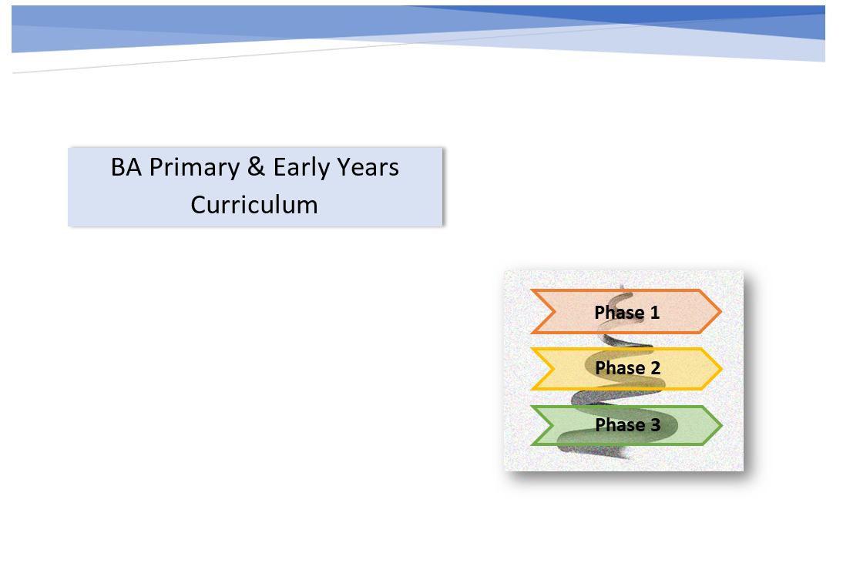
PGCE/BA Curriculum Document for schools
Notes:
Booklets

Slide 7
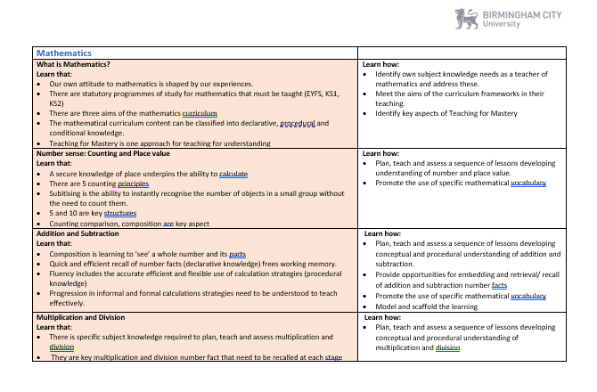
Each subject has identified the key ‘learn that’ and ‘learn how’ to statements
Notes:
Both PGCE and BA Curriculums have been broken down into subject specific ‘learn that’ and ‘learn how to’ statements. These statements allow the mentor to have clarity of the developmental nature of how we share our curriculum with Associate Teachers. They will know that for example in school based training 1, AT’s will have not been necessarily taught all subject specific content, but it will guide mentors as to what they have been taught at that point and how they can continue to support AT’s development.

Slide 8


Subject Specific Development Journal

Slide 9
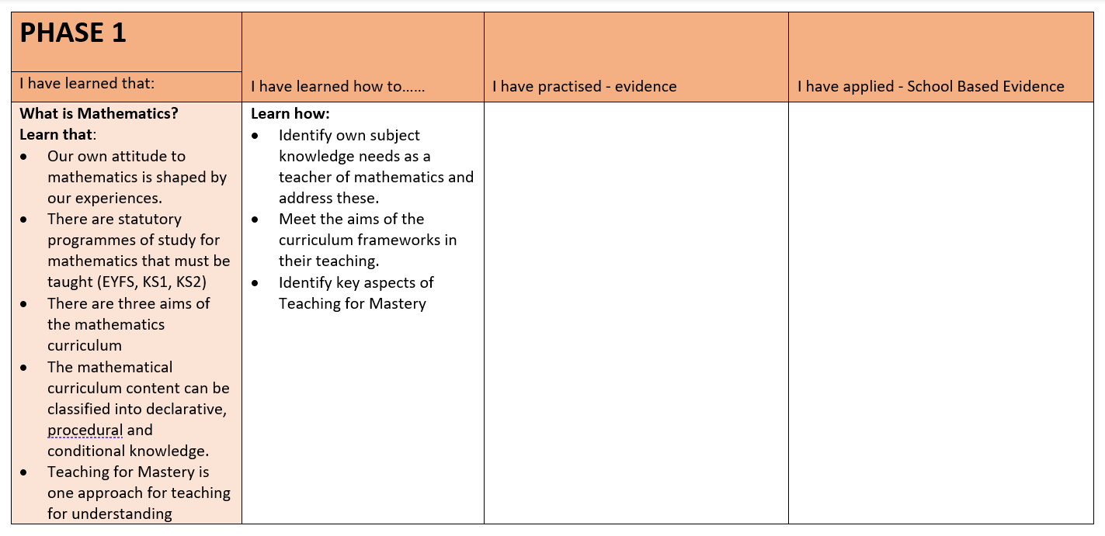

Slide 10
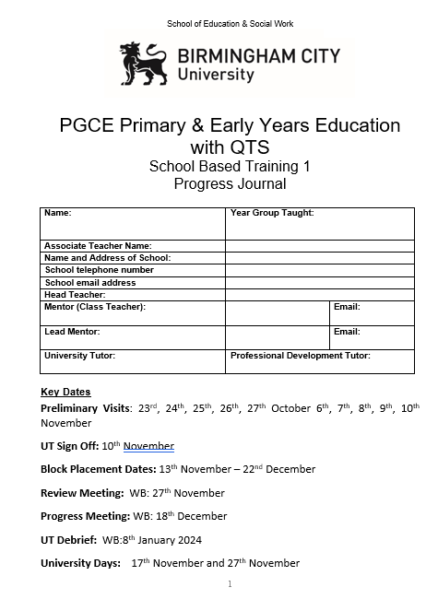
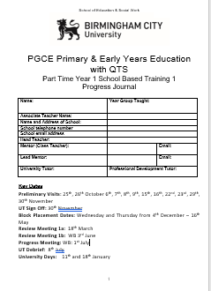
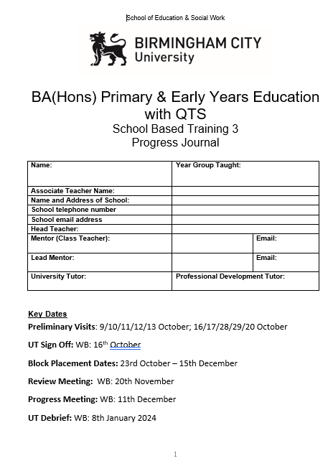

Slide 11
Progress Journal
It is the Associate Teachers responsibility to keep their Progress Journal up to date.
The Associate teacher should share their Progress Journal with their UT and Mentor via their OneDrive Associate Teacher Folder
Preliminary Tasks
Associate Teacher Learning Observation
Checklist of tasks that need to be completed for sign off
BCU Assessment Tracker
Attendance register
Targets page
Weekly Meeting and Target Setting
Review/Progress Meetings
Critical Incidents

Slide 12
SBT Prelim Tasks
These are to be completed during PPSE days.
Linked directly with pre-approval checklist.
The Prelim Tasks are:
Safeguarding Prelim Task
Behaviour Prelim Task
Professional Behaviours
Learning Environment Prelim Task
Foundation and Phonics Learning Observations
All prelim task must be completed prior to the UT sign off meeting.

Slide 13
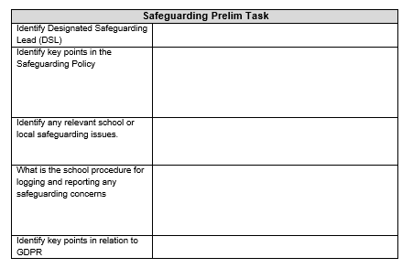

Slide 14
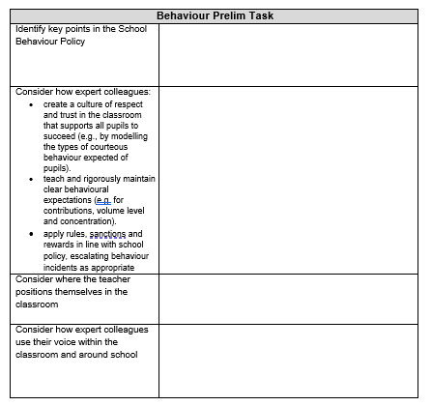

Slide 15
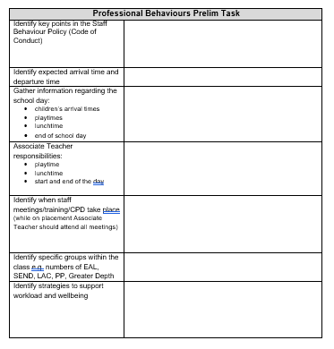

Slide 16
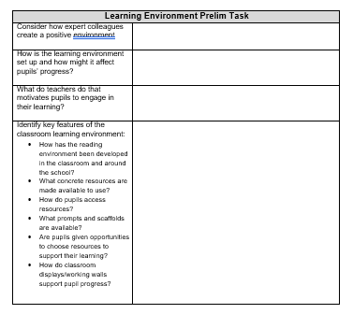

Slide 17
Associate Teacher Learning Observation
The minimum expectations in the preliminary visits of Learning Observations are:
One Core Subject
One Foundation Subject
One Phonics Session
Notes:
Refer trainees to pp3-8 of TP Booklet.

Slide 18
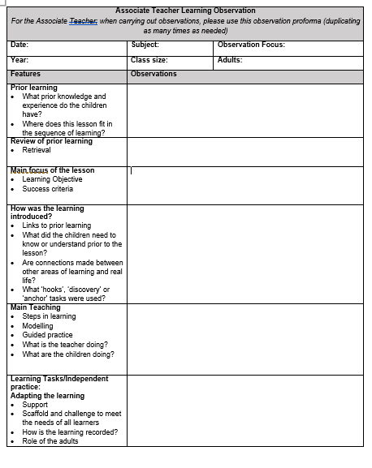
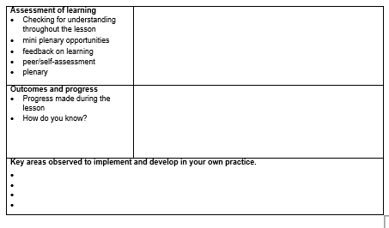

Slide 19
How to prepare for the School Based Training Block:
  Develop an appropriate teaching timetable through negotiation between mentor (class teacher) and Associate Teacher.
  Discuss targets and generate strategies for in-school support, this could include arranging to observe other colleagues in school.
  Identify subject knowledge needs and appropriate activities/resources/ideas to support the planning process.
  Identify a schedule for Weekly Meeting and Target Setting.
  Identify relevant staff meetings that should be attended.
  If, for any reason, you feel that the Associate Teachers is not ready to start the block experience, please contact the University Tutor.

Slide 20
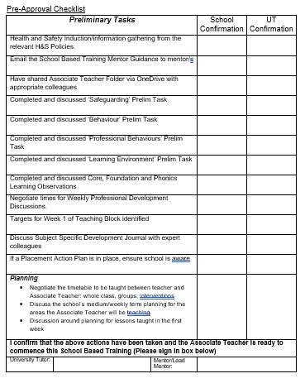
UT Sign off Meeting - Online
Associate Teacher should contact UT to arrange a time to meet via TEAMs
Targets should have been discussed
Associate Teachers will have to talk through the Pre-Approval checklist
Associate Teachers will be in school on this day but will need time to meet with their UT

Slide 21
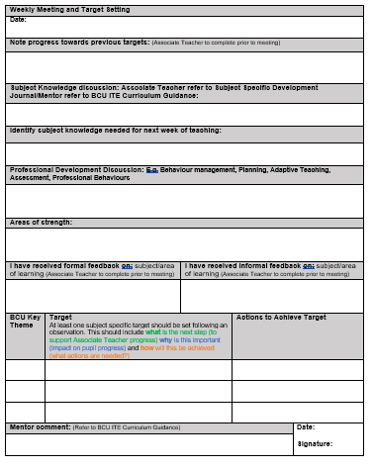
Weekly Meeting & Target Setting
These meetings provide an opportunity to identify what has been learnt and how the Associate Teachers has learnt it.
It is also an opportunity to discuss strengths and skills, knowledge and practice needed to develop.
Review targets set from the week before and set new targets
Please comment on progress towards the BCU curriculum

Slide 22
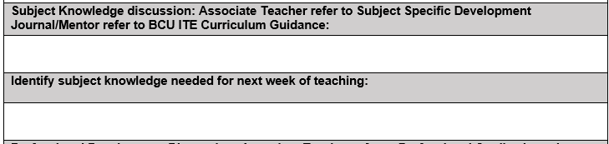
Weekly Meeting & Target Setting
Associate Teachers should be sharing their Subject Specific Development Journal at the Weekly Meetings. They should be talking to you about how their subject knowledge has developed with links to learning from university and how they have applied it in the classroom.

Slide 23
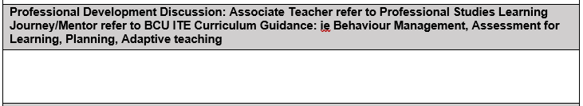
Weekly Meeting & Target Setting
Comments should be made relating to Professional Studies such as Behaviour Management, relationships with parents/carers, the wider roles and responsibilities of a teacher, planning and assessment.

Slide 24
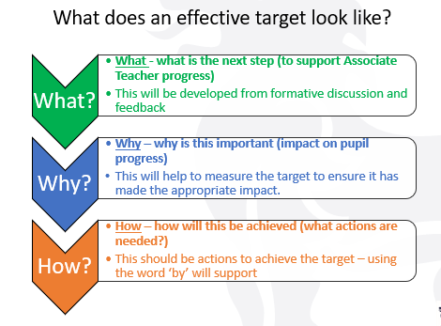
Target Setting

Slide 25
Focus on Target Setting
Target Setting: At least one subject specific target should be set following an observation. This should include what is the next step (to support Associate Teacher progress) why is this important (impact on pupil progress) and how will this be achieved (what actions are needed?)
PE EXAMPLE:
To scaffold the learning to enable all children to demonstrate the skill of jumping from 2 feet to 2 feet using the STEP model.
MATHS EXAMPLE
To use concrete resources for column addition to ensure secure procedural knowledge by modelling methods using concrete resources and provide opportunities for pupil to use them alongside the abstract.
HISTORY EXAMPLE
To embed effective use of timelines in your history teaching in order to develop and secure children’s chronological knowledge by revisiting university taught sessions for specific examples and including them within your history planning and teaching.

Slide 26
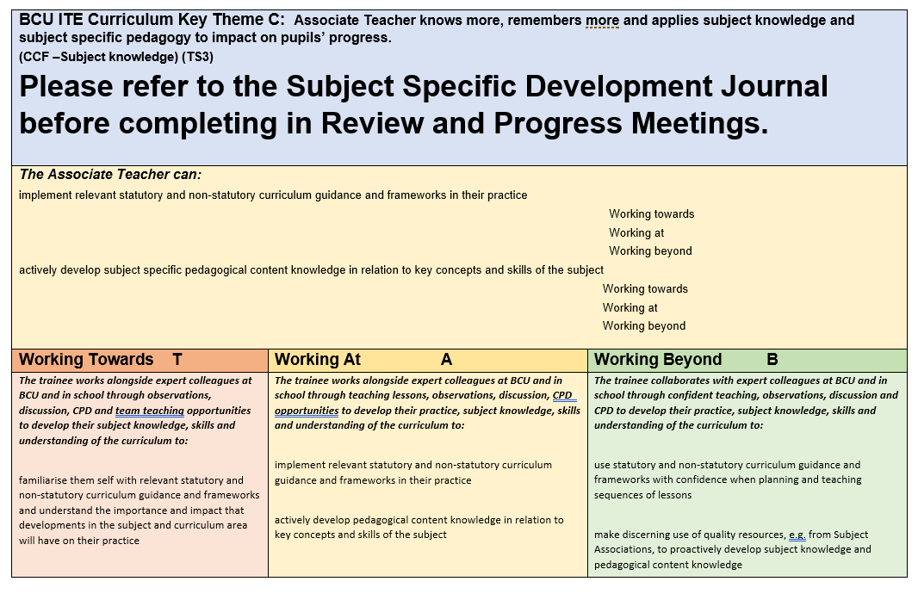
Assessment Tracker – Theme C
Notes:
This is a copy of Theme C. You will see that the colour coding as for our Phase 1, Phase 2 and Phase 3 of both our BAQTS and PGCE Curriculum coincides with our Primary Assessment Tracker. Theme C, focusing on subject knowledge looks different to last year as we have combined the evidence for this section with the Subject Specific Development Journal which PGCE Associate Teachers should be sharing with you.

Slide 27
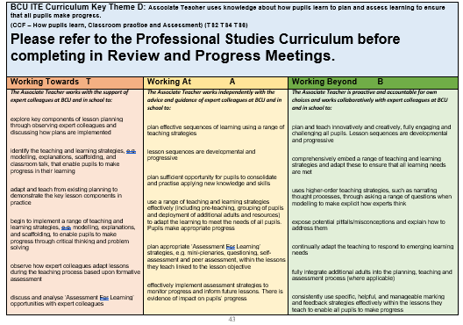
Assessment Tracker – A, B, D, E, F

Slide 28
Review Meeting/Progress Meeting
One of these should be completed face to face
The other is then completed online
In attendance there should be the UT, Associate Teacher and a Mentor from the school
Associate Teacher should come to this meeting with their Critical Incident completed and ready to share – up to 5 pieces of evidence CAN be bought to support the Critical Incident

Slide 29
Critical Incident - Definition
Critical incidents are learning situations that lead to significant learning and personal growth.
A critical incident does not need to be a serious or dangerous event; rather “critical” is to be interpreted as relevant or important that would require more in-depth reflections.

Slide 30
Critical Incident
BCU Assessment tracker is used to identify key areas of progression
Associate Teacher shows how they are progressing toward the BCU Curriculum Key Themes
The Critical Incident is the Associate Teacher’s opportunity to show and prove how they are progressing and developing.

Slide 31
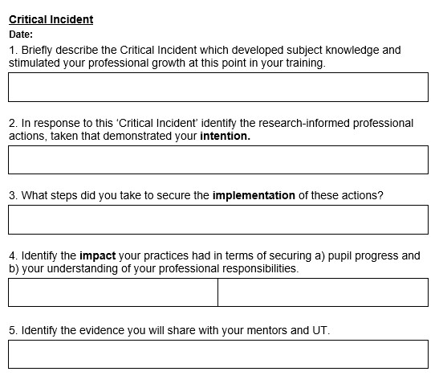

Slide 32
Critical Incident Focus
CI RM1 – Behaviour
CI PM1 – Linked to Phonics/Subject Specialism/An area of student reflection/learning
CI RM2 – Adaptive teaching linked to a subject
CI PM2 - Linked to Phonics/Subject Specialism/An area of student reflection/learning
CI RM3 – Assessment linked to a subject
CI PM3 - Linked to Phonics/Subject Specialism/An area of student reflection/learning

Slide 33
Joint observation
Face to face with mentor using subject specific feedback prompts
Non-negotiable one face to face joint observation per placement
If school requests an additional observation for support for a struggling Associate Teacher this is fine

Slide 34
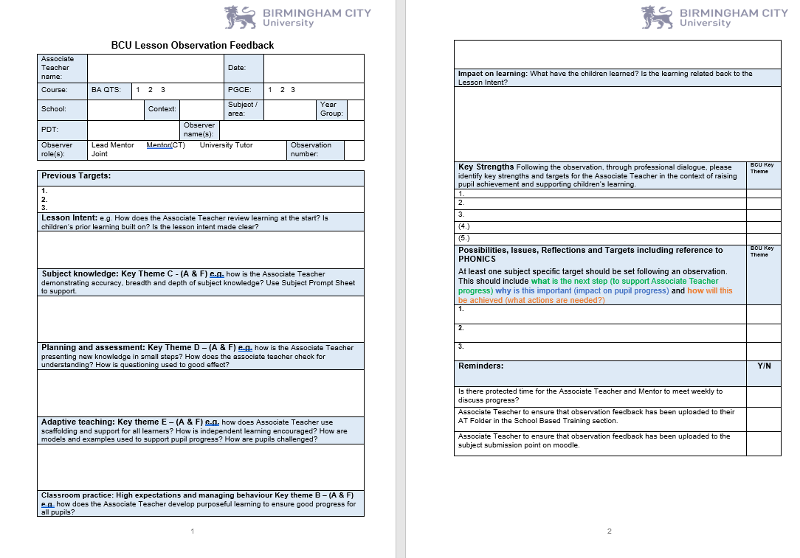

Slide 35
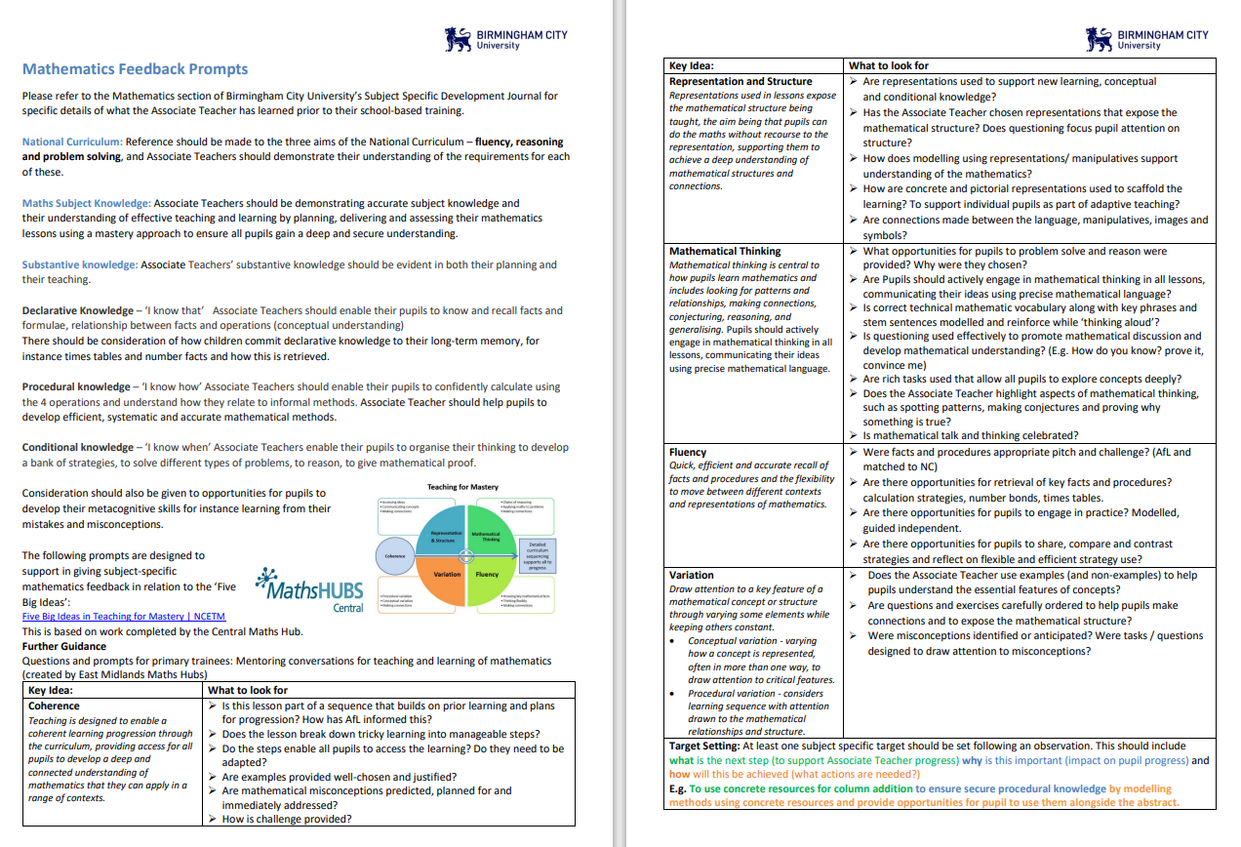
Subject Feedback Prompts

Slide 36
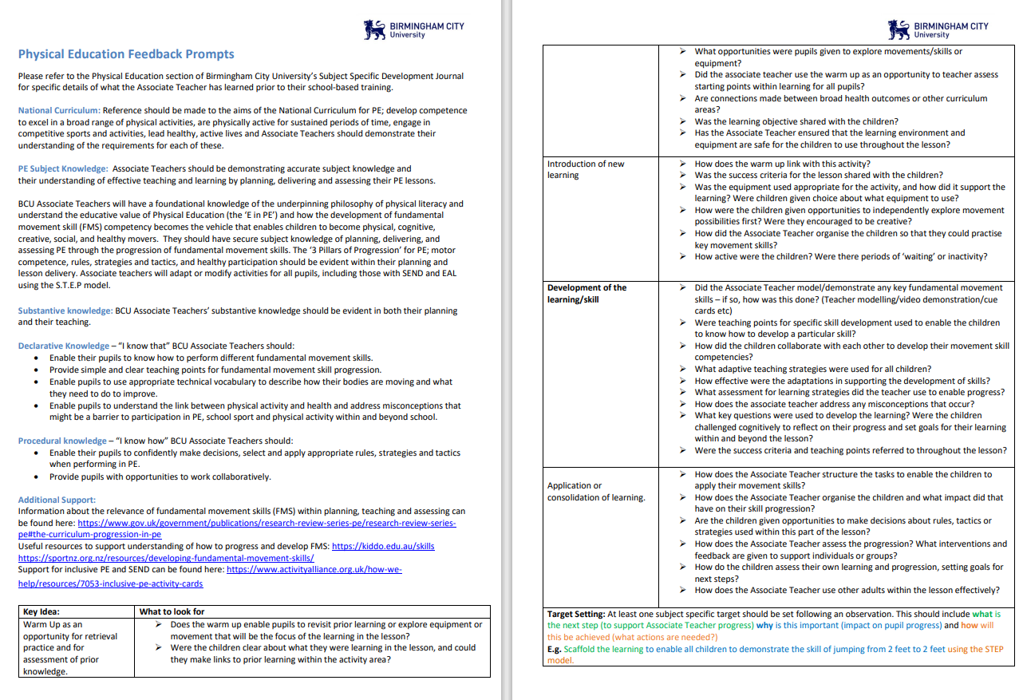

Slide 37
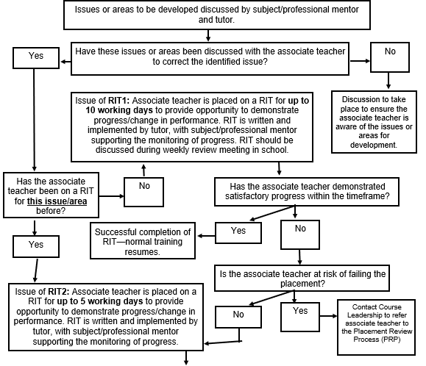
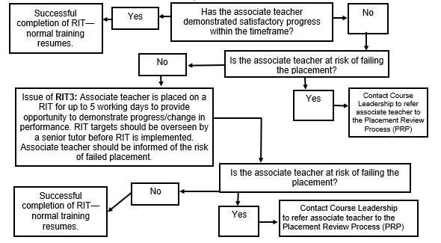
Rapid Improvement Targets

Slide 38

Mentor Guidance Booklet

Slide 39
Associate Teacher Planning Expectations
Associate Teachers are expected to use the BCU Planning Proforma
For Associate Teachers on their first placement this is for all lessons taught
They should have a clear understanding of the sequence of learning
For later placements all observed lessons should have planning on this proforma available

Slide 40
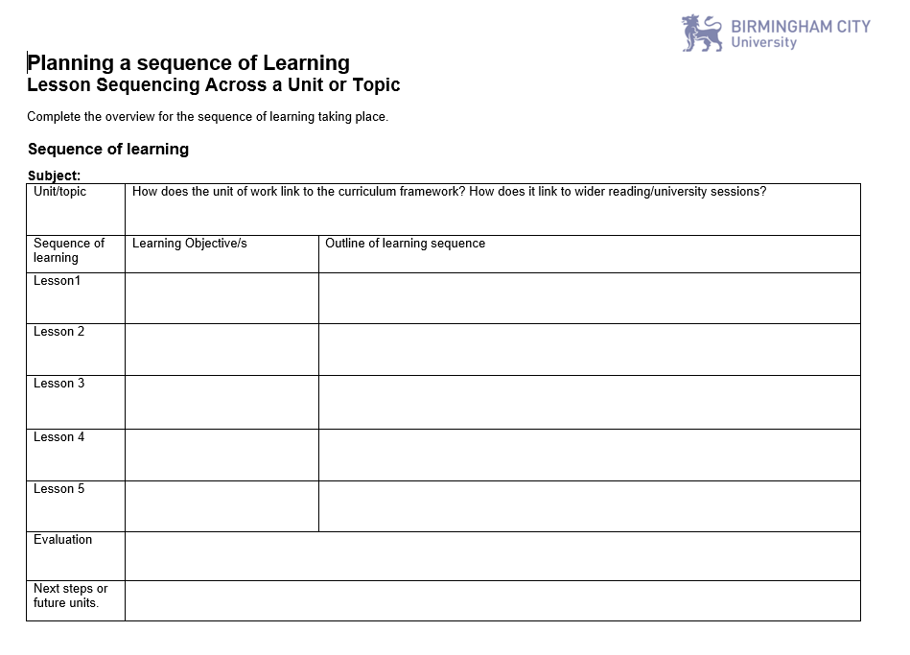

Slide 41
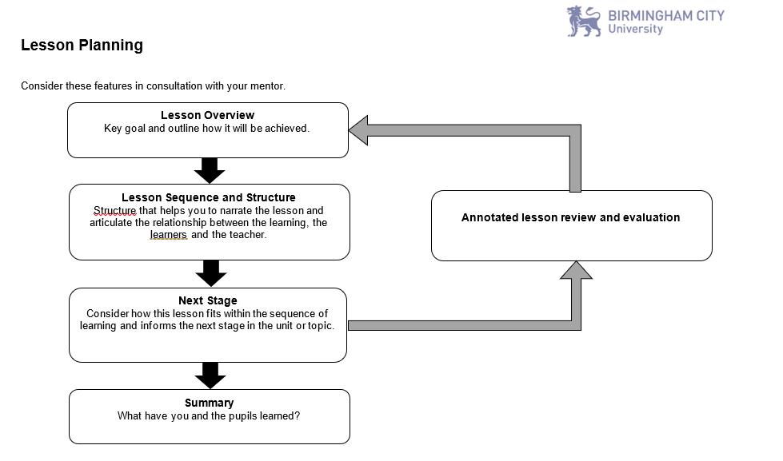

Slide 42
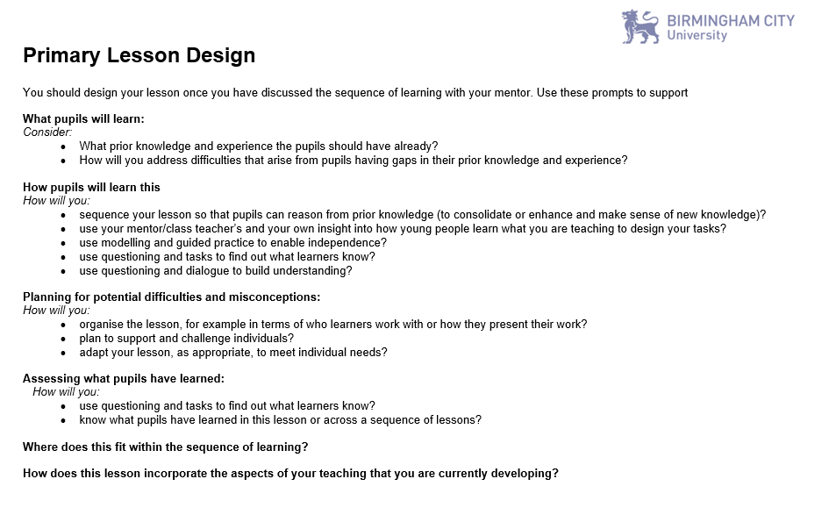

Slide 43
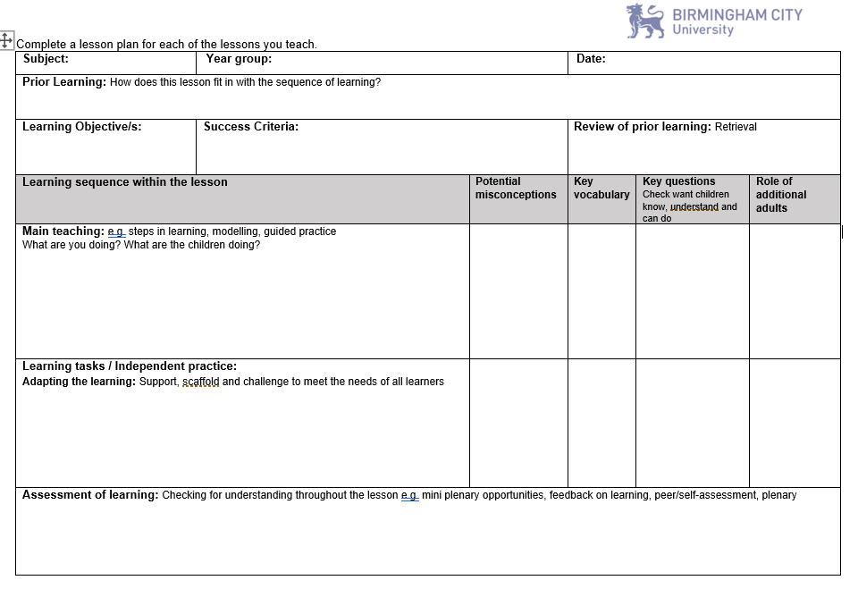
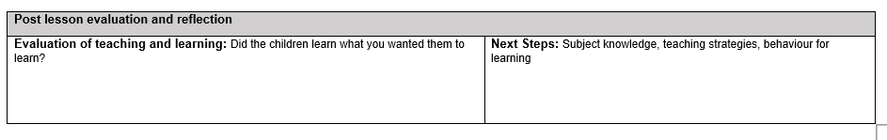

Slide 44
Other points to note:
Additional visits maybe needed for some Associate Teachers
Hub Leads will be contacting schools to continue building network opportunities
Primary and Early Years partnership website
Mentor Induction recording - Mentor Induction 2023-24
Mentor Induction information - Access Mentor Induction PowerPoint

Slide 45
Mentor and CPD dates for 2023-24
Primary Partnership Website
CPD 1 | Monday 6 November or Thursday 9 November 2023 3.45 - 4.45 pm | Focus: Giving effective feedback, written and verbal. What makes a good mentor or good mentoring? Supporting Associate Teachers in the critical incident step by step process.
CPD 2 | Tuesday 21 November or Thursday 23 November 3.45 – 4.45 pm | Focus: Using the BCU ITE Curriculum to set appropriate SMART targets to support Associate Teacher development and progress. Critical incident update and quality of evidence. Assessing Associate Teachers accurately against the BCU ITE Assessment tracker.
Drop-in | Monday 27 November or Tuesday 28 November 4.00 - 5.00 pm | Focus: Questions and answer drop-in session to support all mentors in school.
CPD 3 | Monday 22 January or Tuesday 23 January 4.00 - 5.00 pm | Focus: Bespoke: Supporting new schools and mentors working with PGCE SBT2 and BA Year 2 Associate Teachers.
CPD 4 | Tuesday 5 March or Thursday 7 March 2024 3.45 - 4.45 pm | Focus: Challenging our Associate Teachers to use their developing subject knowledge to have an impact on the learners in their class. How does the Progress meeting demonstrate professional competency?
Drop-in | Monday 22 April or Tuesday 23 April 4.00 - 5.00 pm | Focus: Questions and answer drop-in session to support all mentors in school.
Notes:
These are our CPD dates for 2023/24.
We have deliberately kept these to three repeater sessions so that you can also work closely with your University Tutor to develop your understanding and active engagement with our BCU ITE Curriculum.
All dates have been added to the Primary Partnership Website Please note that the expectation is that all mentors complete the Mentor Induction whether this is live through the sessions on offer or watching the recorded version. Mentors also attend at one CPD session and relevant school briefing when they have Associate Teachers in schools. Mentors are more than welcome to engage with any of the CPD sessions as again, recordings and PowerPoints will be uploaded to the Primary Partnership website.

Slide 46
UT Conversation Checklist with School Colleagues
Progress Journal - Weekly meeting filled in appropriately
Subject Specific Targets
Subject Specific Development Journal/Professional Studies Development Journal
Observations – subject specific targets
Are Subject Feedback Prompts being used?
Partnership website awareness
Aware of mentor CPD
Access to Associate Teacher Folder
Has mentor accessed recordings of School Briefing if not attended?
Share dates for future School Based Mentor Briefings

Slide 47
Initial Conversation
UTs will be checking with schools that they are compliant either before the block placement or as soon as feasibly possible. This includes confirming the Ofsted grading, safeguarding issues and to make sure all information is accurate in terms of name and email address of the Headteacher, ITE Mentor and relevant mentors.

