Slide 1


Birmingham City University (BCU) International Enrolment
Edwin Boateng – Enrolment Officer
Jo Cully – Head of UKVI Compliance
Sukhvinder Rana - Account Collections Manager
2023-24

Slide 2

International Enrolment 2023-24
What is enrolment?
When you enrol at BCU you enter into a formal agreement with the University, with rules, regulations policies and procedures on both sides.
You can find out more about the legal details and your responsibilities as a student in the Student Contract.
You must complete enrolment to study at BCU.
You are required to complete a series of online enrolment tasks before you arrive and attend an on-campus enrolment appointment when you get here.
Enrolment is also a time to ask us any questions, get your ID card and officially become a student!

Slide 3
International Enrolment 2023-24
Before you arrive
Check your emails - An invitation to enrol will be sent to your personal email address before your course start date provided you have accepted an unconditional offer and received your Confirmation of Acceptance of Study (CAS) Letter.
You will receive a separate email with IT log in details.
Make a note of your student ID number.
Let us know your travel plans and keep us updated with your arrival date.

Slide 4
Travel Plans and Arrival Details
International Enrolment 2023-24
Travel plans and arrival details
So that we can support you, it is important that you keep us updated with your travel plans and arrival details. Please log into your mySRS portal and provide the following details:
Visa issued (inc. details)
BRP issue point
Flight booked
Arrival date
If anything changes you will need to log back in and keep us updated.
Students should arrive in the UK and enrol by the time your teaching starts. This will ensure that you have the necessary access to all the resources that you need to successfully start your course.
If you are going to be delayed, you must let the Student Engagement Team know by logging this on the mySRS portal or by emailing studentengagement@bcu.ac.uk. PLEASE NOTE: late arrivals may not be accepted.

Slide 5
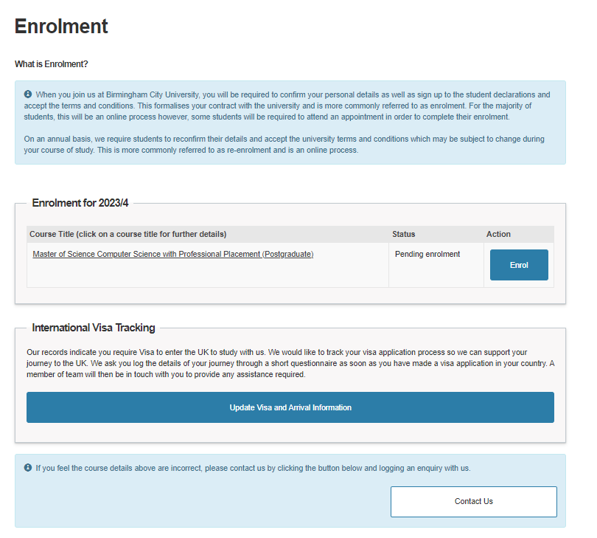
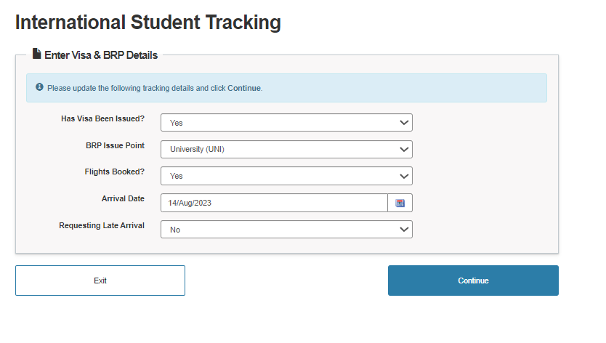
International Student Tracking
International Enrolment 2023-24
International Student Tracking

Slide 6
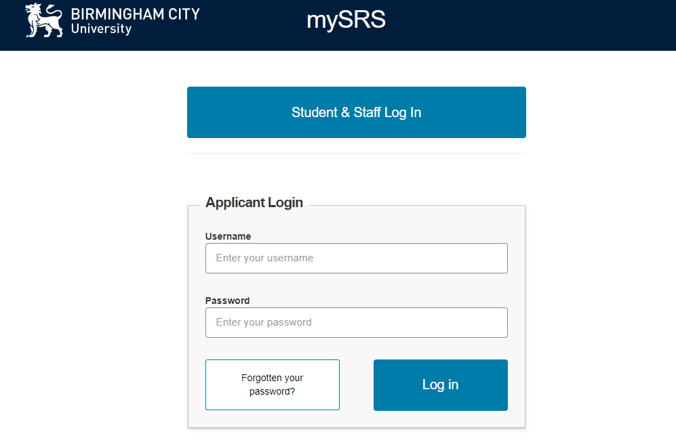
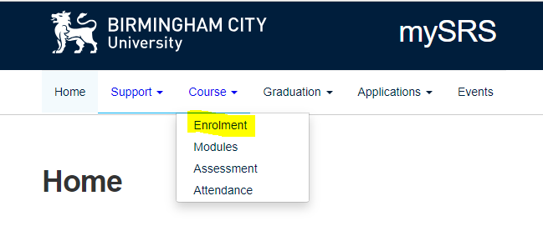
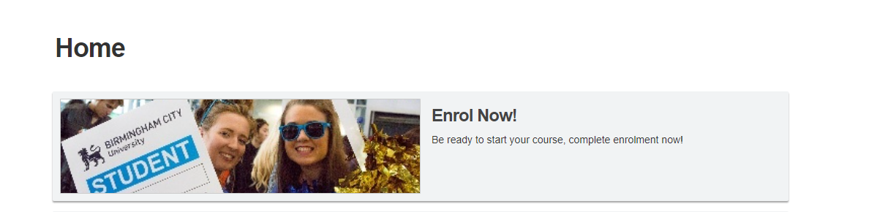
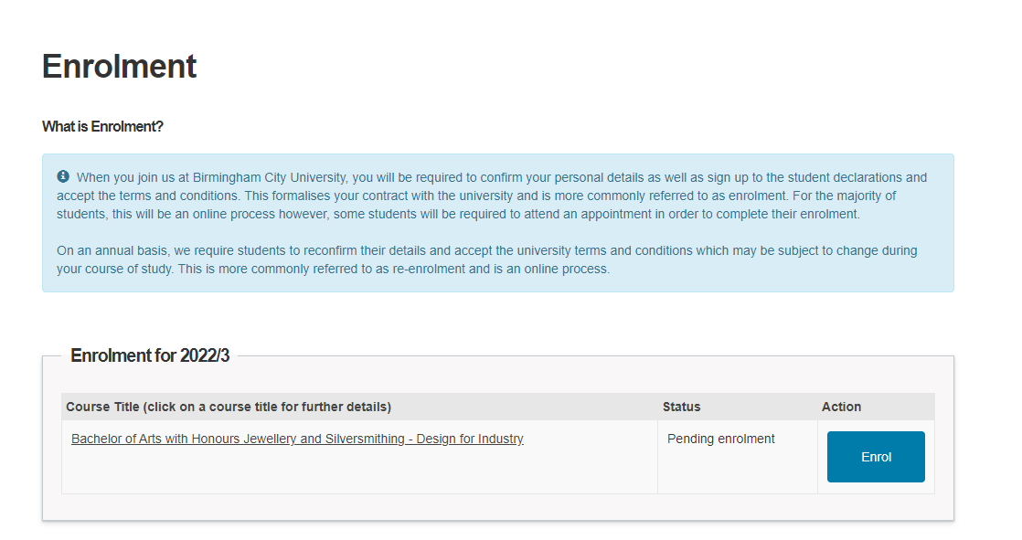
Enrolment Portal
International Enrolment 2023-24
Enrolment portal
Logging in
The first time you access your enrolment portal, click on the link in your invitation to enrol email.
To go back into your enrolment page please log back into your MySRS portal - https://mysrs.bcu.ac.uk/
Log in with your applicant ID and password

Slide 7
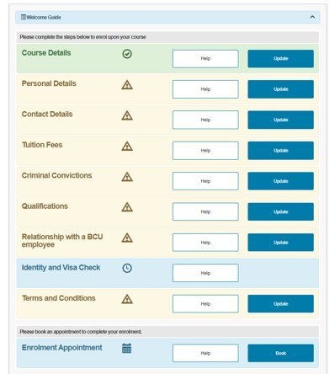
Online enrolment tasks
International Enrolment 2023-24
Online enrolment tasks
Work through the online enrolment tasks -
Tasks you need to update are in orange.
Once a section is complete it will turn green.
If a task is blue this means it is pending and a member of staff needs to look at it before you can complete enrolment.
The Identity and Visa Check and Tuition Fees tasks will remain blue until you see the relevant at your enrolment appointment.

Slide 8
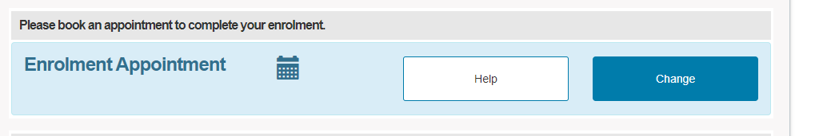
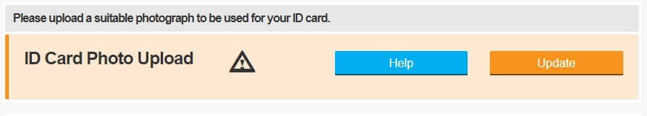
International Enrolment 2023-24
Online enrolment tasks
Book an enrolment appointment on your MySRS portal - Please book the first available appointment that you can attend.
You are required to upload a passport-style photo - Click update on the enrolment task and follow the instructions on screen

Slide 9
What to expect at your enrolment appointment
International Enrolment 2023-24
What to expect at your enrolment appointment
The Enrolment Centre is located on the first floor in Curzon Building in room C140. Maps and directions can be found here - City Centre Campus - Map and Directions | Birmingham City University (bcu.ac.uk)
There will be a meet and greet at Curzon reception to welcome you to BCU.
​You will see the following teams at your enrolment appointment -
Registration desk
UKVI Team
Admissions Team (you will be contacted in advance if you need to provide evidence of qualifications)
Finance Team
ID card collection
Under 18's must be accompanied by a legal guardian. This must be the guardian you nominated as part of the admissions process. Your guardian must also bring their passport to the appointment.

Slide 10
International Enrolment 2023-24
Which documents do I need to bring with me?
Proof that you have paid 50% tuition fee, including Visa deposit. PLEASE NOTE: this does not include any scholarship awarded as this will be applied to your remaining fee's after enrolment.
Have your full address of your current accommodation and UK mobile number (if you have one) ready to show us.
Any other documents that you have been asked to provide.
Providing proof of qualifications –
If required, International Admissions team will contact you to confirm which qualifications you need to bring.

Slide 11
International Enrolment 2023-24.
Which documents do I need to bring with me?
Please have your Student ID number ready when you come in to see us. This can be found on your email inviting you to enrol.
Please bring the following documents with you to your enrolment appointment –
Passport
Biometrics Residence Permit (BRP) if you have already collected it - If you’re collecting from the Post Office, please make sure you have collected the BRP before your appointment
Your dependants’ passports if you are collecting their BRP

Slide 12
International Enrolment 2023-24.
How do payments work?
We do not accept cash payments, card payments OR bank transfers.
Deposit
You are required to pay 50% of your tuition fees to complete your enrolment. Scholarships cannot be used as part of your deposit.
These will be applied to the remaining 50% of your fees.
Tuition Fee 23/24 £16,870
Deposit -£ 4,000
50% deposit -£ 4,435
Balance £ 8,435
Scholarship -£ 2,000
Balance to Pay £ 6,435
This can be made using one of the following links - https://ipay.bcu.ac.uk/open / https://payment.flywire.com/pay/payment
2. Payment Plans
Once you have been enrolled you will receive an invoice via email to your BCU email account.
At this point you have 2 choices, either to pay the balance in full or join an official payment plan. (4 weeks from course start date)
Plans available 3 or 6 instalments. (Non-negotiable)
Full payment or setting up of a payment plan can be done via the following link: https://ipay.bcu.ac.uk/invoice
For non-compliance there are penalties applied to your account

Slide 13
International Enrolment 2023-24
Passport and BRP
As a Student Visa Route Holder you will need to present your Passport and BRP to the UKVI team at your enrolment appointment. Without these two documents you will not be able to enrol.
PLEASE NOTE: you must not send your BRP to the DVLA or any other organisations such as this before you have completed your enrolment.
If you have selected to collect your BRP from Birmingham City University your BRP will be issued to you during your appointment. Our ACL Code is 2HE522
If you have selected to collect your BRP from a local Post Office you will need to collect your BRP before your enrolment appointment.
By selecting BCU as the collection point, we can resolve issues with incorrect or undelivered BRPs more quickly than if they have been delivered to the Post Office
If you’re unsure where your BRP is going to be sent, please refer to your Decision Letter. This letter is sent to you by the Home Office via email or in the post when your Passport is returned to you. The address for your BRP collection point is referenced in this document.

Slide 14
How do payment work
International Enrolment 2023-24
How do payments work?
We do not accept cash payments, card payments OR bank transfers.
3. Collections Team
This is the team responsible for making sure you have paid your 50% deposit, monitoring payment plans and payment of your tuition fee.
They are contactable via email collections@bcu.ac.uk or via phone:
BLSS – Business school 07784361292
BLSS – Law & Social Sciences 07784361293
CEBE – Computer Engineering Built Environment 07784361299
ADM – Art Design & Media 07784361291
HELS - Health 07784361303
HELS – Education and Life Sciences 07871991034
https://icity.bcu.ac.uk/Student-Affairs/Finance-and-money-matters/Financial-Support/Index

Slide 15
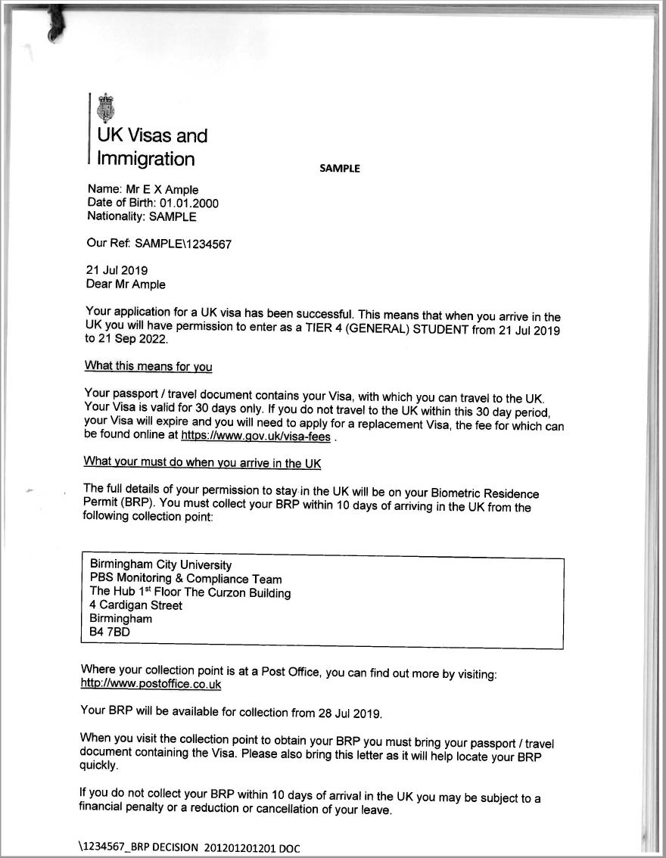
Example of a Decision Letter
International Enrolment 2023-24
Example of Decision Letter
This is an example of your Decision Letter, your letter may look slightly different to the example used here however, it will still contain the details we are about to cover.
Your decision letter will have the end date of your Student Visa on your first page this is important to note as the end date on your BRP will likely appear as '31/12/2024'.
The decision letter will also have the address that your BRP is going to be sent to, to collect your BRP you will need to go to the address that is listed on your decision letter. If this is Birmingham City University your BRP will be issued to you during your Enrolment Appointment. You may find your BRP collection point on page 3 of the document.
Your decision letter may be sent to you in an email or via the post, please make sure you have read and understand the details of your decision letter as it will be needed during your appointment.

Slide 16
Accommodation
International Enrolment 2023-24
Accommodation
As part of the UKVI enrolment process you will be asked to confirm the address you’re currently living in.
If this is a temporary address you must change the address on your MySRS portal once you have moved to your permanent accommodation.
You will need to provide your full address, so make sure to have the following information ready at your enrolment appointment.
  Postcode
  Name of street
  The house/flat number
You will also need to provide your UK mobile phone number
It is BCU's legal responsibility to always have your up-to-date contact details during your studies
Please have this information ready before your appointment

Slide 17
International Enrolment 2023-24
Collecting your Dependents' BRPs
If you’re collecting your BRPs for yourself and your dependents, you will need to make the UKVI team aware of this at the beginning of your appointment.
To collect your dependants BRPs you will need to bring their passports with you to the appointment as well.
If you have arrived in the UK before your dependents you won't be able to pick up their BRPs until they are in the UK. You will still need to bring your passport and your dependents passports to collect them.

Slide 18
International Enrolment 2023-24
Living in Birmingham
•BCU expects students to live within reasonable distance of campus.
•Living close to campus has many benefits:
•Helps ease transition into university life.
•Better academic results (because of better attendance & engagement).
  For example - If you have a 9am lecture - can you get in on time?
•Participate fully in university life –
  Societies, clubs, events etc.
  Meet new people, make new friends.
•Explore Birmingham’s vibrant cultural life.
•Excellent transport links – easy to explore UK.

Slide 19
International Enrolment 2023-24
Bringing Dependents to the UK
BCU cannot currently provide family accommodation
Please note that BCU does not have any family accommodation. We recommend that you organise any family accommodation as early as possible.
Useful rental companies - Rightmove, Zoopla, Open Rents
Childcare
The University does not have any childcare facilities and you cannot bring children or babies with you to campus.
Childcare is expensive in the UK so you should factor this into your living expenses.

Slide 20
Generating a Share code
International Enrolment 2023-24
Generating a Share Code
If you’re a student living inside of the EU you will be required to present the following information at your enrolment appointment:
Your Passport
Your UKVI Visa Share Code
  To generate your Share Code follow the link: https://www.gov.uk/view-prove-immigration-status
Your UKVI Visa Decision Letter
Boarding pass information that evidences your entry into the UK

Slide 21
International Enrolment 2023-24
Attendance Monitoring
You must attend all your timetabled sessions from the first week of teaching, even if you are still completing your enrolment.
If you have arrived in the UK but not yet had your enrolment appointment, you must still attend classes. You can access your timetable via iCity (Log in to iCity > Click the BCU Links button in the top left-hand side > Click Your Calendar) or the BCU app.
Attendance is monitored from the start of term, if you have not been given a student ID card let your lecturer know that you are there and ask them to update your attendance.
If you arrive in the UK after teaching has started, you are expected to attend your next scheduled teaching session.
Attendance is linked to the conditions of your Student Route Visa as your primary purpose to be in the UK is to study. Failure to attend and/or low attendance will result in the University withdrawing you from your course and reporting the breach to the Home Office.
The Student Academic Engagement Policy can be accessed from the Student Contract under the 2023/24 academic year.

Slide 22
Help with enrolment
Your Enrolment Support Team can be contacted by email or telephone. The team are available Monday to Friday, 9am - 5pm.
Email: studentengagement@bcu.ac.uk
Telephone: +44 121 331 5684
International Enrolment 2023-24

