Slide 1
Review and Progress Meeting Assessment Points

Slide 2
Review Meeting and Progress Meeting
One of these should be completed face to face
The other is then completed online
In attendance there should be the University Tutor, Associate Teacher and a Mentor from the school
The Associate Teacher should come to this meeting with their Critical Incident completed and ready to share – up to 5 pieces of evidence CAN be bought to support the Critical Incident for discussion.

Slide 3
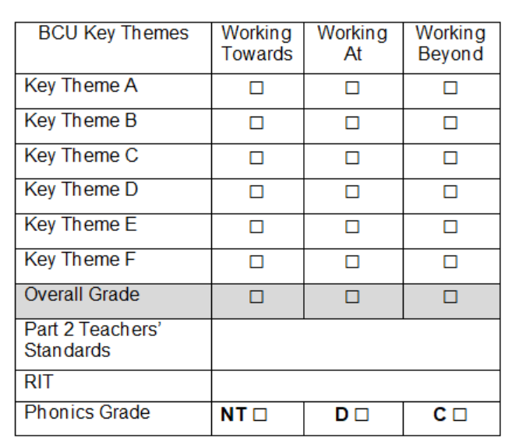
Review meeting 1
(Mid-point)
Review Meeting 1 will take place between the Associate Teacher, class teacher (or school mentor) and university tutor.
BA Year1 (SBT1: Part 1)
PGCE (SBT1)
When making a judgement for the Review Meeting 1 consider the Associate Teachers’ overall performance to date and make a ‘best fit ‘judgement based upon performance against all of the BCU Curriculum Key Themes as recorded in the BCU Formative Assessment Tracker.
Review the Associate Teachers’ progress and attainment against Part 2 of the Teachers’ Standards.
Review Meeting 1 – Associate Teachers who are on track to be awarded QTS will be demonstrating their competence in most of the BCU Curriculum Key Themes at the Working Towards level.
If the Associate Teacher is not able to demonstrate their competence in one or more of the BCU Curriculum Key Themes at Working Towards level and/or is not fully engaged or responding to advice and feedback their progress is judged as requiring improvement.
Please identify targets and strategies for improvement with the Associate Teacher and complete the RAPID IMPROVEMENT TARGETS form.
Please email a copy of the RAPID IMPROVEMENT TARGETS to:
Course/Year Leads
Notes:
BA Year 1 will have just completed their Review Meeting 1. PGCE will have just completed their Review Meeting 1 in their first placement and BA Year 2’s will have completed this last year. This point they should have demonstrated key themes at the Working Towards Evel and still on track.

Slide 4
Progress meeting 1 (End of SBT1)
Progress Meeting 1 will take place between the Associate Teacher, class teacher (or school mentor) and university tutor.
BA Year 1 (SBT1: Part 2)
PGCE (SBT1)
The BCU Formative Assessment Tracker incorporates the Teachers’ Standards so it is the assessment tool that is used to make a summative judgement for the award of QTS.
When making a judgement for the Progress Meeting 1 consider the Associate Teachers’ overall performance to date and make a ‘best fit ‘judgement based upon performance against all of the BCU Key Themes as recorded in the Assessment Criteria.
If the Associate Teacher has any RAPID IMPROVEMENT TARGETS outstanding from during the placement, please review these during Progress Meeting 1.
Review the Associate Teachers’ progress and attainment against Part 2 of the Teachers’ Standards.
Progress Meeting 1 – Associate Teachers who are on track to be awarded QTS will be demonstrating their competence in all of the BCU Curriculum Key Themes at the Working Towards level.
If the Associate Teacher is not able to demonstrate their competence within all areas of the BCU Curriculum Key Themes at Working Towards level and/or is not fully engaged or responding to advice and feedback their progress is judged as Failed Placement.
Associate Teacher has taught phonics/guided reading - yes/no
If the Associate Teacher still requires further experience of teaching phonics/ guided reading, include as a target for their next placement.
Please email a copy of the RAPID IMPROVEMENT TARGETS to: Course/Year Leads

Slide 5
Review Meeting 2
(Mid-point)
BA Year 2 (SBT2)
PGCE (SBT2)
Review Meeting 2 will take place between the trainee, class teacher (or school mentor) and university tutor.
When making a judgement for the Review Meeting 2 consider the Associate Teachers' overall performance to date and make a ‘best fit ‘judgement based upon performance against all of the BCU Curriculum Key Themes as recorded in the BCU Assessment Tracker.
Review the Associate Teachers’ progress and attainment against Part 2 of the Teachers’ Standards.
Notes:
Now we’re moving onto Review Meeting 2 which will be taking place next week for our BA Year 2s and PGCEs.
This is the mid-point. Using the Assessment tracker and overall performance to date and making a best fit judgement against those key themes. So at your weekly meetings or discussions with ATs you will have highlighted the relevant statements with robust evidence to support that judgement. What we want to see at this point who are on track should be demonstrating their competence of each of the key themes at 75% at the Working Towards. Some may have highlights statements at working at as well. Anyone requiring improvement will be demonstrating less than 75 % n- not fully engaged or responding to advice and feedback. At this point we would put in a Rapid Improvement Target in place. Identifying where the gaps are and what they need to do and focus practice. This will of course be done in consultation with the AT, yourself and the UT.

Slide 6
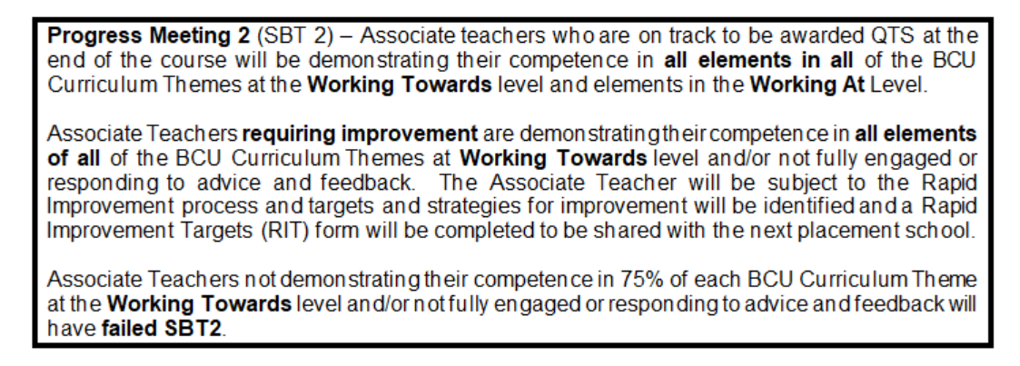
Progress meeting 2 (End of SBT2)
BA Year 2 (SBT2)
PGCE (SBT2)
Progress Meeting 2 will take place between the trainee, class teacher (or school mentor) and university tutor.
When making a judgement for the Progress Meeting 2 consider the Associate Teachers’ overall performance to date and make a ‘best fit ‘judgement based upon performance against all of the BCU Key Themes as recorded in the Assessment Criteria.
If the Associate Teachers’ has any RAPID IMPROVEMENT TARGETS outstanding from during the placement, please review these during Progress Meeting 2. Review the trainee’s progress and attainment against Part 2 of the Teachers’ Standards.
Notes:
Working towards to Progress Meeting 2 – now making the judgement of their overall performance based against those key themes. At this point they should have all elements in all of the key themes. If they haven’t by then it will be a failed SBT2.
This means that if they were not on track at Review Meeting 2 and come to this Progress Meeting still not meeting that 75% coverage at Working Towards even with Rapid Improvement Targets in place, this would be a failed SBT2.

Slide 7
Review meeting 3
(Mid-point)
BA Year 3 (SBT3)
PGCE (SBT3)
Review Meeting 3 will take place between the trainee, class teacher (or school mentor) and university tutor.
When making a judgement for the Review Meeting 3 consider the Associate Teachers’ overall performance to date and make a ‘best fit ‘judgement based upon performance against all of the BCU Curriculum Key Themes as recorded in the BCU Assessment Tracker. Review the Associate Teacher’s progress and attainment against Part 2 of the Teachers’ Standards.
Review Meeting 3 – Associate Teachers who are on track to be awarded QTS will be demonstrating their competence in all of the BCU Curriculum Key Themes at the Working At level.
If Associate Teachers do not demonstrate competence in all standards at the Working Towards level and 75%/+ in the Working At their progress is judged as requiring improvement. Please identify targets and strategies for improvement with the Associate Teacher and complete the RAPID IMPROVEMENT TARGETS form with your University Tutor.
Notes:
Moving on Review Meeting 3 – for PGCE associate Teachers. Demonstrating competency in all of the key themes in all of the Key Themes in Working At. If there are any Working Towards or less than 75% in the Working At they will have a Rapid Improvement Target set. Again this is about preparing our ATs to make sure they are meeting the minimum requirements in order to be awarded QTS.

Slide 8
Progress meeting 3
(Final)
BA Year 3 (SBT3)
PGCE (SBT3)
Progress Meeting 2 will take place between the trainee, class teacher (or school mentor) and university tutor.
When making a judgement for the Progress Meeting 3 consider the Associate Teachers’ overall performance to date and make a ‘best fit ‘judgement based upon performance against all of the BCU Key Themes as recorded in the Assessment Criteria.
If the Associate Teacher has any RAPID IMPROVEMENT TARGETS outstanding from during the placement, please review these during Progress Meeting 3.
Progress Meeting 3 – Associate Teachers who are on track to be awarded QTS will be demonstrating their competence in all of the BCU Curriculum Key Themes at the Working At level. Associate Teachers in the Working Beyond levels can be deemed to have made very good progress in readiness for their ECT year.
If Associate Teachers have any standard in the Working Towards level the placement is deemed as a FAIL.

