Slide 1

CPD 3: New Schools
22 or 23 January 2024
Introduction and purpose
Keeping in touch: Primary Partnership Website
Supporting good mentoring
Giving effective feedback: Verbal and Written
Critical Incident reflection
Feedback/Actions/next steps
Notes:
A very warm welcome. This is the Agenda for today's CPD. We will be recoding this

Slide 2

Please add your name and email address to the chat bar
Notes:
Please add your name and email address to the chat bar.

Slide 3
1. Introductions and purpose
Introductions
Placement communication HELS.Placements@bcu.ac.uk
PGCE and BA Year 2 Associate Teachers are on School Based Training 2
BA Year 1 Associate Teachers are on School Based Training 1
CPD training
Mentor Induction – overview of our documentation
School Based Training Mentor Guidance 2023-24
School Colleague Mentor Briefings – identify specifics of the placement
Notes:
A warm welcome to this CPD 3 aimed at New Schools and partners who are working with us for the first time this academic year. For those of you who have already been working with us some of the content you will be familiar, but we want to draw your attention to how to work with your Associate Teacher to support their subject specific knowledge development through engagement with our BCU ITE Curriculum and complementary resources.
For all placement enquiries, please contact Hels Placement. We are signposting all our ATs to this team to resolve any questions/issues they or you may have.
We currently have PGCE, BA Year 1 and 2 out on placement.
To support you if you are new, we’d recommend that you look at the Mentor Induction PowerPoint. This will support you to ensure that the Associate Teacher shares their One Drive and in particular their Subject Specific Development Journal.
We will also share the School Based Training Mentor Guidance for 2023-24 later in this presentation.
You will also be guided to the specific School Colleague Mentor Briefings, again the links for will be shared shortly.

Slide 4

2. Keeping in touch: Primary Partnership Website
Primary Partnership Website
Notes:
This is our Primary Partnership Website, the source of key information. I'm going to click on the link and show you around. Check and discuss on this slide and next slide.

Slide 5
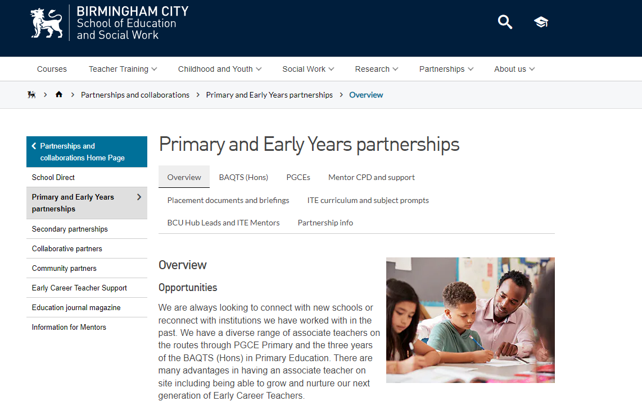
2. Keeping in touch: Primary Partnership Website
You are likely to be using the three sections identified most to support your Associate Teacher.
This is a ‘one-stop’ point to access all relevant BCU information.

Slide 6
3. Supporting good mentoring
Link | Mentor Induction | Purpose
Click to view Mentor Induction PowerPoint 2023-24 Click to access the Mentor Induction Video 2023-24 | Welcome and updates Ways of working Roles and Responsibilities Mentoring Associate Teachers Supporting Documentation and CPD dates Market Review 2024 | Supports mentors to have an overview or the BCU way to support Associate Teachers
Click on the link to access Mentor CPD and support
Notes:
As mentioned earlier, the Mentor Induction gives you a useful overview of our processes if you have not worked with us before. I’d recommend that you review the PowerPoint presentation which outlines roles and responsibilities, particularly as a mentor and how our Universtiy Tutors will be working with you. We look at the ways in which you can support struggling ATs and the supporting documentation.

Slide 7
Future CPD
Date(s) What | MS Teams Link | Content
05 February: 4.00 – 5.00 pm or 08 February: 4.00 – 5.00 pm SEND School Drop-in | Click to join on 5 February or Click to join on 8 February | Focus: Supporting SEND Schools to engage with our BCU Curriculum and support Associate Teachers effectively including those on the SEND Training route.
05 March: 3.45 – 4.45 pm or 07 March: 3.45 – 4.45 pm CPD4 | Click to join on 5 March or Click to join on 7 March | Focus: Challenging our Associate Teachers to use their developing subject knowledge to have an impact on the learners in their class. How does the Progress meeting demonstrate professional competency?
22 April: 4.00 – 5.00 pm or 23 April: 4.00 – 5.00 pm Drop-in | Click to join on 22 April or Click to join on 23 April
Click to access Mentor CPD and support
Notes:
These are our future CPD dates. We also have a further Mentor Conference which we will discuss at the end of this briefing.
We have changed our focus this year to work more effectively with you as mentors. Hence, there are two CPD sessions close together (which you can access again at your leisure) and a drop-in in case you have queries. Your University Tutor is also key and suggest if you have any immediate questions to ask them when they visit Associate Teachers.

Slide 8
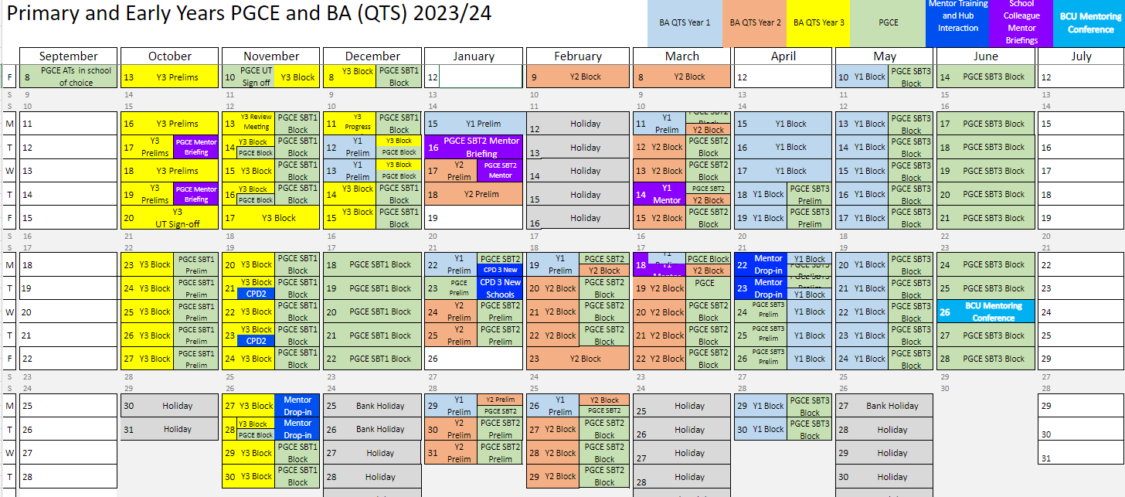
3. Supporting good mentoring: Mentor CPD Calendar
Outlines:-
Associate Teacher placement dates – broken down into PGCE, BA Y1, Y2, Y3
Mentor CPD
School Briefings
BCU Mentor Conference
BCU Mentor Calendar
Notes:
This is our Mentor CPD Calendar. This outlines key dates for placement and includes Mentor CPD.

Slide 9
3. Supporting good mentoring: School Colleague Briefings
BA Year 1 (School Based Training 1)
Click to access BA 1 Joint School Mentor Briefing Recording
Click to access BA 1 Joint School Mentor Briefing PowerPoint
BA Year 2 (School Based Training 2)
Click to access BA 2 Joint School Mentor Briefing Recording
Click to access BA 2 Joint School Mentor Briefing PowerPoint
PGCE (School Based Training 2)
Click to access PGCE SBT2 School Mentor Briefing PowerPoint
All available on:
Placement documents and briefings
Notes:
School Briefing Mentor Meetings have already taken place for our Associate Teachers in schools. These school briefings hold important information for you to be able to support our Associate Teachers effectively. School briefings will be shared with you by your University Tutor, but in the interim you can find these on our Primary Partnership Website as well as using the links in this presentation. If you have any questions regarding content, please liaise with your University Tutor when you have your initial conversation.

Slide 10

3. Supporting good mentoring: Mentor Guidance
Please take a moment to flick through the School Based Training Mentor Guidance PGCE-BAQTS 2023-24
School Based Training Mentor Guidance PGCE-BAQTS 2023-24
Primary Partnership Website
Notes:
Our School Based Training Mentor Guidance is your one-stop ‘bible’ for understanding your role as a mentor working with us this year. Associate Teachers should have shared this with you via their One Drive.

Slide 11

3. Supporting good mentoring: Mentor Guidance

Slide 12
4. Giving effective feedback: Verbal
What does good feedback look like?
Discussion – share your thoughts?

Slide 13
Written
Verbal
Challenge
Elicit
Support
Impart
BCU Mentoring Hub (2023)

Slide 14
4. Giving effective feedback: Verbal
Elicit – ask questions and then listen
Challenge – provide a different perspective, another point of view
Support – encourage and validate
Impart – share knowledge and experience
Can you think of an example of your own?

Slide 15
4. Giving effective feedback: Verbal
What went well in the lesson how do you know?
How well did the lesson sit within the sequence of lessons being taught in the subject?
Did you achieve your learning outcomes? If not, how would you address this if you taught the same lesson again?
What did the pupils learn in the subject taught ? How do you know? Did all pupils make good progress?
How did you adapt your teaching to meet the needs of all learners?
Do you think you created a positive learning environment? How? What behaviour management strategies did you use? Were they effective?
Do you think you organised and managed the groupings of pupils well?
How did knowledge of pupil data/prior knowledge inform your decisions?
Did you challenge the different attainment levels effectively? How were they engaged and inspired?
How did you use your body language (non-verbal communication NVC)/voice effectively? How might you improve this further?
How well did you manage transitions between tasks?
In which part of the lesson did you feel most confident? Why?
How effective were the resources you used? How do you know? Would you tweak/change any of them for next time?
Notes:
These questions are intended as support for the lesson observation feedback discussion. Tale a moment to read and share any thoughts in the chat bar.

Slide 16
4. Giving effective feedback: Written targets
Focus on the targets
Knowing what the Associate Teacher needs to develop further
Setting precise targets to support Associate Teacher
Identify next steps
Making links to the BCU ITE Assessment Tracker
Using the Subject Specific Prompts to support written feedback

Slide 17
BCU ITE Curriculum Key Themes: Assessment Tracker
BCU ITE Curriculum Key Themes
A. Associate Teachers use critical enquiry and research informed practice to develop their understanding of effective teaching and learning.
B. Associate Teacher’s classroom practice establishes effective behaviour management through the use of high expectations and awareness of pupil wellbeing.
C. Associate Teachers knows more, remembers more and applies subject knowledge and subject specific pedagogy to impact on pupils’ progress
D. Associate Teachers uses knowledge about how pupils learn to plan and asses learning to ensure that all pupils make progress.
E. Associate Teachers implement effective adaptive teaching approaches to support all learners, including SEND (Special Educational Needs and Disabilities) and EAL (English as Additional Language) learners.
F. Associate Teacher’s demonstrate professional behaviours and contributes effectively to the wider life of the school.
Notes:
As you will see from this slide the BCU ITE Curriculum has six principles which underpin the content of all our Initial Teacher Education courses. These principles are used by mentors and BCU University tutors in review and progress meetings to formatively assess a trainee’s strengths and areas for development. The six foci within this core curriculum are:
Associate Teacher uses critical enquiry and research informed practice to develop their understanding of effective teaching and learning
Associate Teacher’s classroom practice establishes effective behaviour management using high expectations and awareness of pupil wellbeing
Associate Teacher knows more, remembers more and applies subject knowledge and subject specific pedagogy to impact on pupils’ progress
Associate Teacher uses knowledge about how pupils learn to plan and assess learning to ensure that all pupils make progress
Associate Teacher implements effective adaptive teaching approaches to meet all learners’ needs, including SEND (Special Educational Needs and Disability) and EAL (English as an Additional Language learners).
Associate Teacher demonstrates professional behaviours and contributes effectively to the wider life of the school

Slide 18
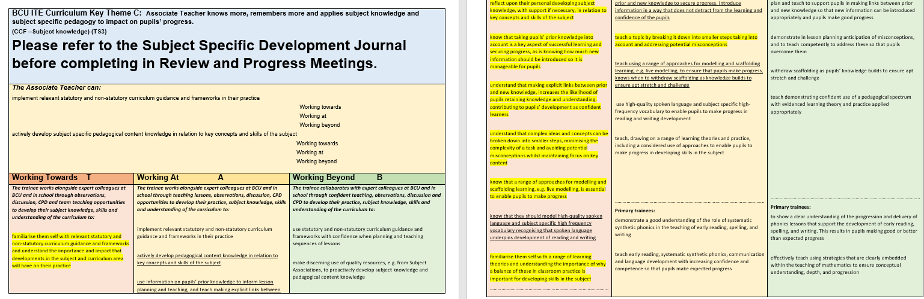
4. Giving effective feedback: Written targets
Click on the link to access the BCU ITE Assessment Tracker
Flick through each of the Key Themes to familiarise yourself with the language. This will also support with target setting.
Notes:
This is a copy of Theme C. You will see that the colour coding as for our Phase 1, Phase 2 and Phase 3 of both our BAQTS and PGCE Curriculum coincides with our Primary Assessment Tracker. Theme C, focusing on subject knowledge through the Associate Teacher’s Subject Specific Development Journal which PGCE Associate Teachers will have shared with you. As an activity, click on the link on the PowerPoint to access the Primary BCU ITE Assessment Tracker. If you have a PGCE you will be primarily focusing on Phase 1 ‘Working towards’. If you are working with a BA Year 3 you should be looking at ‘Working at’ and ‘Working Beyond.’

Slide 19
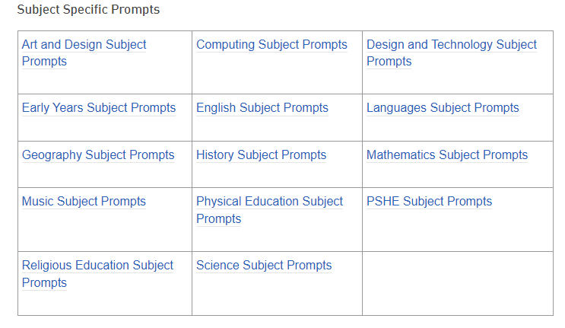
4. Giving effective feedback: Subject Specific Prompts
Giving effective feedback

Slide 20
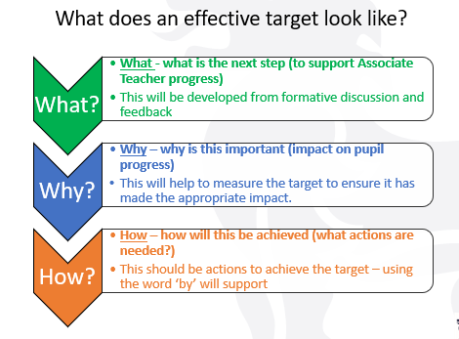
Notes:
What does an effective target look like? You will notice that to support you when thinking about each What Why How aspect, these have been developed to remind you when you are completing the Lesson Observation Feedback form.

Slide 21
Target Setting:
At least one subject specific target should be set following an observation. This should include what is the next step (to support Associate Teacher progress) why is this important (impact on pupil progress) and how will this be achieved (what actions are needed?)
(Make those links to Subject Specific Prompts)
Notes:
To support our Associate Teachers following their observation, one of these targets needs to be subject based. As this slide outlines, what the next step would be to support progress, why this is important and how will this be achieved.

Slide 22
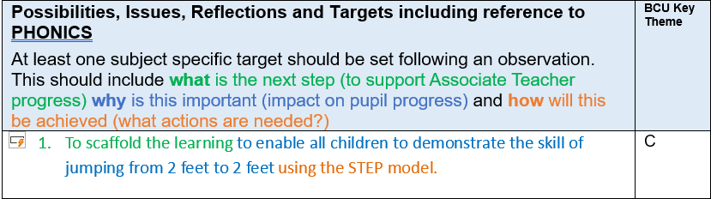
Using the new Lesson Observation Feedback Prompt sheet : PE Example of Target
Lesson Observation Feedback Form
Notes:
Here is an example in PE. This target is subject specific – links to the next step, scaffold learning, why this is important – to enable all children to demonstrate the skill jumping from 2 feet to 2 feet and how this will be achieved, using the STEP model (Space, Time, Task, Equipment. People). Remember to add in the Key Theme which this target represents.

Slide 23
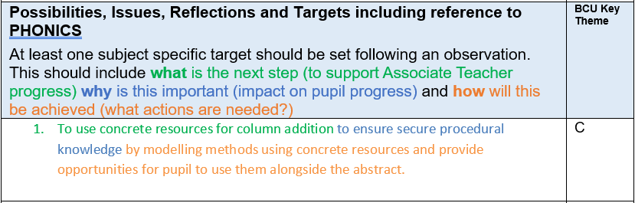
Using the new Lesson Observation Feedback Prompt sheet : Maths example
Lesson Observation Feedback Form
Notes:
Another example in mathematics. Remember you can also add in additional targets but these are specific.

Slide 24
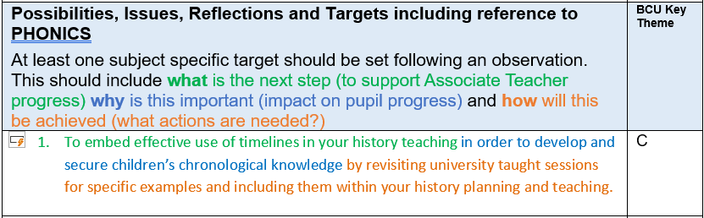
Using the new Lesson Observation Feedback Prompt sheet : History example
Lesson Observation Feedback Form

Slide 25
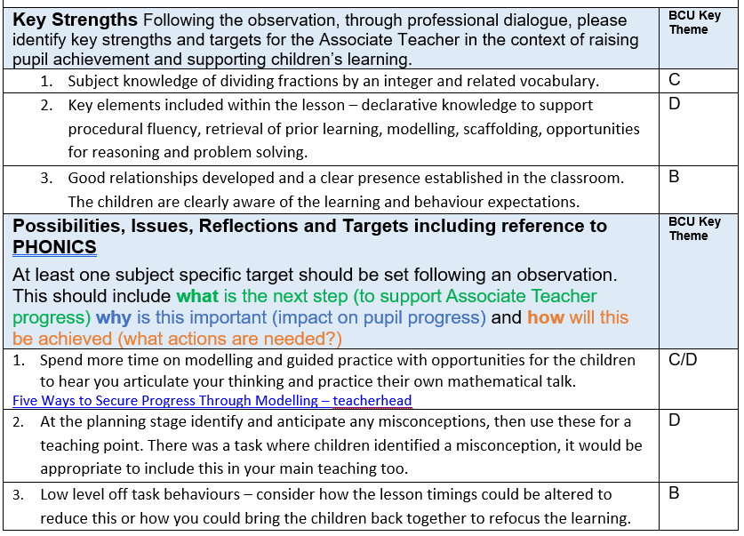
Maths focus: example
Targets
Subject Specific Feedback Prompts
Notes:
To demonstrate what these might look like, please look at the example shared. If you think the Associate Teacher would benefit from further reading or a short video, add in the links. Also the Subject Specific Prompts are designed to give you examples of how targets can be generated.

Slide 26
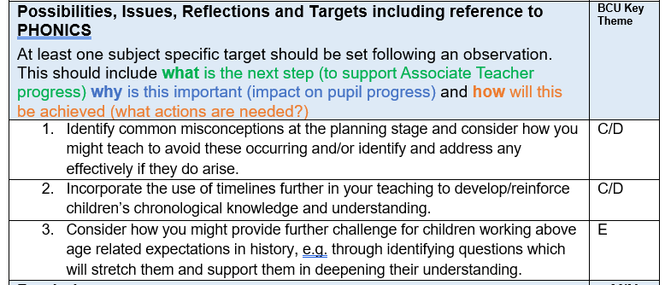
History focus: example
Targets
Subject Specific Feedback Prompts

Slide 27
5. Critical incident reflection
Developing Associate Teachers as reflective thinkers
Critical incidents that lead to significant learning and personal growth
The impact of completing a critical incident reflection
Working with Associate Teachers to support this reflection at Review Meeting and Progress Meeting 1 or 3
Part of the Associate Teacher Progress Journal

Slide 28
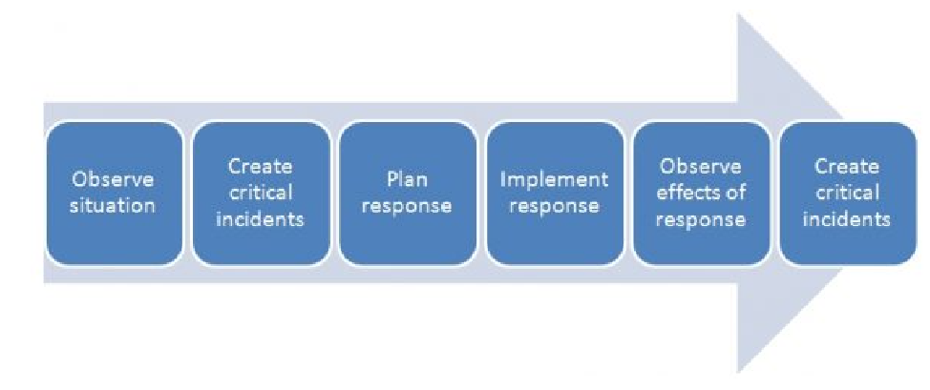
The Critical Incident Tripp (1993)
Reference:
Tripp, D. (1993). Critical Incidents in Teaching: Developing Professional Judgement. London: Routledge.
https://www.nicole-brown.co.uk/critical-incidents-according-to-tripp/?tag=reflective
Often, teachers who are new to the profession struggle to identify situations that should be used for deeper reflections.
Tripp’s (1993) approach to learning is via what he considers “critical incidents” that come out of observations of what happens in classrooms.

Slide 29
5. Critical incident reflection
Ensure that ATs are using the BCU Assessment tracker to identify key areas of progression
How can ATs show that they are progressing toward the BCU Curriculum Key Themes
The Critical Incident is their opportunity to show and prove they are progressing and developing
Your involvement and discussion as mentor is vital being the expert

Slide 30
5. Critical incident reflection: Focus
CI RM1 – Behaviour (BA Year 1, SBT1)
CI PM1 – Linked to Phonics/Subject Specialism/An area of student reflection/learning (BA Year 1, SBT1)
CI RM2 – Adaptive teaching linked to a subject (PGCE and BA Year 2, SBT2)
CI PM2 - Linked to Phonics/Subject Specialism/An area of student reflection/learning (PGCE and BA Year 2, SBT2)
CI RM3 – Assessment linked to a subject
CI PM3 - Linked to Phonics/Subject Specialism/An area of student reflection/learning
Notes:
Here are the Critical Incident Foci – as a general rule the PGCEs completing SBT1 will focus on Behaviour and subject of development. For BA Year 3’s they will link to subject and a further area of development.

Slide 31
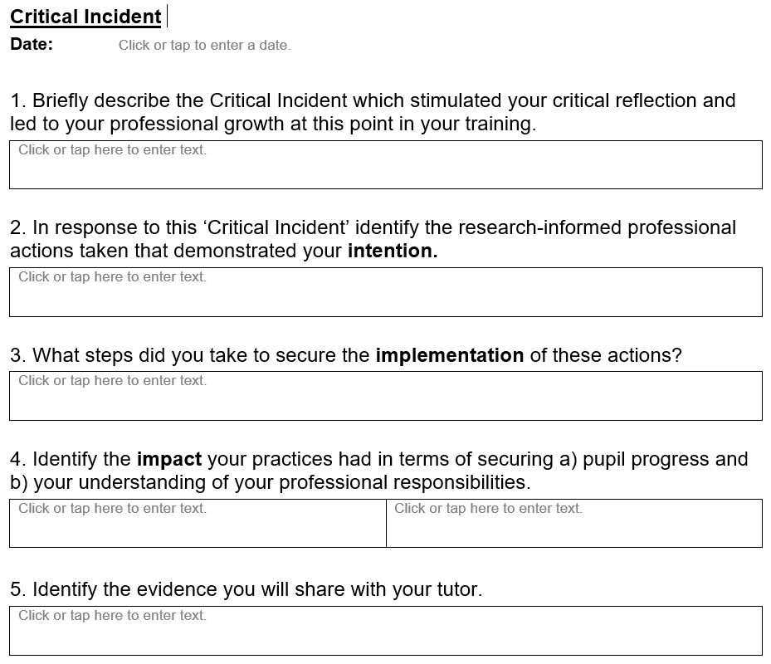
The template is in the Progress Journal and must be completed before the Review Meeting and Progress Meeting.
Ideally, there should be an on-going discussion with the Associate Teacher to support them to complete this reflection piece and provide some examples to prove progress is being made.

Slide 32
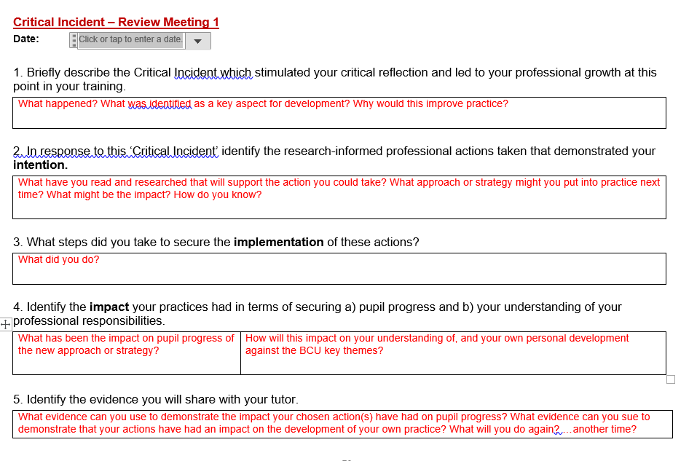

Slide 33
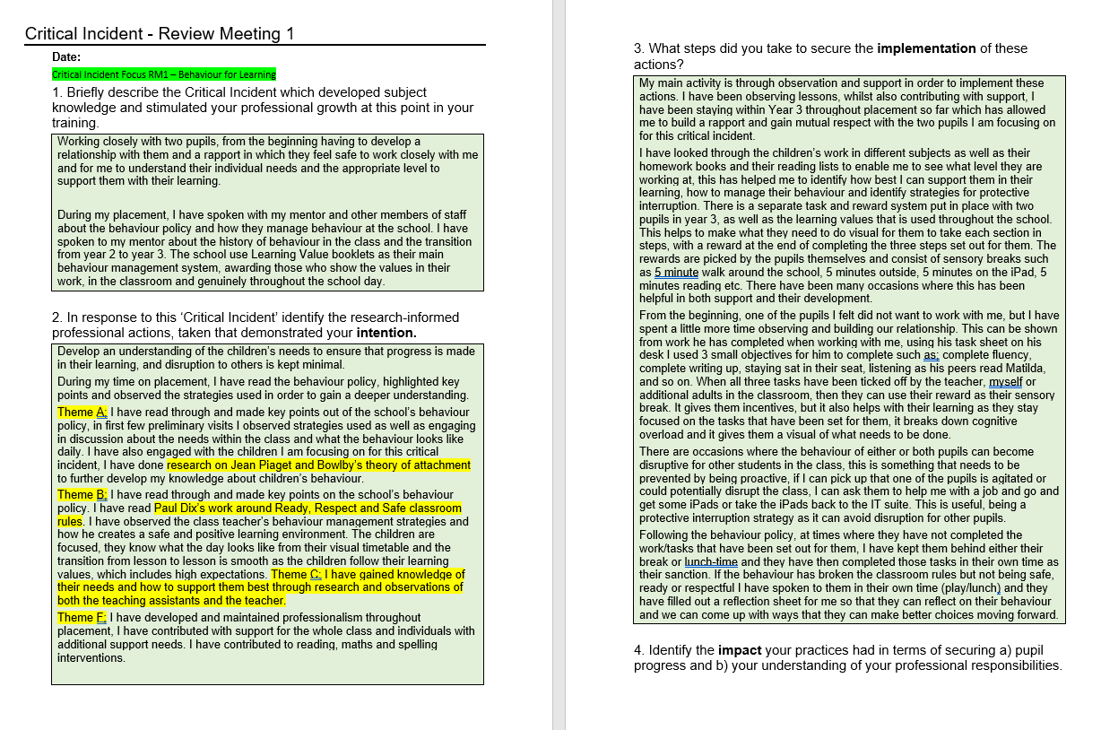
5. Critical incident reflection: Behaviour

Slide 34
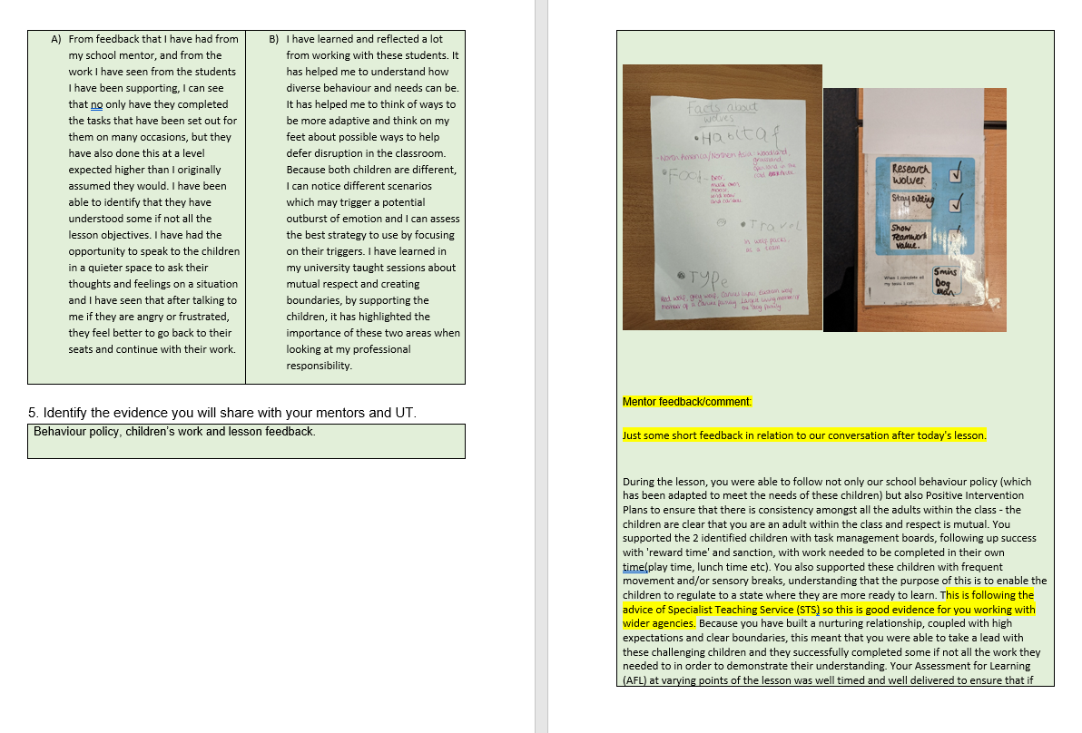

Slide 35
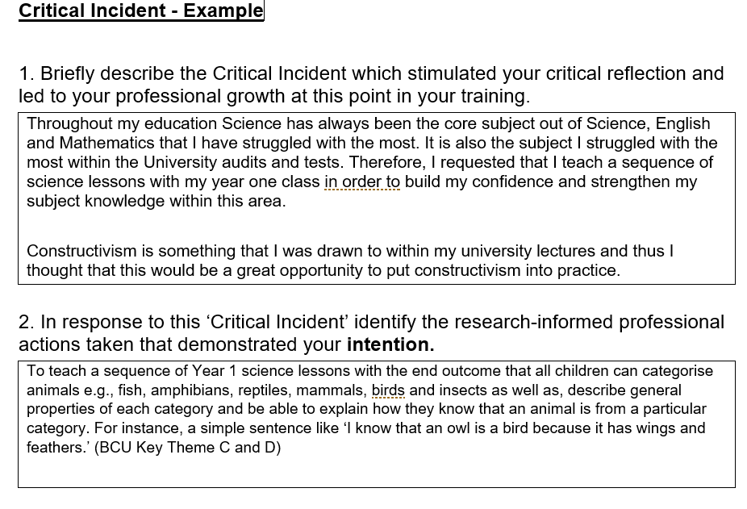
Subject: Science

Slide 36
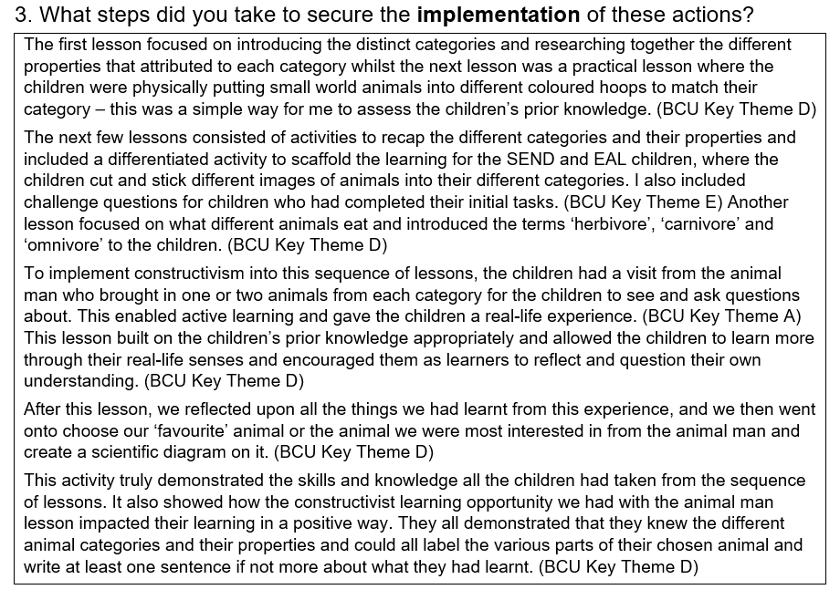

Slide 37
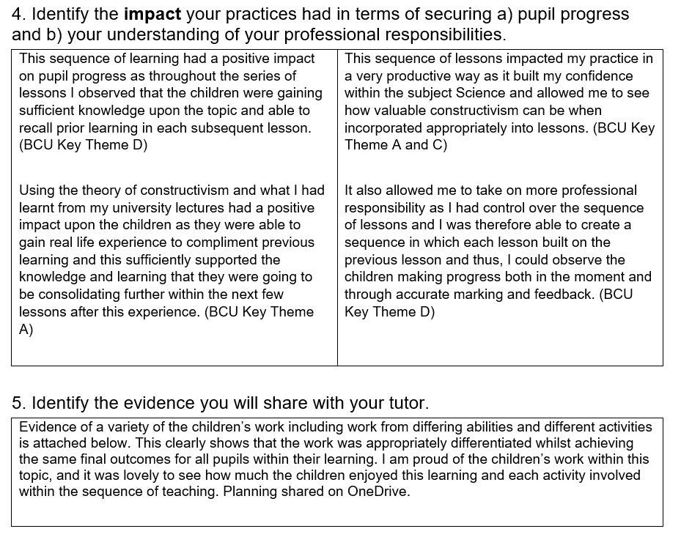

Slide 38
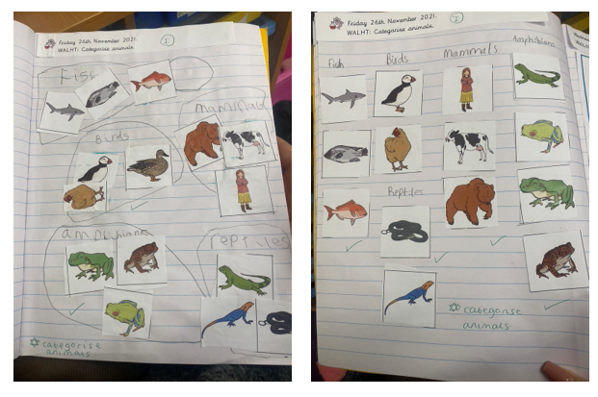

Slide 39
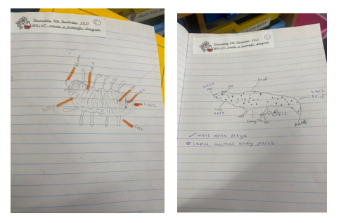

Slide 40

6. Feedback/Actions/Next Time
Using the BCU ITE Curriculum to set appropriate SMART targets to support Associate Teacher development and progress
Critical incident update and quality of evidence
Assessing Associate Teachers accurately against the BCU ITE Assessment Tracker
Working with your Universtiy Tutor
We value your feedback. Please add comments in the chat bar.
Notes:
We welcome your feedback. Please add comments in the chat bar. Thank you again for joining us.

Slide 41

Save the date….
BCU Mentoring Conference
26 June 2024
Venue: City South Campus
(B15 3TN)
Networking and CPD

Slide 42
Useful contacts
PGCE Course Team:
mailto:primaryandearlyyearspgcecourseteam@bcu.ac.uk
BA Year 1 Course Team:
primaryandearlyyearsbayear1team@bcu.ac.uk
BA Year 2 Course Team:
primaryandearlyyearsbayear2team@bcu.ac.uk
Placement queries:
HELS.Placements@bcu.ac.uk
Primary Partnership Lead:
Anne Whitacre
anne.whitacre@bcu.ac.uk

