Slide 1
Supporting Mentors with weekly meetings and target setting
2023-24

Slide 2
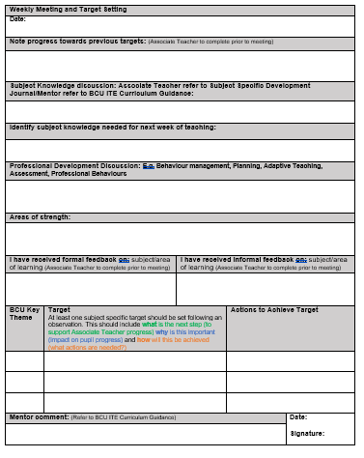
Weekly Meeting & Target Setting
These meetings provide an opportunity to identify what has been learnt and how the Associate Teachers has learnt it.
It is also an opportunity to discuss strengths and skills, knowledge and practice needed to develop.
Review targets set from the week before and set new targets
Please comment on progress towards the BCU curriculum

Slide 3
Weekly Meeting & Target Setting
Associate Teachers should be sharing their Subject Specific Development Journal at the Weekly Meetings. They should be talking to you about how their subject knowledge has developed with links to learning from university and how they have applied it in the classroom.

Slide 4
Weekly Meeting & Target Setting
Comments should be made relating to Professional Studies such as Behaviour Management, relationships with parents/carers, the wider roles and responsibilities of a teacher, planning and assessment.

Slide 5
Target Setting

Slide 6
Focus on Target Setting
Target Setting: At least one subject specific target should be set following an observation. This should include what is the next step (to support Associate Teacher progress) why is this important (impact on pupil progress) and how will this be achieved (what actions are needed?)
PE EXAMPLE:
To scaffold the learning to enable all children to demonstrate the skill of jumping from 2 feet to 2 feet using the STEP model.
MATHS EXAMPLE
To use concrete resources for column addition to ensure secure procedural knowledge by modelling methods using concrete resources and provide opportunities for pupil to use them alongside the abstract.
HISTORY EXAMPLE
To embed effective use of timelines in your history teaching in order to develop and secure children’s chronological knowledge by revisiting university taught sessions for specific examples and including them within your history planning and teaching.

Slide 7
Assessment Tracker – Theme C
This is a copy of Theme C. You will see that the colour coding as for our Phase 1, Phase 2 and Phase 3 of both our BAQTS and PGCE Curriculum coincides with our Primary Assessment Tracker. Theme C, focusing on subject knowledge looks different to last year as we have combined the evidence for this section with the Subject Specific Development Journal which PGCE Associate Teachers should be sharing with you.
Notes:
This is a copy of Theme C. You will see that the colour coding as for our Phase 1, Phase 2 and Phase 3 of both our BAQTS and PGCE Curriculum coincides with our Primary Assessment Tracker. Theme C, focusing on subject knowledge looks different to last year as we have combined the evidence for this section with the Subject Specific Development Journal which PGCE Associate Teachers should be sharing with you.

Slide 8
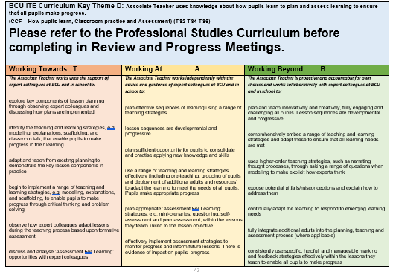
Assessment Tracker – A, B, D, E, F

